Slide 1

HOW MIGHT WE CONDUCT VITAL TRAINING?
Pre-training Slide
VALUING INCLUSIVE TEACHING AND LEARNING (VITAL) ORIENTATION & TRAINING
This slide deck is a guide to conduct a 3-day orientation for observers to use the VITAL Learning Environment Observation and Teacher Reflection Toolkit.
It includes observation in a school on day 2 which needs to be arranged beforehand.
Some materials also need to be prepared beforehand for activities.
You will need to give additional training to observers to ensure they allocate the same levels for observed behaviours in the classroom.
Notes:
HOW MIGHT WE CONDUCT VITAL TRAINING?
The first two slides are for your facilitating team to help with preparation. The slides for the workshop then follow.
Note that your team will need to prepare well for the training to ensure all the material for activities are ready and the arrangements for observation in school are finalised.
Note that this is an orientation training and that observers will need additional detailed training on allocating levels to an observation. It is important that observers arrive at a common understanding of concepts, can take good observation notes and understand how to allocate levels 1- 4 . Aim for at least 80% of the observers allocating the same level for a behaviour to get inter-relater reliability.
Key questions to ask in relation to training on the VITAL Toolkit
What is the training format that you will use to train the observers? I day, 3 days or more? Face-to-face training, remote on-line or a blended model?
Which videos can you use or create of actual teaching and learning in your contexts that demonstrate behaviours at different levels? Is there time to practise observing lessons in schools?
What other sources are there for assistance?
TEACH has an observation manual and a five -day training manual (wbgfiles.worldbank.org/documents/hdn/ed/saber/Teach/Manual/132204-WP-PUBLIC-Teach-Manual-English.pdf) which could help with preparation of training and clarifying certain behaviours.
AKF’s blended learning course materials on the classroom guide to Creating an Inclusive Learning Environment would also be helpful. These include training on the guide, using development dialogues and how to facilitate a course, as well as videos of classroom teaching and mentoring scenarios from Kenya, Pakistan and Portugal AKF - The Learning Hub (akflearninghub.org). These videos are used for this 3-day training.

Slide 2

OVERVIEW OF 3-DAY TRAINING
Pre-training Slide
DAY 1 0900-1630 | DAY 2 0800-1550 | DAY 3 0900-1530
WELCOME, INTRODUCTION & OUTCOMES | LESSON OBSERVATIONS IN SCHOOLS | WELCOME & REFLECTIONS ON DAY 2
 |  | WHAT IS REFLECTION? TEACHER SELF-REFLECTION FORM
MY TEACHERS- VISUALISATION |  | WHAT IS REFLECTION? TEACHER SELF-REFLECTION FORM
 |  | WHAT IS MENTORING?
EFFECTIVE LEARNING ENVIRONMENT |  | WHAT IS MENTORING?
TEA BREAK |  | TEA BREAK
21ST CENTURY VALUES. ATTITUDES & COMPETENCIES |  | REFLECTIVE DIALOGUE QUESTION BANK
 |  | MENTORING VIDEOS & POST-OBSERVATION FEEDBACK
VITAL TOOLKIT & VIDEO |  | MENTORING VIDEOS & POST-OBSERVATION FEEDBACK
LUNCH
WHAT IS OBSERVATION? FORM & RUBRIC; CONDUCTING OBSERVATIONS | WELCOME & REFLECTION ON DAY 1 | CONTEXTUALISATION
HAVE A GO! CLASSROOM VIDEOS | REFLECTION ON OBSERVED LESSONS | ETHICAL DILEMMAS
SAFEGUARDING | ALLOCATING LEVELS | VITAL STEPS
CLOSING ROUND | CLOSING ROUND | CLOSING ROUND
Notes:
OVERVIEW OF 3 DAY TRAINING
The table provides the overview of the three days which you may wish to share with the participants. The timings are indicative- timings for individual activities are given in the relevant slide.
Reminder: please arrange for the school observations in good time. 2-3 participants will need to observe a whole lesson together.

Slide 3


VALUING INCLUSIVE TEACHING AND LEARNING (VITAL)
LEARNING ENVIRONMENT OBSERVATION & TEACHER REFLECTION TOOLKIT
( Primary/ Secondary)
ORIENTATION & TRAINING
Prepared by Dr. Sughra Choudhry Khan
Global Assessment Partner
October 2025
Notes:
TITLE PAGE FOR PRESENTATION FOR THE WORKSHOP

Slide 4




WELCOME!
Day 1
Pass the Ball!
Your name
What’s the one thing you would love to see happening in the classroom?
Notes:
WELCOME 25m
Welcome the group to the training and first day. To get going have an initial warm up activity to engage everyone immediately, e.g.:
Pass the Ball: Have a ball that you and the participants throw – they give their name and one thing they would love to see happening in a classroom.

Slide 5

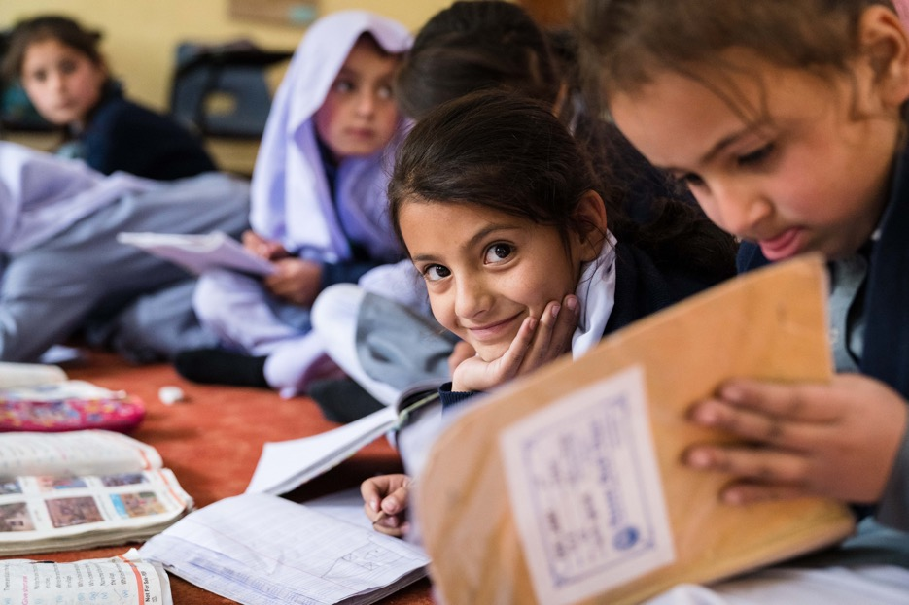
EXPECTED OUTCOMES OF THE TRAINING
Shared understanding of the purpose of the Toolkit.
Understanding of VITAL components, areas, dimensions, behaviours and four levels.
Experience of observing and assessing classroom teaching from videos and real classrooms.
Reflect on and critique key mentoring skills.
Ability to contextualise and implement the Toolkit.
Designing ‘learning environments which are both serious and focused on one hand, but which are also joyous and inspiring places, operating on the cutting edge of pedagogy and knowledge’.
HH Aga Khan IV 2008
Notes:
INTRODUCTION AND EXPECTED LEARNING OUTCOMES 10 Minutes
Introduce the theme of the training/workshop – to be oriented to the Schools2030 VITAL Toolkit and how to use it.
Share the expected outcomes of the training and read/ask someone to read the quote and asks a couple of participants what this means to them.

Slide 6
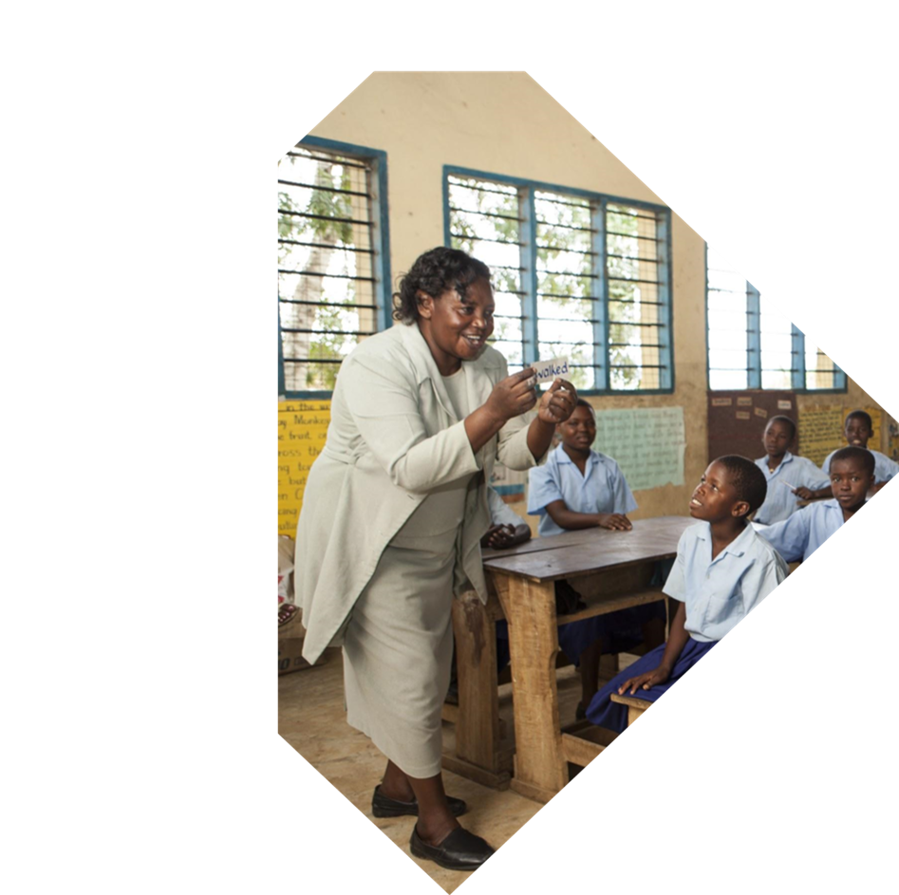

My Teachers
Creative Visualisation
Notes:
MY TEACHERS – Creative Visualisation 30 minutes
Guidance:
Creative visualisation can be a powerful way to better understand ourselves, our subconscious thoughts and responses to the world. It can help to build empathy towards oneself and reveal the values that underwrite our actions (AKF 2025 Activating Values Forthcoming).
The creative visualisation (15 mins minimum) requires skilful facilitation as it can lead to deep emotions coming to the fore as workshop participants recall experiences of schooling when they were young. It is important the facilitators create a safe space, are empathetic, gentle and supportive and listen fully to help participants explore both negative and positive emotions and the impact on learning.
It would be helpful to practise the script of the visualisation (see below) with a co-facilitator beforehand, remembering to use a gentle but clear voice and regular pauses to allow participants time to imagine and go into the space suggested by the guided facilitation. Relaxing music will assist the process.
After the creative visualisation there are around 15 minutes for a debrief essential before going into the brainstorming activity on an effective learning environment (next slide). The brainstorming (20 mins) after this activity can happen without this visualisation activity but may not be as effective without the personal connections that come from the visualisation.
1. Creative Visualisation: My experience of teachers in school (30m)
Visualisation (15mins): Narrate the following using a calm, slow, clear and steady tone, taking pauses so that participants have time to visualise while listening to you leading them through the visualisation. Play some gentle relaxing music e.g. Indian flute, Chinese bamboo, yoga relaxation.
We are now going to do a visualisation exercise, I’ll play some soft music to help us think deeply. I would like you to just listen to my words. Do not worry if your thoughts wander, just acknowledge them and come back to the instructions. So, let’s get ready. You can either be seated or lie down on the floor. If sitting, make some space around you. Let’s make sure that your backs are straight but relaxed against the chair and your feet on the floor, palms lying on your lap facing upwards. If there is room, you could lie with your back on the floor, your arms and legs spread out and your palms facing upwards to help you completely relax without falling asleep and gain the maximum benefit from the visualisation.
Close your eyes, or have them facing the ground if you are not comfortable closing them……… Take a few deep breaths from the abdomen and through your nose if you can……. Take a breath in ……… and a breath out…….. Breathe in…………. feel the breath move down to your belly as it raises …………breathe out as your belly contracts…………Breathe in and breathe out…………………Feel your breath slowing down……. Concentrate on your breath and relaxing each part of your body………breathe in…….. out……relax your feet….. relax your lower legs…… relax your upper legs………. your hips……….relax……………Relax your abdomen……………….your lower back……….your fingers…………...your hands………… Relax your lower arms………..your upper arms……………your chest………… your upper back…………..your shoulders……………Relax your neck…………your ears………….your jaw………Relax your face………..your forehead, the back of your head. Relax your whole body………..You are now completely relaxed. …….
Now take yourself back to your school days……. You get up in the morning to prepare for school…………… You are walking along to the path to school…………………. What are you feeling? How do you feel about school? ………………… You enter your school…………. As you enter the school think of the worst teacher in the school whose classroom you now walk into ……………………. What did he or she look like?................. What did he/she sound like?.............. …………What did he/she say and do to you or the other children?.................. What was it you did not like?.................... How did he/she make you feel? ……………………...What was the impact on your learning........................? (longer pause)
Now take a deep breath, knowing you can leave the worst teacher behind, and move into the classroom with your best teacher................... How did you feel coming to school knowing that you would see him/her? ………………..What was it about him/her that you really liked?......................... What did he/she look like?........................... What did he/she say and do to you or the other children ………………………………? How did he/she make you feel? ……………….. How did this teacher help you learn?.................... What was the impact on your learning? …………………..(longer pause).
As you walk out of the classroom say thank you and goodbye to your best teacher …….. Walk out of the school, onto the path and make your way slowly back …………………back into this room staying with the positive thoughts of your best teacher………................... Become aware of your breathing……….. Become aware of the sounds you are now hearing………. If you are on lying down, turn to your right and gently sit up keeping your eyes closed ………..When you are ready open your eyes and stay silent for a few moments.
2. Debrief: (15m) Have a whole group discussion using the following guiding questions, being very sensitive to responses and validating each participant:
How do you feel?
What made teachers your worst teachers? How did they make you feel and how did it affect your learning? How did they exclude you?
What made teachers your best teachers? How did they make you feel and how did it affect your learning? How did they include you?
Thank the group and move to the next activity drawing their attention to the board/charts.

Slide 7


WHAT MAKES AN EFFECTIVE LEARNING ENVIRONMENT?
Notes:
WHAT MAKES AN EFFECTIVE LEARNING ENVIRONMENT? 20 minutes
Brainstorm: What makes an effective learning environment, drawing from participants’ personal visualisations and professional experience and/ or others they have seen (10m).
2. Brainstorm: What does a teacher need to be able to create an effective learning environment? (10m)
Try to elicit that an effective learning environment depends on:
Teachers’ own socio-emotional skills, including relationship-building
Understanding values/competencies
Ability to be truly inclusive of all children and views- no child is left out.
Ability to use appropriate pedagogies
Mentoring support and professional development
3. Pick up what’s coming out strong, ask for clarifications etc.

Slide 8


To equip girls, boys and young adults
with
the knowledge, skills, attitudes and values
to
help them interact effectively with the world
contribute to
society.
and
AGA KHAN FOUNDATION │ Our Shared AKDN Education Goal
Our AKDN Education Goal
Notes:
21st Century Values, Attitudes and Competencies ( 30 minutes)
1. Introduce the AKDN Goal for Education, stressing emphasis on attitudes and values and latest research on the importance of socio-emotional skills, the belief in teachers being at the heart of change and the importance of positive teacher-student relationships. (5m)

Slide 9



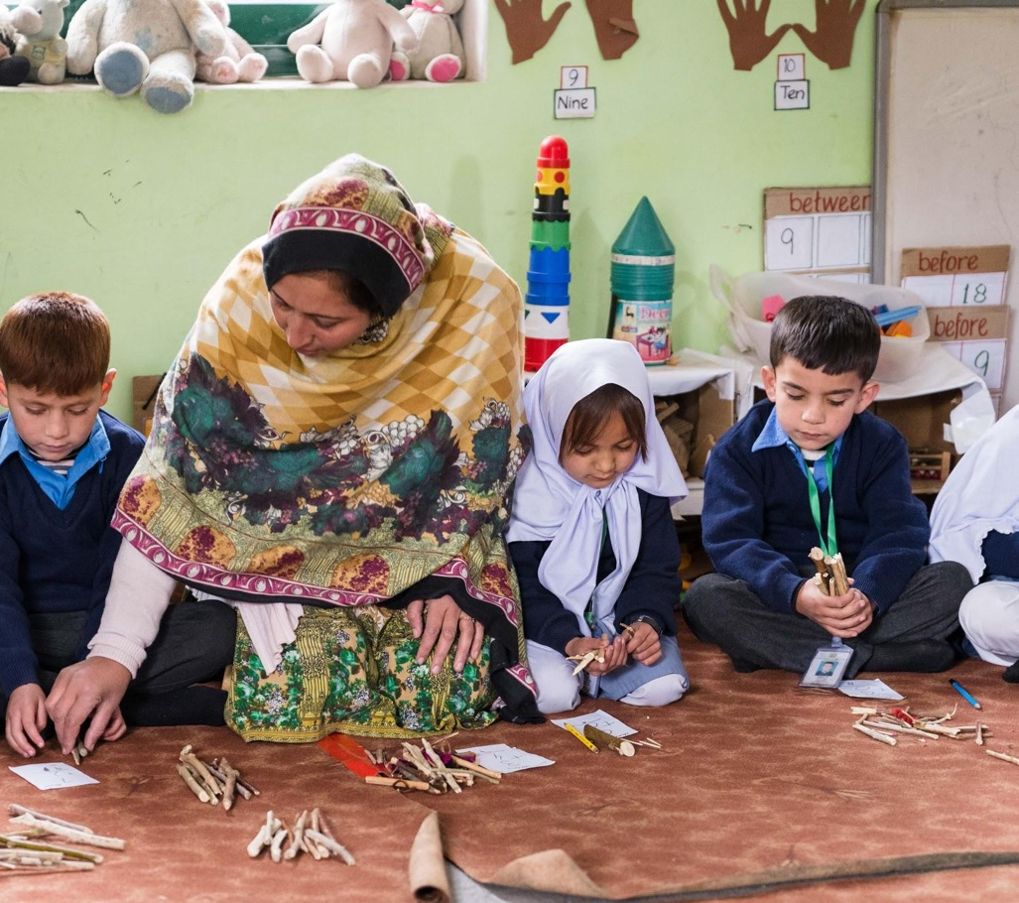
Which Values/Skills do you think are most important?
Which values are depicted in the
National Curriculum?
Notes:
Contd.
2. Brainstorm: What values and competencies do you think are important to include in teaching and learning? (10m)
3. Values in the National Curriculum: (15m) Please prepare for this session using your country’s National Curriculum.
What values are included in our National Curriculum, do you know? : (5m)
Prepare and present a slide of key values found in the National Curriculum (10m)

Slide 10
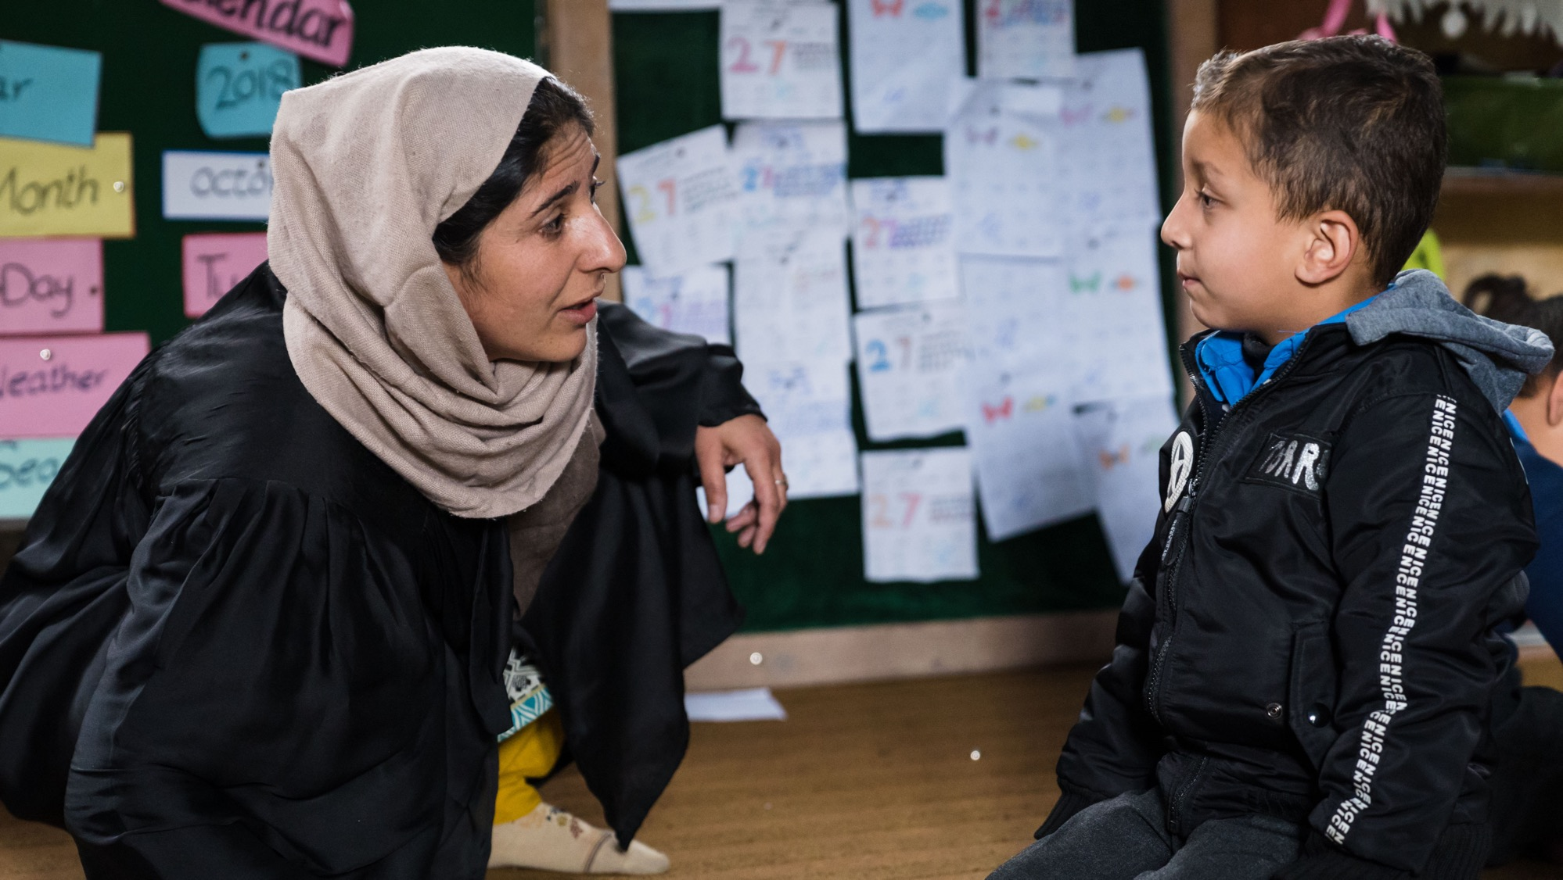

WHY
IS AN INCLUSIVE/ EFFECTIVE LEARNING ENVIRONMENT
IMPORTANT?
Teachers Matter : Key Influencing Factor, especially for the disadvantaged.
Playful pedagogies
Teachers DESIGN learning experiences
Social & Emotional Skills
Pluralism & Ethical disposition:
Equity
Inclusion
Diversity
Process: Teacher-Student Relationship
Growth Mindset
Student Perceptions of learning environment relates to motivation.
21st Century Skills
Notes:
WHY IS AN INCLUSIVE/EFFECTIVE LEARNING ENVIRONMENT IMPORTANT? 10 mins
Point out the importance of an inclusive learning environment.
Teachers make the most difference to student learning, especially for the most disadvantaged.
Teachers are designers – they design the learning experience consciously and unconsciously – refer back to the visualisation experiences.
The teacher-student relationship is paramount – children need to feel valued and that they belong. Their perceptions of the learning environment affects their motivation- remember how a good teacher made you feel?
Social & Emotional Skills: self-awareness, self-management, responsible decision-making, social awareness and relationship skills (CASEL);
Open-mindedness, task performance, engaging with others, collaboration and emotional regulation (OECD).
Growth Mindset: belief that one’s intelligence, qualities and skills can be cultivated through effort, good strategies and help from others, other than a static ‘fixed mindset’ in which one feels one cannot improve and is not good at learning (Dweck) .
21st Century Skills: Learning & Innovation Skills: Critical thinking and Problem Solving, Communication & Collaboration & Creativity & Innovation. Life and Career Skills; Information, Media & Technology Skills; Core subjects (3Rs and 21st Century themes). - these are all skills that need to integrated.
Playful pedagogies: these are joyful, socially iterative, meaningful, iterative and actively engaging. These help students engage in and remember learning.
Pluralist and ethical disposition: These are the personal qualities and competencies that AKF feel are essential to develop a pluralist and ethical disposition. They provide the skills needed to increase equity, be inclusive and embrace diversity. They are all included in the Schools2030 learning domains:
Self-awareness and Resilience
Empathy & Open-mindedness
Relationship building
Critical thinking & Problem-solving
Collaboration
Taking responsibility
Reconciling tensions
Creativity & Imagination
Respect for diversity

Slide 11
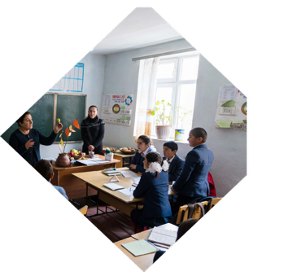






PURPOSE OF VITAL
to enable teachers to use evidence from an assessment of their classroom
learning environment to improve their teaching and learning practices
Covers the most important evidence-based practices of effective teaching and learning.
Each country adapts
to their contexts.
Assesses how well learners are supported and the quality of teaching and learning practices.
Adapts and enriches the World Bank TEACH Tool & AKF’s Inclusive Learning Environment Guide.
Serves as a basis for professional development: teacher reflection and mentoring.
Includes student behaviours, creativity, pluralism, self-assessment and integrates social and emotional skills, with detailed examples.
Notes:
INTRO TO THE VITAL TOOLKIT 10 minutes
1. Explain the Purpose and essential characteristics.

Slide 12










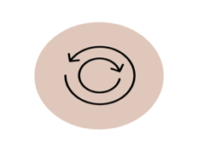
WHAT IS THE SCHOOLS2030 VITAL TOOLKIT?
Primary/Secondary Learning Environment Observation Tool
Teacher Reflection Tool
2. Learning Environment Observation Form
3.Observation Rubric
1.
Introduction
5. Observer Reflective Dialogue Question Bank
4. Teacher Self-Reflection Form
6. How Might We Use VITAL?
7. How Might We Observe Lessons?
6. How Might We Conduct VITAL Training?
Informs human-centered design process to create
and iterate classroom solutions
ASSESS​
DESIGN
TRACK
ITERATE
Notes:
Contd.
2. Explain the Components of the VITAL Learning Environment Observation & Teacher Reflection Toolkit:
Introduction
Four key tools:
Learning Environment Observation Form
Observation Rubric
Teacher Self-Reflection Form
Observer Reflective Dialogue Question Bank
Four guides:
Introduction
How Might We Use VITAL?
How Might We Observe Lessons?
How Might We Conduct VITAL training (slide deck)
3. Explain how VITAL has been incorporated into the HCD process as data is reviewed at the Launch stage. Teachers choose 2-3 target behaviours/practices linked to the innovative solution to improve while implementing their micro-solution.

Slide 13

What does a successful education for today provide?
Notes:
WHAT DOES A SUCCESSFUL EDUCATION FOR TODAY PROVIDE? 10 minutes
1. Ask the question and take a few responses from participants.

Slide 14

‘Success in education today builds not just cognitive but character fortitude. It is about curiosity – opening minds; it is about compassion – opening hearts; and it is about courage – mobilising our cognitive, social and emotional resources to take action. These qualities, or social and emotional skills as our report calls them, are also weapons against the greatest threats of our time: ignorance – the closed mind; hate – the closed heart; and fear – the enemy of agency’
(OECD 2021:5).
Notes:
Contd.
2. Ask participants to read this silently and ask for any comments/reflections. Take a couple and ask people to reflect on this.

Slide 15



VITAL OBSERVATION: AREAS & DIMENSIONS
SUPPORTIVE LEARNING ENVIRONMENT
QUALITY TEACHING & LEARNING PRACTICES
What dimensions would you include?
Notes:
VITAL CLASSROOM OBSERVATION : TOOLKIT: Areas and Dimensions 30mins
Ask participants what dimensions they would include within the two Areas of Supportive Learning Environment and Quality Teaching & Learning Practices.

Slide 16



VITAL SUPPORTIVE LEARNING ENVIRONMENT & QUALITY TEACHING AND LEARNING PRACTICES:
EIGHT DIMENSIONS
A Supportive Learning Environment is warm and positive; learners feel they belong; are safe and validated. As a result, they take learning risks and rise to high expectations.
EMOTIONAL CLIMATE
Learners are engaged; learn to think critically and be creative; work individually and in pairs and groups; resolve tensions and respect diversity.
FACILITATING LEARNING
LEARNING TO LEARN
CRITICAL THINKING & CREATIVITY
CHECKS FOR UNDERSTANDING
Quality Teaching and Learning Practices enable teachers to become facilitators, build on what learners know and use a variety of appropriate strategies and materials, adapting these to meet individual needs.
The teacher models and guides learning, assesses, acknowledges, deepens and extends understanding and helps learners to acquire a ‘growth mindset’.
SOCIAL & COLLABORATIVE LEARNING
FEEDBACK
HIGH EXPECTATIONS
Teachers design the learning environment! Teacher and learner relationships make a difference!
Notes:
Contd. The VITAL Dimensions and overall Summary
2. Go through the Dimensions and overall summaries.
Note that research repeatedly highlights the centrality of the teacher for learning improvement. The quality of the relationship between the teacher and learner impacts on how learners feel and how ready they are to learn.
Quality teaching and learning practices build on the relationship with learners though building social and emotional skills and structuring learning to meet individual needs. Paramount is the teacher belief that each child can learn through effort, persistence and support.

Slide 17

DIMENSION SUMMARY: A1.
A. Supportive Learning Environment | 1. Emotional Climate: The teacher creates a supportive, warm, positive and inclusive learning environment in which all students feel emotionally safe and are encouraged to take learning risks. Moreover, all students feel they belong and are welcome as the teacher treats all students respectfully regardless of background and abilities; attends to their needs and enables them to feel heard, understood, trusted and validated. Teacher and student interactions are positive, and students demonstrate sensitivity, empathy and respect towards each other.
Notes:
Contd.
3. Go through the Summary Descriptions of Dimensions. (You may wish to exclude this section and go straight to the behaviours under each dimension from slide 22)

Slide 18
DIMENSION SUMMARY: A2.
A. Supportive Learning Environment | 2. High Expectations: The teacher communicates the highest expectations for learning and behaviour for all students. S/he enables them to make ethical and socially responsible choices and provides opportunities for students to take on meaningful roles in classroom activities. S/he promotes positive behaviour by acknowledging student behaviour that meets or exceeds expectations. Moreover, the teacher sets clear behavioural expectations for different parts of the lesson and focuses on the expected behaviour when re-directing misbehaviour.
Notes:
Contd.

Slide 19

DIMENSION SUMMARY: B3 &4
B. Quality Teaching and Learning Practices | 3. Facilitating Learning: The teacher facilitates learning to improve student understanding and holistic learning outcomes. The teacher explicitly articulates the expected learning outcome and explains concepts clearly. S/he connects lesson content to classroom activities, and relates it to students’ prior learning, other content and/or students’ lives. The teacher uses a variety of appropriate strategies and materials, provides students with choices, and differentiates/adjusts learning activities to meet the varied levels of the students while still challenging them. Lessons are well structured and paced. All students are engaged in learning activities.
 | 4. Critical Thinking & Creativity: The teacher builds students’ critical thinking and creativity skills to help them reflect on and use information in various ways, including actively applying and analysing information. The teacher asks open-ended questions, provides thinking tasks, learning through play and activities that encourage initiative, imagination, curiosity and creativity. Students happily engage in high level questioning and are not afraid to make mistakes.
Notes:
Contd.

Slide 20
DIMENSION SUMMARY: B5 & 6
B. Quality Teaching and Learning Practices | 5. Social & Collaborative Learning: The teacher fosters a collaborative and inclusive learning environment that incorporates a respect for diversity. The teacher promotes interpersonal skills and peer interaction through effective use of individual, pair and group work. Collaborative activities encourage all students to participate and work with peers from different genders, abilities, backgrounds and with diverse views. The teacher helps students find ways to resolve conflicts and reach agreements to create an environment free from hostility.
 | 6. Learning to Learn: The teacher models learning to learn and guides students in thinking through how to approach tasks and how they learn. The teacher responds positively to students’ challenges, framing failure and frustrations as part of the learning process. S/he provides opportunities for students to self-assess, assess their peers and set short- and long-term learning goals. Students seek clarification whenever they are struggling and learn to become leaders of their own learning.
Notes:
Contd.

Slide 21
DIMENSION SUMMARY: B7-8
B. Quality Teaching and Learning Practices | 7. Checks for Understanding: The teacher checks for understanding and builds upon this to ensure that students comprehend the lesson content and to extend learning. The teacher walks around the class to assess understanding, monitor progress and assist. The teacher promotes students’ efforts towards acquiring new concepts, skills and attitudes instead of focusing only on results, intelligence and natural abilities, helping students acquire a ‘growth mind-set’.
 | 8. Feedback: The teacher provides genuine, meaningful and timely feedback that is framed positively and constructively to deepen student understanding. The teacher provides specific comments or prompts that help identify student misunderstandings, understand successes and guide thought processes to promote learning. Students have opportunities to give constructive feedback to one another and to the teacher.
Notes:
Contd.

Slide 22
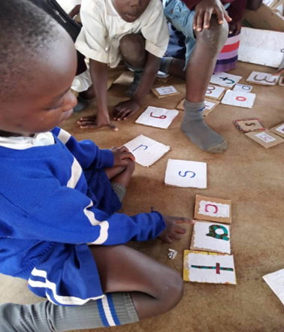
DIMENSIONS & BEHAVIOURS 1-11.
AREA | DIMENSION | BEHAVIOURS
SUPPORTIVE LEARNING ENVIRONMENT | EMOTIONAL CLIMATE | 1.1. The teacher treats all students respectfully.
 |  | 1.2. Teacher and student interactions are positive.
 |  | 1.3. The teacher responds to students’ emotional, physical and material needs.
 |  | 1.4. The teacher does not exhibit bias (relating to gender, disability, colour, ethnicity, linguistic or socio-economic background etc.).
 |  | 1.5. The teacher challenges stereotypes (relating to gender, disability, colour, ethnicity, linguistic or socio-economic background etc.).
 |  | 1.6. Students demonstrate sensitivity, empathy and respect towards each other and are willing to help peers.
 | 2. HIGH EXPECTATIONS | 2.1. The teacher communicates the highest behavioural expectations for learning activities.
 |  | 2.2. The teacher acknowledges positive student behaviour.
 |  | 2.3. The teacher redirects misbehaviour by focusing on the expected behaviour.
 |  | 2.4. The teacher helps students make ethical and socially acceptable choices.
 |  | 2.5. The teacher provides opportunities for students to take on meaningful roles in the classroom.
Notes:
Contd.
4. Go through the Behaviour Statements for each Dimension.

Slide 23
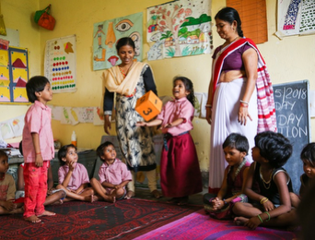
DIMENSIONS & BEHAVIOURS 12-23
B. QUALITY TEACHING AND LEARNING PRACTICES | 3. FACILITATING LEARNING | 3.1. The teacher explicitly articulates the expected learning outcomes of the lesson and relates learning activities to these outcomes.
 |  | 3.2. The teacher explains concepts and content clearly.
 |  | 3.3. The teacher relates content to previous learning, other content and /or students’ daily lives.
 |  | 3.3. The teacher uses a variety of appropriate learning strategies, tasks and materials (e.g., auditory, visual, movement, play, role-play, multisensory, discussion, presentation, digital technologies etc., and uses low -cost materials and those from the contexts/environment).
 |  | 3.4. The teacher provides students with choices.
 |  | 3.6. The teacher adjusts and provides activities relevant to the levels of the students.
 |  | 3.7. The teacher provides a beginning, middle and end to the lesson with good sequencing and pacing.
 |  | 3.8. Students are engaged in learning activities.
 | 4. CRITICAL THINKING & CREATIVITY | 4.1. The teacher asks open-ended questions (that require reasoning, explanation, generalization or have more than one correct answer).
 |  | 4.2. Students are happy to ask questions, including open-ended questions.
 |  | 4.3.The teacher provides thinking tasks (that require students to actively analyse content as opposed to rote learning or building fluency).
 |  | 4.4. The teacher provides activities that encourage student initiative, curiosity, imagination, creativity and learning through play, (e.g., use of art, craft and design, mime, movement, drama, music, poetry and playful pedagogies such as experiential learning, games, inquiry, problem-solving, project-based learning; use of outdoor activities).
Notes:
Contd.

Slide 24

DIMENSIONS & BEHAVIOURS 24-37
B. QUALITY TEACHING & LEARNING PRACTICES | 5. SOCIAL & COLLABORATIVE LEARNING | 5.1. The teacher uses collaborative pair and group work effectively.
 |  | 5.2. The teacher helps students find ways to resolve conflict and reach agreements.
 |  | 5.3 The teacher integrates a respect for diversity into lesson content and delivery (e.g., respect for diverse perspectives, opinions, peoples, ethnicities, genders, abilities/’disabilities’, neurodiversity, geographies, cultures, contexts, beliefs, languages etc.).
 | 6. LEARNING TO LEARN | 6.1. The teacher models learning to learn and/or offers guided instruction to help students think through how they will approach a task.
 |  | 6.2. The teacher responds positively to student challenges.
 |  | 6.3. Students seek clarification and support.
 |  | 6.4. The teacher provides opportunities for self-assessment and /or peer assessment.
 |  | 6.5. The teacher provides opportunities for students to set their own goals.
 | 7. CHECKS FOR UNDERSTANDING | 7.1. The teacher uses questions, prompts, or other strategies to determine students’ level of understanding.
 |  | 7.2. The teacher monitors students during independent and group work.
 |  | 7.3. The teacher acknowledges and focuses on students’ efforts and attitudes (rather than focusing on results, perceived intelligence or ‘natural’ abilities’).
 | 8. FEEDBACK | 8.1. The teacher provides specific comments that help identify students’ successes.
 |  | 8.2. The teacher provides specific comments or prompts to clarify students’ misunderstandings.
 |  | 8.3. The teacher provides opportunities for students to give constructive feedback to one another.
Notes:
Contd.

Slide 25
Matching
Behaviours to Dimensions
Game
Notes:
MATCHING BEHAVIOURS TO DIMENSIONS 30 minutes
Make sure you have prepared the Game. Prepare cards/paper slips with the name of each dimension and the behaviour statements. You could make for example 6 groups and give each group 2-3 Dimension Titles and behaviour statements mixed up in envelopes, as follows:
Groups 1 & 4: Emotional Climate, Feedback and Social & Collaborative Learning dimensions and related behaviours mixed up.
Groups 2 & 5: Facilitating Learning and Learning to Learn and related behaviours.
Groups 3 & 6: Critical Thinking & Creativity, Checks for Understanding and High Expectations and related behaviours.

Slide 26
What do you observe the teacher Murad and the learners doing? (insert video)
https://vimeo.com/user70288799/download/413068810/2853904769
Notes:
WHAT DOES TEACHING & LEARNING LOOK LIKE IN MURAD’S CLASS? 10 minutes
1. Show the participants that you are showing a short video of Murad teaching in Kenya. Ask them: What do you observe?.
Watch AKF Video: Murad 24.4. 4m
Murad https://vimeo.com/user70288799/download/413068810/2853904769
2. Take some responses for about 5 mins. Here are some notes to help:
Murad in Kenya: Dimensions: Emotional Climate, High Expectations, Facilitating Learning, Critical thinking and Creativity, Learning to Learn Video length: 4.27 mins.
Respect- beginnings; learners engaged, redirects misbehaviour; relating to lives, objective, content clear, materials; open-ended questions and picking learners to respond, variety of materials, movement and sounds; responding to challenges- asking learner to try.
Question: Room arrangements? Learners engaging with each other? Could have told a story around animals?
(Break for Lunch)

Slide 27

What is Observation?
How does it feel to be observed?
Notes:
WHAT IS OBSERVATION? 10 minutes
Welcome everyone back after lunch.
Ask participants to brainstorm on the word ‘observation’ – what is it?
Extend this to asking ‘How does it feel to be observed?’
Pick up on a few points and ask participants to expand on statements that are not clear or interesting.

Slide 28

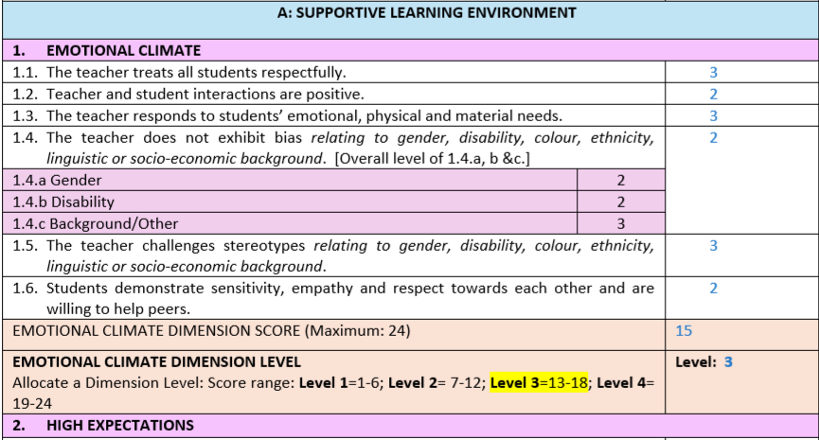
CLASSROOM OBSERVATION FORM: EXTRACT
General Information
Summary notes: what went well/could have been better
Mentoring/Coaching Points
4. Focus of Next Classroom Observation
5. Notes on Teacher Reflection
6.Space for Observation Notes- use during observation
7. Observation Level Allocation Form
8. Additional optional form- impt.info:
Picture, School, languages, special educational needs, resources, physical environment.
Notes:
OBSERVATION TOOLSET: OBSERVATION FORM & RUBRIC 15 minutes
Show the slide of the Classroom Observation Form extract. You may wish to give copies of the full observation form for participants to review.
2. Explain what it is and the sections.
3. Explain that only ONE behaviour can be given a ‘not applicable’ on the form (6.5) . All others must have a level – if the behaviour is not seen, check if it is a Level 1.

Slide 29
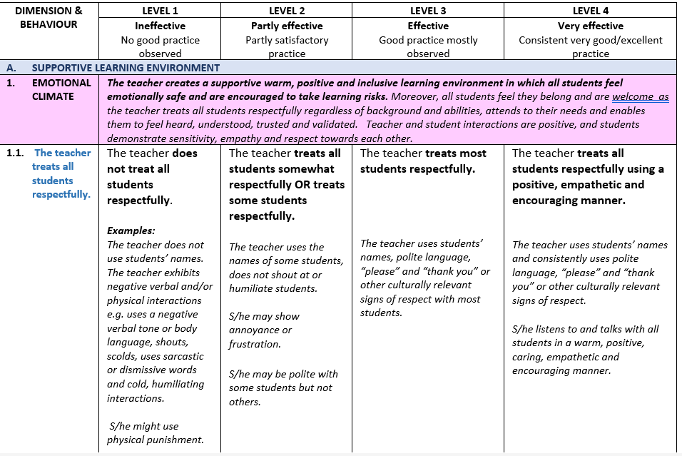
VITAL LEARNING ENVIRONMENT OBSERVATION RUBRIC
FOUR LEVELS OF BEHAVIOURS: EXAMPLE 1
Notes:
Contd.
Show the example from the Observation Rubric for Emotional Climate: Behaviour 1.1. The teacher treats all students respectfully.
Explain the 4 levels from ineffective to very effective, and that level 4 is exemplary teaching and learning and would serve as a model for others.
Explain the four specific behaviour statements for each of the levels and how this builds up to level 4.
Explain that the examples are only indicative.
Countries would need to contextualise the Rubric for their own contexts while retaining all the Dimensions.

Slide 30
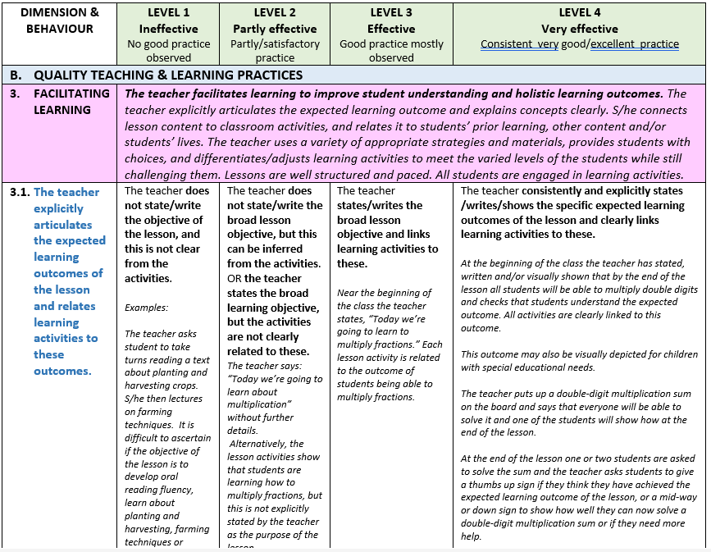
VITAL LEARNING ENVIRONMENT RUBRIC
FOUR LEVELS OF BEHAVIOURS: EXAMPLE 2
Notes:
Contd.
Show and explain Example 2 of the Rubric.

Slide 31
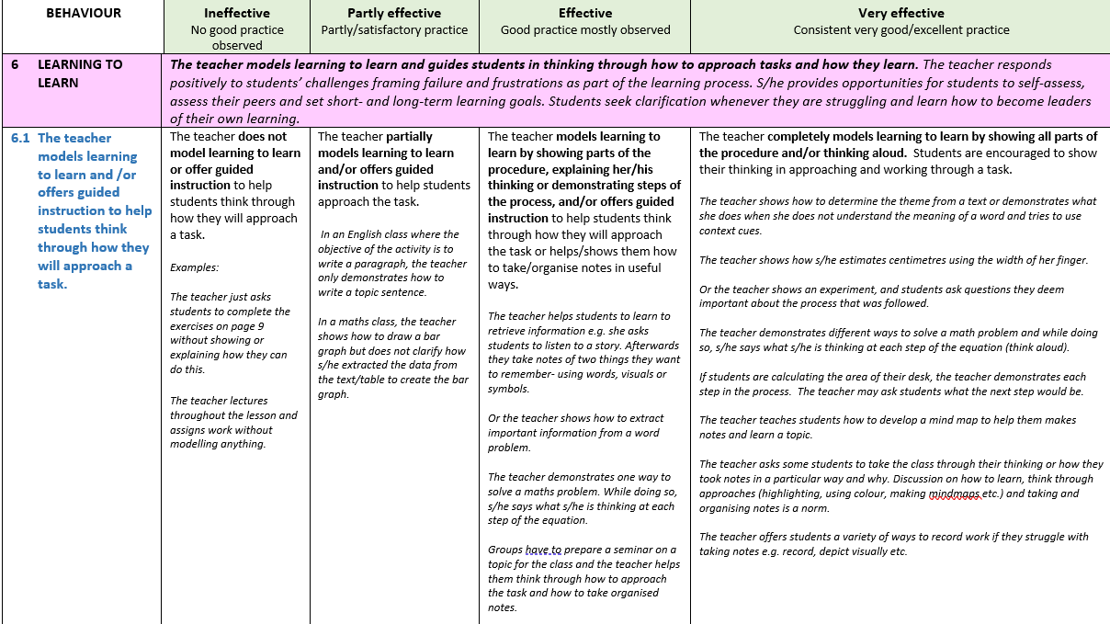
VITAL LEARNING ENVIRONMENT RUBRIC
FOUR LEVELS OF BEHAVIOURS: EXAMPLE 3
Notes:
Contd.
Show and explain Example 3 of the Rubric.
You may wish to share the Rubric with the participants to review.

Slide 32

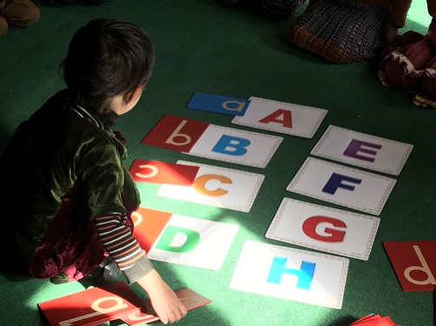
CLASSROOM OBSERVATION
Classroom observation is the formal or informal observation of the teaching and learning activities and interactions occurring during instruction in a classroom or other learning environment (AITSL 2014).
‘Skilfully handled classroom observation can benefit both the observer, and the person observed, serving to inform and enhance the professional skill of both people. Badly handled, however, it becomes counterproductive, at its worst arousing hostility, resistance and suspicion.’
Wragg, E.C. 2012 cited in AITSL (2014)
Notes:
CLASSROOM OBSERVATION 25 minutes
Read or ask someone to read the quotes on observation. Refer to the earlier brainstorm on what observation is and how it feels to be observed.
Stress the need for lesson observation to be a learning experience for both observer and learner.

Slide 33
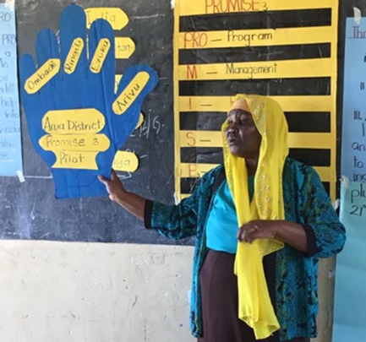
HOW TO CONDUCT CLASSROOM OBSERVATIONS
WHO?
Schools2030 team, learning/assessment partners, mentors, head teacher, peer teachers.
WHY?
Help the teacher to create a supportive learning environment and improve teaching and learning practices.
Observe, describe actions and behaviours so they can be analysed and discussed.
Increase teacher self-awareness and reflection- critically analyse and improve.
WHEN?
Before the HCD training, once/twice during the year, at the end of the year.
HOW?
Refer to as ‘visit’ not inspection; encourage peer observations, offer help, e.g. model, co-teach.
In the first and last visit – observe all dimensions.
Twice in the year: Observe the 2-3 behaviours selected aligned with micro-innovation during HCD process.
Notes:
Contd.
Explain the who, why, when, and how of conducting classroom observations.

Slide 34
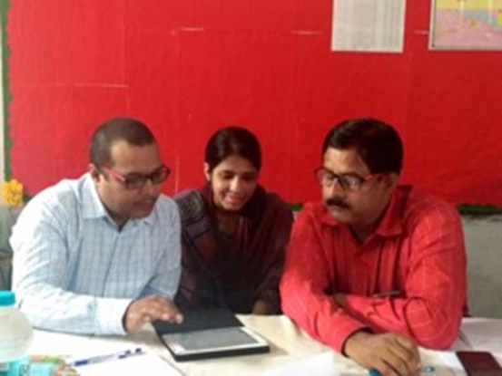
BEFORE THE OBSERVATION
Gain permission, dates and times. Observe the whole lesson at different times of day.
Ensure the head teacher, teacher and observer understand the purpose.
Teacher- develop effective trust and communication. Not an evaluation but professional opportunity to learn.
Agree with the teacher how you will be introduced to the class. Stress that s/he is to teach as normal. Say you will be taking notes.
Discuss safeguarding and what to do should you observe any harm.
Ensure you have all the equipment: observation form, pens, watch, phone on silent.
Ensure you are familiar with the Observation Form & Rubric.
Rubric will be needed AFTER the observation.
Ask the teacher to fill in the Teacher Self-reflection form before, having gone through it if you are using it.
Decide on where the mentoring session will take place.
Notes:
Contd.
Go through the points on what needs to happen before the observation.
The whole lesson can be 35- 60 minutes.

Slide 35
DURING and AFTER THE OBSERVATION
Arrive early – 10 mins before the start. Get a feel of the school ethos.
Ask the teacher to introduce you to the class or agree that you do this.
Sit at/near the back where you can see the whole class and not be in the way.
Observe and listen carefully with respect. Do not answer phone or distract others. Do not use negative expressions.
Observe from when the lesson was due to start- note if it is late.
Only talk to students if you have gained the teacher’s permission.
Do not criticize the teacher.
Make running notes with examples of what teachers and students say and do.
Leave with encouraging comments and thanks.
AFTER THE OBSERVATION:
  Assign the allocation for levels 1-4 that best fits. This can be done immediately after the observation takes place.
Notes:
Contd.
5. Go through the points of what to do during the observation.
Emphasise that the observer takes running notes of what s/he actually sees happening in the classroom, using the space in the observation form and adding more paper if needed. This provides the evidence for the latter allocation of levels.
Emphasise that the observer must no take over teaching or criticize the teacher.
Emphasise that the observer allocates levels to the behaviours as soon as possible AFTER the observation using the Rubric to assist.
The allocations would then be transferred to the database being used.

Slide 36
Taking Observer Notes
Taking Observer Notes (WB TEACH 2019)
TECHNIQUE | WHAT IS OBSERVED | WHAT IS WRITTEN
SCRIPTING: quotes by teachers (T) or students (S) | After a lesson on forming past tense sentences, the teacher asks students to relate the current lesson to a previous one on action verbs by forming a sentence using both strategies. She asks, “Who can take an action verb from yesterday and create a past tense sentence?” A student raises her hand and responds, “Amna jumped over the puddle.” | T: Who can take an action verb from yesterday and create a past tense sentence? S: Amna jumped over the puddle.
TALLIES: shortcuts for frequently used words or phrases | Throughout the lesson, the teacher says “very good” 8 times in response to student participation and answers. | “Very good” √√√√√√√√
SHORTHAND: specific symbols or letters to represent behaviors | The teacher reviews a student’s paragraph and provides feedback by saying, “Great job on the first paragraph. The way you open with a personal story is very compelling.” | FB- T: opening paragraph is compelling b/c of personal story
ANECDOTES: summaries of what was seen or heard | At the start of an activity, the teacher asks if everyone has a textbook. Six students raise their hands to indicate they do not. The teacher continues teaching at the board. Meanwhile, 3 students are playing with a ball of paper and distracting others. | 6 Ss no book, T cont. teaching at board, 3 Ss playing (disruptive).
What do they say?
Do?
Interact?
Be Exact
Notes:
Contd.
6. Explain different ways to take observation notes. Show and explain the example from the World Bank.

Slide 37
IMPORTANT TO REMEMBER!
Read and understand the Observation Rubric well.
Assign the level that BEST FITS.
Put aside any other information that you may have.
Do not compare with others or what you may know of the teacher/class.
All is interconnected – score behaviours independently, e.g. feedback encourages critical thinking.
Takes notes to rely on as evidence.
Afterwards:
  Do not worry about high or low levels-assign the best fit.
  Assign a level according to the behaviour description not examples.
6.5. Goals- not in every lesson, can be N/A.
All other behaviours need to be assigned a level.
Allocate a level to each behaviour individually.
Notes:
Contd.
7. Go through the important points to remember.

Slide 38


HAVE A GO AT WRITING OBSERVATION NOTES!
AKF Inclusive Guide Videos:
Pakistan: 16.2 Nargis
Notes:
HAVE A GO! WHAT DID YOU SEE, HEAR & OBSERVE? 15 minutes
Tell the participants that you will show a video of Nargis teaching in Pakistan and that you would like them to have a go at writing running observation notes.
Let them know that the video is very short but the interactions fast moving and they will need to use shorthand!
Here are some notes to help:

Slide 39
Pakistan Nargis16.2
https://vimeo.com/user70288799/download/413067793/8ce69d34ad
Notes:
Contd.
4. Download the video and place in the presentation.
https://vimeo.com/user70288799/download/413067793/8ce69d34ad
5. Ask the participants to take observation notes.

Slide 40
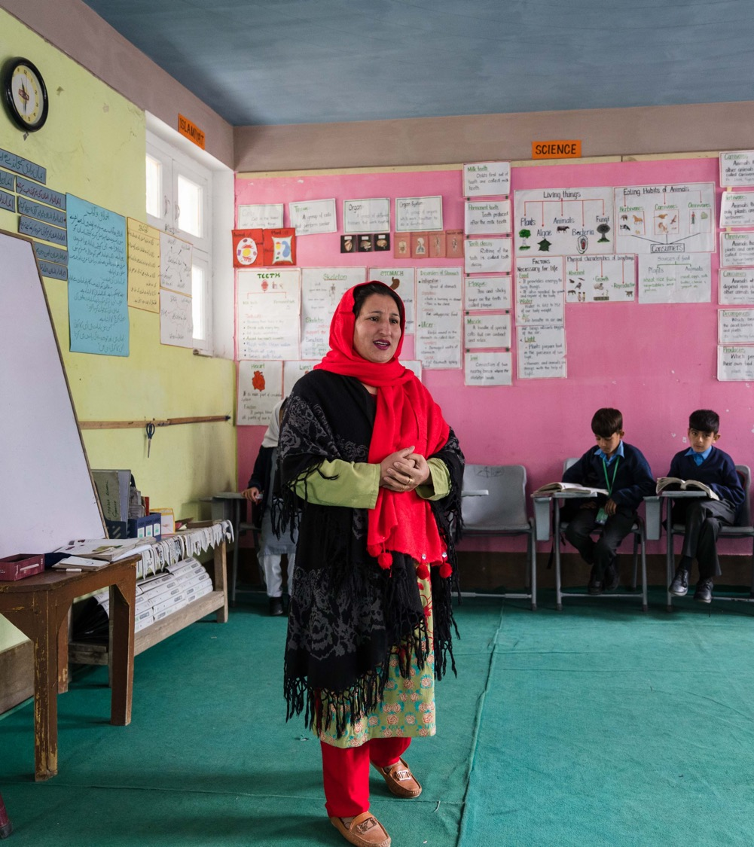
WHAT DID YOU SEE, HEAR, OBSERVE?
What kind of notes did you take? Share visually
What dimensions did you see?
What behaviours did you see?
For Emotional Climate what level would you allocate? ‘The teacher treats all students respectfully’ ? Why?
For ‘The teacher challenges stereotypes?’
Notes:
Contd.
6. Have a group discussion of around 10 minutes
Ask them to share/show and discuss the kind of notes they took.
Ask what VITAL dimensions they saw e.g. Emotional Climate
Ask what behaviours they observed.
Ask what level they would allocate for Behaviour 1.1. The teacher treats all students respectfully’
Akl what level they would allocate for Behaviour 1.5. The teacher challenges stereotypes.
7. Some notes to help:
Video: Nargis in Pakistan: Emotional Climate, Facilitating Learning, Critical thinking and Creativity Video length: 1.40 mins.
Respecting all, happy, engaged; positive teacher - learner interactions; relating to students’ lives; materials; open-ended questions.
Question: Respect- names? Challenging Stereotypes- reinforces gender stereotype- could have challenged (Level 1).

Slide 41

WHICH BEHAVIOURS & LEVELS DO YOU SEE? HAVE A GO!
AKF Inclusive Guide Videos
Portugal: 28.5 Marta
Kenya: 36.7 Fatuma
Portugal: 32.6 Marta
4. Pakistan: 40.8 Sher Zaman
Portugal: 48.10 Marta
Pakistan: 12.1 Shakeela
Notes:
WHICH BEHAVIOURS & LEVELS DO YOU SEE? HAVE A GO! (AKF INCLUSIVE GUIDE VIDEOS) 1 hour.
1. Ask the participants to watch the videos and identify the dimensions and behaviours (and if possible the levels) they can see. Play each one and then discuss. The videos are from Portugal, Kenya and Pakistan.
.

Slide 42
Portugal: Marta 28.5
https://vimeo.com/user70288799/download/413074673/0b1cb2e2f4
Notes:
Contd.
2. Insert the video for Martha 28.5 . Play the video asking the participants to observe and identify dimensions, behaviours and possibly levels.
3. Some notes to help:
Marta in Portugal : Emotional Climate, High Expectations, Facilitating Learning, Critical thinking & Creativity, Social and Collaborative Learning, Learning to Learn, Feedback Video length: 2.12 mins.
https://vimeo.com/user70288799/download/413074673/0b1cb2e2f4
Respect and meeting individual needs; individualized work plans; meaningful roles, classroom set up and orderly class. Classroom agreements
High expectations- learner agency, choice, monitoring, ethical & social responsibility; presenting peer assessment /feedback/opinion

Slide 43
Kenya: Fatima 36.7
https://vimeo.com/user70288799/download/413077814/c36c6fd5de
Notes:
Contd.
4.. Insert the video for Fatima 36.7 https://vimeo.com/user70288799/download/413077814/c36c6fd5de
Play the video asking the participants to observe and identify dimensions, behaviours and possibly levels.
5. Some notes to help:
Fatuma in Kenya: High Expectation, Facilitating Learning, Critical Thinking, Social & Collaborative Learning, Checks for Understanding Video length: 2. 02 mins.
Lesson objectives; praise; open-ended questions; group work; learners engaged; monitoring by walking around the groups. “What is this?” – just removes this.
Question: “Stop fighting”, later ‘it’s not good’– redirecting misbehaviour?

Slide 44
Portugal Marta 32.6
https://vimeo.com/user70288799/download/413075575/cb60e23427
Notes:
Contd.
6. Insert the video for Marta 32.6 Play the video asking the participants to observe and identify dimensions, behaviours and possibly levels.
https://vimeo.com/user70288799/download/413075575/cb60e23427
7. Some notes to help:
Marta in Portugal: Emotional Climate, High Expectations, Facilitating Learning, Critical thinking & Creativity, Social and Collaborative Learning; 32.6 Video length: 1.41 mins.
Respect, attending to individual needs- individual sheets, good behaviour, adjusts activities, praise, open-ended questions and thinking tasks, creative tasks, individual, pair and group work, respect for diversity
Inclusive and different materials.

Slide 45
Pakistan Sher Zaman 40.8
https://vimeo.com/user70288799/download/413079345/2f3c4a5841
Notes:
Contd.
8. Insert the video for Sher Zaman 40.8. Play the video asking the participants to observe and identify dimensions, behaviours and possibly levels.
https://vimeo.com/user70288799/download/413079345/2f3c4a5841
9. Some notes to help:
Sher Zaman in Pakistan: High Expectations, Learning to Learn, Checks for Understanding and Feedback. Video Length: 3.16 mins
Expectations of all learners; ask for self-assessment; uses questions and prompts checking for understanding and specific comments to clarify misunderstandings.

Slide 46
Portugal Marta 48.10
https://vimeo.com/user70288799/download/413080222/6540c3e4f8
Notes:
Contd.
10. Insert the video for Marta 48.10. https://vimeo.com/user70288799/download/413080222/6540c3e4f8Play the video asking the participants to observe and identify dimensions, behaviours and possibly levels.
11. Some notes to help:
Marta in Portugal: Emotional Climate, High Expectations, Social and Collaborative Learning, Learning to Learn, Respect for Diversity. Video length: 4.47min
Respect; leadership- meaningful role; expressing different opinions and Chinese numbers; positive response to challenge; guided instruction and self-assessment.

Slide 47
12.1 Shakeela Pakistan: Learning Objectives
https://vimeo.com/user70288799/download/413446771/fa3e137be2
Notes:
Contd.
12. Insert the video for Shakeela 12.1. https://vimeo.com/user70288799/download/413446771/fa3e137be2
Play the video asking the participants to observe and identify dimensions, behaviours and possibly levels.
13. Some notes to help:
Shakeela in Pakistan: Facilitating Learning Video length: 3. 15 mins.
Objectives, concepts, respect, language use, activity, materials, learners engaged, spotless classroom.
Question: Summarise? Check for understanding? Adjusts for levels of learners?

Slide 48


SAFEGUARDING
Before the observation: agree actions to take if you witness any harm or risk.
Be guided by the national legislation, government and school policies as well as AKF.
Essential: understand whether, when and how you are permitted to intervene.
Mandatory: Safeguarding training for all observers with specific guidance for school environments.
Notes:
Safeguarding and Child Protection 5 mins
1. Discuss Safeguarding requirements as observers could observe harmful actions in the classroom. Please bring in and refer to any current policies that your organisation or country uses.
2. The VITAL guidance is as follows:
Before conducting observations, discuss and agree with school management on the appropriate actions to take if you witness anything that may pose a risk to children or adults in the classroom or wider learning environment. This includes health and safety concerns—such as trip hazards, unsafe furniture, or exposed wiring—as well as incidents of abuse, including corporal punishment, harassment, or the use of degrading or humiliating language.
These actions must be guided by relevant national legislation, as well as government, school safeguarding policies and child protection policies. If the programme is supported by the Aga Khan Foundation (AKF), observers must also follow the AKF Global Safeguarding Manual and Code of Conduct and related guidance. All AKF programme partners are expected to comply with AKF’s Safeguarding Policies or to operate within their own safeguarding frameworks of an equivalent standard.
It is essential that you understand whether, when, and how you are permitted to intervene when harm is occurring. You must also be familiar with the appropriate reporting procedures, which typically involve school leadership and programme teams. Importantly, if you witness or suspect any form of misconduct, abuse, or safeguarding concern, you must report it immediately to the designated safeguarding focal point or via AKF’s independent reporting platform, Safecall.
Safeguarding training for all observers must be mandatory and should specifically include guidance on protecting children in school environments and responding appropriately to concerns.

Slide 49
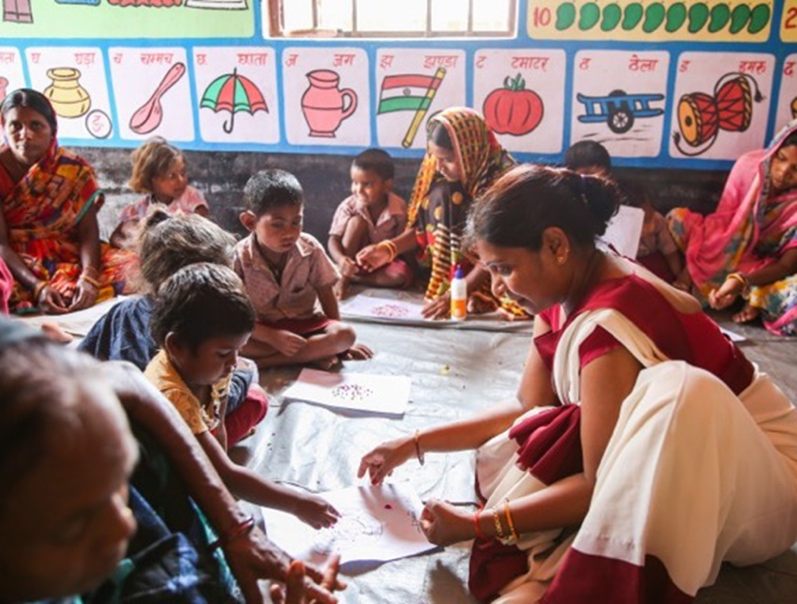

DAY 1
CLOSING ROUND
Choose 2 dimensions to observe in the classroom tomorrow morning
Bring your observation notes to the afternoon session.
Please remember to read the Observation Form and Rubric for your chosen dimensions carefully before your Observation!
One Takeaway from Day 1!
Notes:
Day 1 Closing Round 30 minutes
Ask the participants to choose 2 Dimensions to observe in school tomorrow. Remind them to read the Observation Form and the Rubric for those dimensions so they are familiar with the behaviour descriptions and examples. Also remind them to bring their observation notes to tomorrow’s afternoon session.
Ask the participants to stand in a circle and briefly state one takeaway from this session- something that surprised, interested, will remember etc.
Thank participants, check they all know the arrangements for getting to school and the code for behaviour while there and close Day 1 of the training.

Slide 50





















Day 2 AM: Classroom Observation in Schools
WELCOME to Day 2!
How do you feel today?
OUTCOMES
Share notes and reflections on real classroom observation.
Discuss and allocated levels to the behaviours within the two dimensions observed.
Notes:
DAY 2 WELCOME & OUTCOMES 25 minutes
The participants will have returned from school and have lunch around 12-1pm.
Welcome participants to the 2nd day. Ask them to form a circle and think about how they feel right now for a minute. Ask them to express this in the form of a vehicle– on air, under/on sea, ground etc. through mime. Ask who would like to start and include yourself. You may need to start first if participants are hesitant. Others do not need to guess the vehicle but to just accept, appreciate and try to empathise with the feeling that may be expressed.
Share the expected outcomes for Day 2 afternoon which involves a deep reflection on the lessons observed in the morning and the allocation of levels.

Slide 51
REFLECTIONS FROM DAY 1
An Effective Inclusive Learning Environment
Introduction to VITAL Toolkit, Areas, Dimensions & Behaviours
Observation Form & Rubric
Conducting Observation
Video observations
Safeguarding
Notes:
REFLECTIONS FROM DAY 1 15 minutes
1. Ask participants what they looked at yesterday and to share their reflections about the first day. The slide gives the key areas explored.

Slide 52
HOW DID YOUR OBSERVATION IN SCHOOL
GO?
REFLECTING ON the Observation
SHARE OBSERVATION NOTES
Dimensions & Behaviours
Reflections
Notes:
REFLECTIONS FROM CLASSROOM OBSERVATION 40 mins
Congratulate the group on conducting observations in schools in the morning!
2. Let participants know that in this session they will have an opportunity to reflect on the morning’s lesson observations, share how they wrote notes, look more closely at the behaviours to allocate levels and share further reflections.

Slide 53



REFLECTING ON LESSON OBSERVATIONS
Reflecting on the Observation- 1-2 words
Share observation notes in 6 groups
Reflections
Notes:
Contd.
Ask them going around to explain the experience in one-two words 10 m
Ask a couple of follow up questions– 5m
Ask them to hold up their notes visually 5m
Break the group into 6 groups: ask them to share how they each wrote their observation notes 20m

Slide 54


ALLOCATING LEVELS
Level 1-4 Statements
Evidence: your notes!
Notes:
ALLOCATING LEVELS FROM CLASSROOM OBSERVATION 1 hour
Use the slide to remind participants on allocating levels, using behaviour statements and notes as evidence 5m
Remind them that all behaviours need to be allocated a level. The only exception is 6.4. on setting goals as this will not happen in every lesson and can therefore be deemed not applicable (N.A) . If other behaviours are not seen, check if they are actually a level 1; if not allocate a level that seems appropriate giving the teacher the benefit of the doubt.
Make sure participants have access to the Observation Form and Rubric.

Slide 55


ALLOCATING LEVELS TO OBSERVATIONS:
6 groups
What Level from 1-4 would you allocate to the dimension behaviours you observed?
Use the behaviour statement in the Rubrics to help you.
Use your observation notes as evidence.
Justify your allocation.
Whole group discussion
Notes:
Contd.
In the same 6 groups – allocate a level to the dimension and behaviours that you observed in schools USING the Rubric. 25m
Ask them : Justify your allocation with each other- if you observed the same class reach an agreement with your partner/s.
Whole Group: share what they have allocated and why in whole group 6x5 – 30m

Slide 56
Day 2
CLOSING ROUND
A challenge and an opportunity!
Please read the Teacher Self-Reflection Form and the Observation Dialogue Question Bank for tomorrow’s session!
Notes:
CLOSING ROUND 30 mins
Ask participants to form a circle and to share one challenge & one opportunity with the group.
Remind them to read the Teacher Self-Reflection Form and the Observer Dialogue Question Bank for Day 3 sessions.
Thank the group.

Slide 57
























WELCOME!
Day 3
How do you feel TODAY?
OUTCOMES
Purpose and use of Teacher Reflection Tool: Self-reflection Form and Observer Dialogue Question Bank.
Reflect on mentoring skills and giving feedback.
Reflect on Ethical Dilemmas
Key points for contextualisation
Notes:
WELCOME & OUTCOMES 25 Minutes
Welcome the participants to Day 3 , the final day of the orientation and training on VITAL.
Ask the participants to form a circle, think for a minute on how they are feeling this morning. Ask them to now depict how they feel as an animal with their body. Again, there is no need to guess the animal but to accept the feeling and depiction. Ask who would like to start first.
2. Share the expected outcomes for Day 3.

Slide 58
REFLECTIONS FROM DAY 1
REFLECTIONS FROM DAY 2 OM DAY 1
Classroom observation in schools.
Reflections from school observation.
Sharing observation notes.
Allocating levels.
Notes:
REFLECTIONS FROM DAY 2 15 minutes
1. Ask participants what they looked at yesterday and to share their reflections from Day 2. The slide gives the content explored during Day 2.

Slide 59



HOW MIGHT WE DEFINE REFLECTION?
WHY DO WE WANT TEACHERS TO REFLECT ??
Notes:
WHAT IS REFLECTION 20 mins
Brainstorm: What is reflection 10 mins
& why do we want teachers to reflect 5 min

Slide 60


Reflection is a diagnostic skill that helps you evaluate yourself and determine your learning needs, both in the light of your own past performance and, in comparison with recognised experts. Reflections helps you unpack your actions, to refine the component pieces, and then to put those pieces back together in a way that improves your performance.
Christensen et al. (2020)
Notes:
CONTD.
Share the quote that defines Reflection.
Ask the group if anyone has changed their personal or professional behaviour because of an individual reflection or reflecting with others.

Slide 61

TEACHER SELF-REFLECTION FORM Example 1
How to use this Teacher Self- Reflection Tool
2. Instructions
General Information
EMOTIONAL CLIMATE Students learn best within a supportive, warm, positive and inclusive learning environment in which they all feel safe and are encouraged to take learning risks. This section explores how far you make students feel welcome through treating them with respect, regardless of their background and abilities and attending to their needs. It explores how well you make them feel heard, understood, trusted and valued, and feel a sense of belonging. It looks at your interactions with the students as well as how they interact with each other.
How well do you think you did/do the following? | Not well | Partly well | Well | Very well
1.1. I treat all students respectfully. Use names, polite language, culturally relevant signs of respect and positive body language. Avoid harsh words and punishment.
1.2. My interactions with students are positive. Greet students, eye contact, talk with them to get to know them, create a welcoming classroom.
Notes:
THE VITAL TEACHER SELF REFLECTION FORM 15 mins
Refer to the Example 1 of part of the Teacher Self-Reflection Form, explaining
the initial sections and how the form is set out with general instructions and information to be filled in.
then each Dimension is summarised and behaviours statements given in the 1st person with a helpful note.
the teachers need to reflect on the lesson that was observed (or the lessons over the last week) and indicate if they think they did not do this well, or partly well, well or very well.

Slide 62
TEACHER SELF- REFLECTION TOOL 1: Example 2
CRITICAL THINKING & CREATIVITY Students learn best when teachers help to build their critical thinking and creativity skills so that they can reflect on and use information in different ways, including actively applying and analysing information. This section looks at how well you help students become creative and critical thinkers and include learning through play and activities that encourage students to use their initiative, imagination, curiosity and creativity. It also looks at whether students happily engage in asking questions, including open-ended questions.
How well do you think you did/do the following? |  | Not well | Partly well | Well | Very well
4.1. | I ask open-ended questions that require reasoning, explanation, generalisation or have more than one correct answer. Ask 3 or more open-ended questions; ask students to elaborate, justify and clarify. Build upon answers with further questions.
4.2. | My students are happy to ask questions, including open-ended questions. Help every student ask questions. Ask them to use question words: Why? How? Can? Should? Would? Could? Will? Invite all sorts of questions on a topic.
Notes:
Contd.
Go through Example 2 on Critical Thinking and Creativity.

Slide 63
TEACHER SELF-REFLECTION FORM : Reflecting on Dimensions &Behaviours
Reflections on Critical Thinking and Creativity
My strengths in developing students’ critical thinking and creativity. | The behaviours/practices I need to focus on to improve.
Notes:
Contd.
4. Explain that at the end of the Dimension, there is space for the teacher to reflect on the Dimension. On the left they indicate their strengths in the Dimension behaviours and on the right , they note the practices that they wish to focus on for improvement.

Slide 64
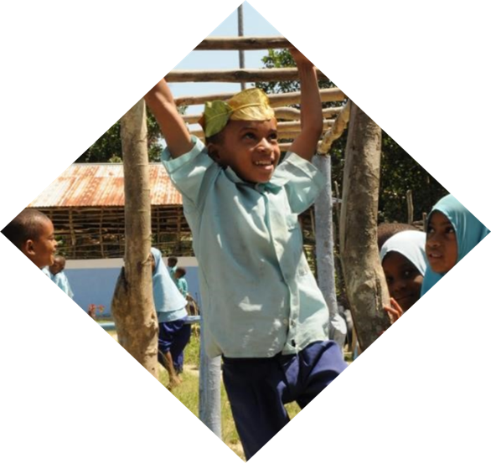
Improving the Learning Environment and Quality of Teaching and Learning in my Classroom: My Overall Strengths and Areas for Improvement. Overall, what are your greatest strengths as a professional teacher? Which areas would you like to prioritise for improvement? Please state your goals below and add any strategies, sources of support and people who could help you.
My greatest strengths include: | My Goals are to focus on improving: | I will use these strategies and/or sources of support:
Example: Creating a warm and supportive emotional climate. | Having and communicating higher expectations of all students: I will communicate high expectations of all students by the next lesson to be observed next month. | State that I want all students to achieve success and what this looks like. State the expected learning outcomes clearly and show that I expect all students to achieve. Study my assessment data and differentiate tasks so I can work more closely with struggling students so they can improve. Ask another teacher whose students do well to help me. Read about communicating high expectations and the influence of ‘growth mindset’ (the belief that one can improve one’s intelligence, qualities and skills), on teachers and children and decide on one thing I will change.
1.
TEACHER SELF-REFLECTION FORM Contd.
Notes:
Contd.
5. Explain that at the end of the Teacher Self-Reflection Form there is a section for the teacher to state what her/his greatest strength is and to set goals to improve along with strategies to use.

Slide 65
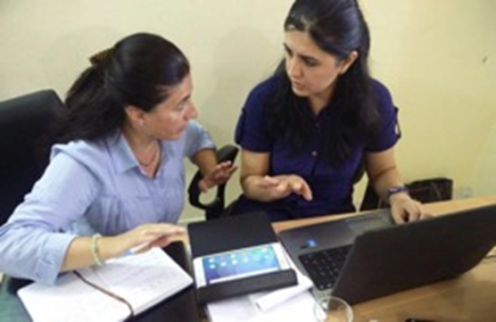
MENTORING
WHAT ARE THE CHARACTERISTICS OF
A GOOD MENTOR?
Notes:
MENTORING 20 mins
1. Brainstorming – what makes a good mentor? 10 mins

Slide 66
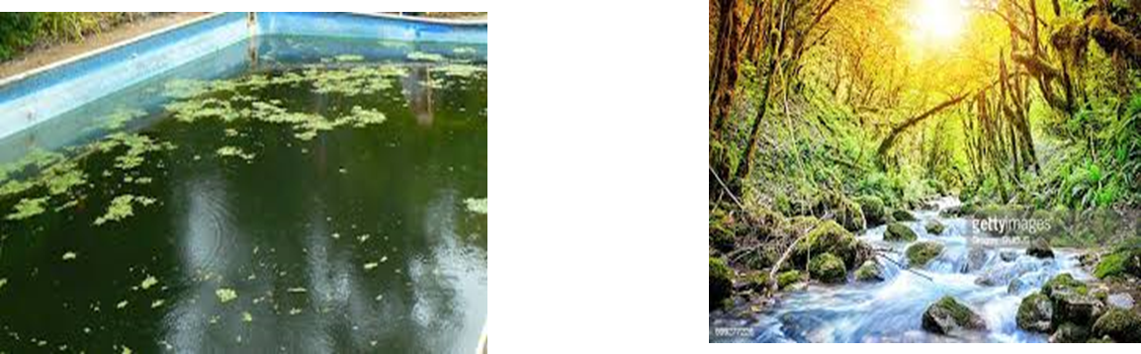
How would you relate these pictures with Mentoring?
Notes:
Contd.
2. Ask participants to look at the two pictures of still water and a flowing brook. Ask them to describe how these may relate to Mentoring. 5 mins

Slide 67
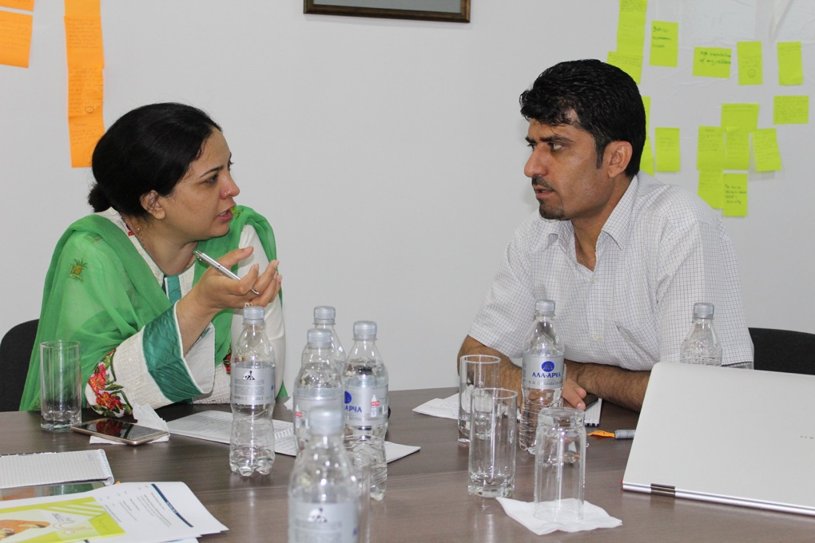
MENTORING IS…….
A learning conversation
Setting goals
A thoughtful relationship
Acknowledging benefits
to mentor and mentee
A learning agreement
Experimenting & observing
Giving and finding support
Using resources effectively
Understanding why different
approaches work
Constructive critique
Jointly inquiring
& enabling reflecting
Growing self-direction-
guiding
Intentional & Nurturing
Insightful
Active listening
Demonstrating & Modelling
Analysing and discussing
Notes:
Contd.
3. Go through the slide outlining Mentoring Skills explaining, asking questions and inviting questions and reflections. 5 mins
The following may be helpful:
Appendix 1
WHAT DO I NEED TO KNOW AS A MENTOR? ESSENTIAL AND ACTIVE MENTORING SKILLS (Stephens, P. 1996; Edwards, A. & Collison, J. 1996; Field, B. & T 1994; CUREE 2005 cited in AKF SIP 2019)
Mentoring is a process that is:
Intentional- carrying out a responsibility
Nurturing-fosters growth and development
Insightful- acquiring wisdom and applying it
Supportive and protective.
Kerry, T & Mayes, A.S. Eds.1995
It’s about having conversations about teaching and learning.
Planning: who to mentor, when, what etc., setting up meetings
Liaising: talking to other stakeholders, e.g. head teacher
Listening and Relating Sensitively: active listening to teachers’ perceptions; building trust and confidence.
Co-inquiring and reflecting: jointly inquiring into and reflecting on aspects of teaching practice; using open questions.
Demonstrating: e.g. teaching a lesson; co-teaching
LISTENING ACTIVELY
listening actively requires that you:
listen quietly and concentrate on what is being said.
Observe body language to understand emotions and mirror body language and tone to show your attention.
Reflect back what is being said to ensure understanding, encourage and re-inforce.
Ask the speaker occasional open questions.
Modelling: e.g. teaching and general classroom management in practice and through conversation.
Analysing and discussing: one own’s practice as well as that of teacher.
Facilitating: ‘flexible scaffolding’- gradually decreasing support; having ‘honest compassion’
Observing: start with participant observation so can offer support; non-participant observation ‘fly on the wall’ with a particular focus and observation schedule; give feedback as soon as possible.
Mentors relate sensitively to learners and work through agreed processes to build trust and confidence. (CUREE 2005)
Assessing: spoken and written: e.g. ‘This is good……..’ ‘Consider this advice…….’
Encouraging and Negotiating: learning goals and focussed self-assessments
Providing: constructive criticism, feedback and helpful information related to evidence.
Mentors use open questions, raise awareness, explore beliefs, develop plans, understand consequences, explore and commit to solutions. (CUREE 2005)
Guiding: skills, ethics, counselling where needed.
Highlighting: learning from analysis of practice.
Enabling: a teacher to reflect on his/her teaching and learning practice: assess and improve skills; evaluate appropriateness of strategies and materials; question and examine values and aims of education etc.
Appendix 2
PRINCIPLES OF MENTORING AND COACHING (CUREE 2005)
Effective mentoring and coaching involves:
A learning conversation
Structured professional dialogue, rooted in evidence from the professional learner’s practice, which articulates existing beliefs and practices to enable reflection on them.
Setting challenging and personal goals
Identifying goals that build on what learners know and can do already, but could not yet achieve alone, whilst attending to both school and individual priorities.
A thoughtful relationship
Developing trust, attending respectfully and with sensitivity to the powerful emotions involved in deep professional learning.
Understanding why different approaches work
Developing understanding of the theory that underpins new practice so it can be interpreted and adapted for different contexts.
A learning agreement
Establishing confidence about the boundaries of the relationship by agreeing and upholding ground rules that address imbalances in power and accountability.
Acknowledging the benefits to the mentors and coaches
Recognising and making use of the professional learning that mentors and coached gain from the opportunity to mentor or coach.
Combining support from fellow professional learners and specialists
Collaborating with colleagues to sustain commitment to learning and relate new approaches to everyday practice; seeking out specialist expertise to extend skills and knowledge and model good practice.
Experimenting and observing
Creating a learning environment that supports risk-taking and innovation and encourages professional learners to seek out direct evidence from practice.
Growing self-direction
An evolving process in which the learner takes increasing responsibility for their professional development as skills, knowledge and self- awareness increase.
Using resources effectively
Making and using time and other resources creatively to protect and sustain learning, action and reflection on a day-to-day basis.

Slide 68

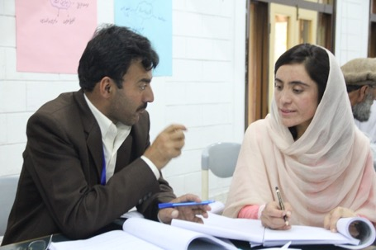

OBSERVER REFLECTIVE DIALOGUE QUESTION BANK
EXAMPLES OF REFLECTIVE DIALOGUE QUESTIONS: EMOTIONAL CLIMATE
How do you think you relate/related to your students? What do /did you do well- how do you know? |  | 8. What differences did you notice in the way you treat different groups of students?
How could you foster more positive and respectful interactions with your students? What strategies could you use? |  | 9. How often do you ask girls or boys, or students from different backgrounds, abilities/disabilities, questions and what type of questions? Where do they sit in your classroom?
What kind of relationships do you think you model in your interactions with various students? |  | 10. How could you make your class more inclusive of students from different genders, abilities, colours, ethnicity, linguistic or socio-economic backgrounds?
How could you learn more about each of your students? What strategies could you use? |  | 11. How could you work more on acknowledging biases you may have, not exhibiting bias and challenging stereotypes?
How do you respond if e.g. a student is late, has not done their homework, unusually starts getting into fights or often misbehaves, suddenly gets low marks, bullies others, cannot read work on the board or is upset? How could you do more to understand the reason behind the behaviour? |  | 12. What strategies could you use to tackle bias and challenge stereotypes in your class?
Which students could you choose to prioritise developing a relationship and rapport so that you could get to know them more and help them, e.g. students with disabilities/special educational needs? |  | 13. How could you better respond on noticing when students are in distress and respond with empathy?
In what ways are you sensitive to and responsive to all students’ needs? What could you do to notice and meet the needs of students who need more help? |  | 14. How well do you think the students relate to each other? How could you better foster warm positive and empathetic interactions among students?
“Effective teachers know and understand their students as individuals in terms of their abilities, achievements, learning styles, culture, and needs, and give greater emphasis to individualization in their teaching”.
Stronge, J. 2018:21
Notes:
OBSERVER REFLECTIVE DIALOGUE TOOL 10 mins
Explain that the Observer Reflective Dialogue Questions Bank helps observers to think about the kind of questions to ask on each dimension to help the teacher reflect on their teaching practices and students’ learning.
Discuss how the examples could relate to something that was observed in the lesson, e.g. “What differences did you notice in the way you treated different groups of students?”. The observer may have seen that the teachers was, for example, ignoring boys at the back of the room and concentrating on the same few students answering questions.

Slide 69



WHAT CAN YOU OBSERVE IN THE MENTORING VIDEOS?
Relationship Building 14:
  Marta & Paulus, Portugal 01:53-02:35
  Suggestions: Nargis & Sughra, Pakistan 03:55-05:06
Using Questions 09:
Fauzia & Sughra, Pakistan
Giving Feedback 11:
Murad & Aisha, Kenya 1: 40-2.19
Observing Mentoring 17:
Shahida & Sughra, Pakistan
LOOK FOR:
Body language
Type of questions
Rephrase any closed questions?
How s/he gave feedback and suggestions
Active listening
What was done well?
What could have been better?
Notes:
MENTORING VIDEOS (AKF Inclusive Guide) 40 mins
Download the videos that you need from the link to insert into the presentation. Links are given in the relevant slide and notes.
Let the participants know that you will be playing come videos of parts of mentoring sessions for them to view and critique. These take place in Portugal, Pakistan and Kenya.
Ask them to look for the particular things listed in the slide.

Slide 70
Relationship Building 14
Paula in Portugal; Nargis in Pakistan
https://vimeo.com/user70288799/download/413863461/8d025f5767
Notes:
Contd.
4. Show the Module 5: Tips- Lesson 1 Relationship Building 14 video of Mr. Paulus with Paula in Portugal from 01:49-02:22. Please note you will have to move to the 01:49 minute to start viewing and stop at 02:22.
https://vimeo.com/user70288799/download/413863461/8d025f5767
5. Show the same video moving on Giving Suggestions of Dr. Choudhry Khan with Nargis in Pakistan playing the video from 03:55-05:06.
6. Discuss with the group their observations of the mentoring skills employed and their effectiveness. Look at :
What were the type of questions? e.g. how do you think? Remind me, What did you do well? Could have done better? Next lesson…..What I hear you saying….
How could you re-phrase any closed questions?
How gave constructive feedback and suggestions?
Body language? Mirroring, setting at ease, trust, confidentiality
ACTIVE listening- how demonstrated?
NB emotional climate and sensitivity applies here!
Any other observations?
What was done well and what could have been better?

Slide 71
Using Development Dialogue Questions 09
Science Pakistan SCK 7 Fauzia
https://vimeo.com/user70288799/download/413863651/819ed42706
Notes:
Contd.
7. Show the video: Module 3: Lesson 4 Using Development Dialogue Questions Science Lesson, Pakistan, with Dr. Choudhry Khan and Fauzia in Pakistan 09 4m34
https://vimeo.com/user70288799/download/413863651/819ed42706
8. Discuss the mentoring skills observed using the questions posed in the previous slide notes.

Slide 72
Giving Feedback 11
Murad & Aisha Kenya 1:40-2.19
https://vimeo.com/user70288799/download/413863243/6995b0b3c2
Notes:
Contd.
7. Show the video from Lesson 6: Giving Feedback Murad, Kenya with Aisha 11 Section from 1:40- 2.19
https://vimeo.com/user70288799/download/413863243/6995b0b3c2
8. Discuss the mentoring skills using the questions posed previously.

Slide 73
Using Mentoring - Dialogue
Shahida & SCK 17
https://vimeo.com/user70288799/download/413863651/819ed42706
Notes:
Contd.
11. Show the whole video. Module 6: Use your Mentoring Knowledge, Lesson 2 Development Dialogue Observation with Shahida & SCK 17 08m 07
12. Discuss the mentoring skills observed using the questions posed previously.
13. Whole group discussion: on reflections of the mentoring and any questions.

Slide 74
Classroom observation supports and reinforces the principles of effective professional learning by emphasising the importance of reflection and feedback on practice. It also demonstrates a powerful model of adult learning to students.
AITSL (2014) p.34
Notes:
GIVING POST-OBSERVATION FEEDBACK 10 mins
Read or ask someone to read out the quote on classroom observation and how it froms an important part of teacher professional development.
Research has shown that schools that regularly use classroom observation improve learning attainment.

Slide 75

POST-OBSERVATION REFLECTIVE DIALOGUE SESSION WITH THE TEACHER
Before the session ask the teacher if s/he has filled in the self-reflection form. You can discuss and refer to this in the dialogue.
Use the Observer Reflective Dialogue Question Bank to help you choose appropriate questions.
Greet the teacher warmly in the planned space.
Listen deeply as a mentor.
Begin with more general questions: How do you feel the lesson went?
Find three positive things. e.g. I liked, …was interesting. I loved the way…
Ask the teacher what could be done better.
Specify behaviours you observed.
Move to more specific questions, e.g. I noticed… what do you think…… Build on responses, e.g., How could you have given her more helpful feedback?
Help the teacher to reflect .
Provide suggestions and support.
Use the teacher’s reflections to help you discuss and set joint goals.
Agree the focus of the next observation.
Notes:
Contd.
. Go through the points on conducting a mentoring session with the teacher after the class observation.

Slide 76



VITAL TOOLKIT
CONTEXTUALISATION
What do we need
to be mindful of?
Notes:
VITAL TOOLKIT CONTEXTUALISATION 15mins
1. Ask the participants what we need to keep in mind when contextualising the VITAL toolkit. Discuss 7-8 mins

Slide 77
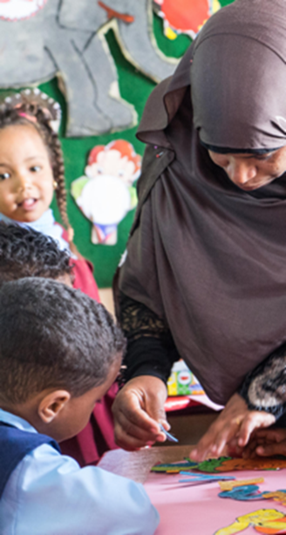
VITAL CONTEXTUALISATION
Engage stakeholders
Place within National Curriculum & Standards
Re-define the behaviour: What is a positive emotional climate in your contexts?
Respect for diversity?
Critical thinking?
Review the behaviours. Retain all dimensions if reduce no. behaviours.
Make adaptations e.g. physical environment, disability info.
Build up contextually relevant examples e.g. large classes, 4 levels.
Translate if needed- keep it simple.
Discuss what bias and diversity means.
Collect videos & photos
Mini-pilot the revised tool.
Ask for a Global Assessment Partner Review, if you have made changes.
Notes:
Contd.
2. Go through the points to consider when contextualising the tool.

Slide 78
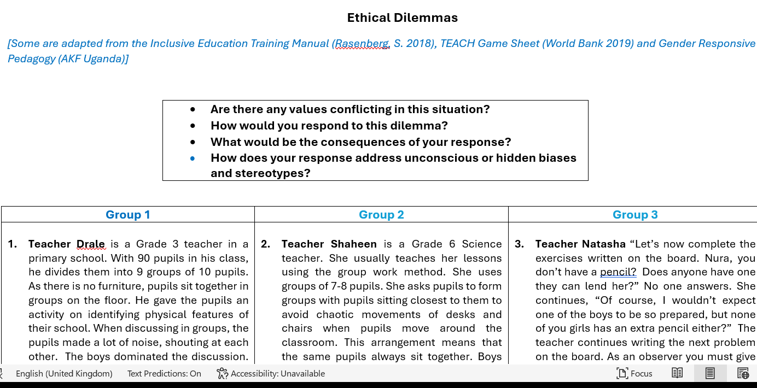
ETHICAL DILEMMAS
Discussion
Notes:
ETHICAL DILEMMAS 25 mins
Split the participants into 9 Groups and give them 1-2 dilemmas to discuss.
Ask that they appoint a rapporteur for the group to give feedback after the discussions.
Questions to pose are:
Are there any values conflicting in this situation?
How would you respond to this dilemma?
What would the consequences of your response be?
How does your response address unconscious or hidden biases and stereotypes?

Slide 79
Group Ethical Dilemmas
Group 2
3. Teacher Shaheen is a Grade 6 Science teacher. She usually teaches her lessons using the group work method. She uses groups of 7-8 pupils. She asks pupils to form groups with pupils sitting closest to them to avoid chaotic movements of desks and chairs when pupils move around the classroom. This arrangement means that the same pupils always sit together. Boys usually sit with boys and girls with girls. Teacher Shaheen gives all the groups a task on the functions of the different parts of the fish. At the end of the lesson, all the groups of girls fully explained the functions of every part of the fish. All the groups of boys were unable to explain some of the functions of the parts of the fish. She does not know what to do- how can you help her?
4. Teacher Manju is a primary grade 4 teacher. He splits his pupils into groups of 6 and gives them a task. Then, he sits down at his desk at the front of the class and reads his newspaper. The pupils do not understand the instructions for the task. One learner raises his hand to signal to the teacher that he needs help, but Manju doesn’t see him. Another learner goes up to Manju and asks for help and he helps her without getting up from his chair. The other pupils are still confused. One pupil in each group ends up just taking charge and doing the assignment on their own – mostly the assertive boys in the class. The other pupils, particularly girls, and those with learning difficulties do not contribute very much to their group. A learner complains to you- how do you support Manju?
Group 1
Teacher Drale is a Grade 3 teacher in a primary school. With 90 pupils in his class, he divides them into 9 groups of 10 pupils. As there is no furniture, pupils sit together in groups on the floor. He gave the pupils an activity on identifying physical features of their school. When discussing in groups, the pupils made a lot of noise, shouting at each other. The boys dominated the discussion. Some learners were laughing at the answers given by girls. Teacher Drale tells the pupils to keep quiet, but they don’t listen. They are laughing and shouting, and he is worried they are not staying on-task. He has asked you for help- what do you do?
2. You notice that learners in your class do not want to sit next to Shilpa, a girl from a very poor family because she is very dirty. They are bullying her in the playground, and you can see that this makes her very sad. What will you do? You ask a colleague for help.
Notes:
Contd.
Print/copy the group dilemmas for the participants – each groupwill have two dilemmas based on school and classroom situations. They may not get to discussing the second dilemma. Here are the dilemmas for groups 1 and 2.

Slide 80
Group Ethical Dilemmas
Group 3
5. Teacher Natasha says: “Let’s now complete the exercises written on the board. Nura, you don’t have a pencil? Does anyone have one they can lend her?” No one answers. She continues, “Of course, I wouldn’t expect one of the boys to be so prepared, but none of you girls has an extra pencil either?” The teacher continues writing the next problem on the board. As an observer you must give the teacher some feedback. What will you say?
6. Teacher Thomas was teaching science in grade 7. On his first day in the class, he introduced himself as “a man who is a teacher of Science.” In his introduction he also told the pupils that the learning area he was handling was for real men because girls’ brains were limited to the kitchen. He further said that some of the girls were mature and ripe for marriage, and it was a waste of time teaching them hard concepts of science. The next day when Thomas came to class to teach science, boys were laughing and repeating what Teacher Thomas had said about the girls. Thomas found that many girls no longer attended school on the days he taught science. How would you help Thomas?
Group 4
7. In your colleague Emily’s grade 3 class you notice that there is a learner who has a visual disability sitting at the back of the room, often just sitting there silently on his own and not involved in activities. There is also another child who has been diagnosed with ADHD (Attention deficit/hyperactivity disorder), who seems not able to focus for long, taps the desk, and sometimes gets upset when there is too much noise and walks out the classroom. What do you advise your colleague?
8. Teacher Fernando was teaching science in Primary 6. He was using instructional materials which had pictures of only boys and the language he used did not encourage the active participation of girls. Fernando only appreciated answers from the boys and allowed the boys to be the leaders during group discussion. The girls were passive listeners in the class. How can you help Fernando?
Notes:
Contd.
Groups 3 and 4 .

Slide 81
Group Ethical Dilemmas
Group 6
11. Ms. Divya has a class of 40 learners in a small fishing village. She is teaching her primary grade 1 class about fish. She grew up in the village and remembers that when she was a child, she already knew a lot about fish when she was in grade 1. She teaches about fish for only 10 minutes and skips over a lot of information in the textbook. The next week she gives pupils a test on the parts of the fish. She is surprised that almost every female learner gets 100% but almost every male learner only gets 50%. How can you support Divya?
12. Mr. Gupta is a class teacher of primary 5. He has several children in his class with special educational needs. Shankar has cerebral palsy and is in a wheelchair, Shagufta has a hearing disability and Arjun is on the autism spectrum disorder. In class he can be heard to say: “Hey, you children with special needs”. He does not know what or how to teach them. What could you do to help him?
Group 5
9. In your class you ask the learners to do group work and ask fast learners to sit with learners who need more support. You notice that some learners do not like to work with learners that need support. What do you do? You go to a colleague for support.
10. Teacher Lakhsmi is not comfortable with using group work in teaching, but her Head Teacher has forced her to try it for one lesson. She teaches primary grade 4 science, and each lesson is 40 minutes. Usually, the girls come late because they have extra work at home. She usually locks out the latecomers, and yet she doesn’t start on time. When the bell rings, she splits them into groups by giving them each a number as they walk in the door and asking them to sit down. First, she gives out all the ‘1’ cards, then the ‘2’ cards, then the ‘3’ cards, then the ‘4’ cards. Once they are seated, she asked them all to move to their groups. There are so many pupils moving around that the last pupils can’t even hear where their number group is supposed to stand. Other pupils know their numbers but don’t know where they are supposed to sit. It takes her 20 minutes to get the pupils into groups. After that, they only have 20 minutes for the lesson. How can you support Lakhsmi?
Notes:
Contd.
Groups 5 and 6.

Slide 82
Group Ethical Dilemmas
Group 8
15. Madam Sadia is a teacher of English in primary 6 in a semi-urban school. In her first lesson of term one after Covid-19 lockdown, she asked the learners to share their experiences at home. Incidentally, the learners were very quiet and passive in the class. Sadia called the learners “You, big girl”, don’t you have an answer? “And you, big boy?” Are your heads full of rice and daal you ate during lockdown that you cannot even remember anything from home? How can you help Sadia?
16. During a lesson the teacher Vishal, has learners complete a worksheet matching word to occupations. After learners are finished, he asks, “What do you want to be when you grow up?” One learner says she wants to be a doctor, and her classmate says, “You can’t be, you can be a nurse, doctors are boys.” The teacher does not say anything. How can you support the teacher?
Group 7
13. Your colleague, Mira has three learners who she always complains about. She says they are such slow learners that she does not bother with them anymore. Moreover, she does not understand why the parents bother to send them to school when they cannot learn the basics. She blames the illiterate parents. You offer to observe her classroom and think the three learners may be dyslexic as they have difficulty reading and writing. What do you do?
14. Mrs. Karim is a grade 7 mathematics teacher. She provided her class with a lesson exercise, which she marked and immediately returned the learners’ books. Most girls scored below an average mark of 50%. The teacher told the girls that they were wasting their parents’ money and her valuable time. Instead, they should get married as a better option. How can you help Mrs. Karim?
Notes:
Contd.
1. Groups 7 and 8

Slide 83
Group Ethical Dilemmas
Group 9
17. You are observing your colleague Simon’s class. A couple of boys have been fighting, and one was crying. Simon told the boy quite harshly to get up and not to cry as boys do not cry. You notice that he treats the boys roughly, with more harsh language than the girls with whom he is very gentle. How can you support Simon?
18. Isha is a capable teacher, however, while she is teaching her class you notice that she rarely asks the Somali children to answer questions or give praise. You also notice that when she is offered food from the Somali children, she puts it aside and does not touch it. You’ve observed this a couple of times – how can you support her?
Notes:
Contd.
Group 9 .

Slide 84

ETHICAL DILEMMAS: Feedback
A reminder:
  Are there any values conflicting in this situation?
  How would you respond to this dilemma?
  What would the consequences of your response be?
  How does your response address unconscious or hidden biases and stereotypes?
What kind of dilemmas
do you see in your schools/classrooms?
Notes:
ETHICAL DILEMMAS FEEDBACK & DISCUSSION 35 mins
Feedback to Whole Group discussion: 9 groups x 3min
Ask each group to describe their dilemma and key points of the discussion, reminding them of the discussion points;
Are there any values conflicting in this situation?
How would you respond to this dilemma?
What would the consequences of your response be?
How does your response address unconscious or hidden biases and stereotypes?
General discussion:
Ask the participants: How relevant are these situations to your context?
Are there other examples of exclusion?
Did you notice any similarities or differences between the groups’ responses?
What kind of unconscious biases or stereotypes do you think are at play that would hinder learning?

Slide 85




VITAL LEARNING OBSERVATION AND TEACHER REFLECTION TOOLKIT
TRY THIS QUIZ!
Notes:
VITAL QUIZ (30 minutes)
Please print out/provide the quiz with 24 questions (text given below) for the participants to fill in. 20 minutes .
Be sure to have studied the quiz beforehand yourself so that you are prepared to discuss responses! CORRECT ANSWERS HAVE BEEN HIGHLIGHTED BUT REMEMBER TO REMOVE THE HIGHLIGHTS FOR THE PARTICIPANTS!!
Discuss the responses 10 mins
Schools2030 VITAL Learning Environment Observation & Teacher Reflection Toolkit QUIZ
(Some adapted from BEQI & TEACH Primary)
1. What does the Schools2030 VITAL Learning Environment Observation & Teacher Reflection Toolkit assess?
Holistic learning outcomes
The quality of the classroom teaching and learning environment
The quality of classroom resources
The quality of classroom leadership
2. The purpose of the Toolkit is to:
Help teachers use evidence from their lessons to improve their teaching and learning practices and the design of micro-innovations.
Appraise teacher performance.
Help teachers identify weak students.
Help teachers grade student’s learning.
3. The Toolkit has the following number of components:
1
2
5
8
4. The main Areas covered in the Toolkit are:
Warm emotional climate and effective facilitation
Creativity and social and emotional Learning
Growth mindset and effective teaching and learning
Supportive learning environment and quality teaching and learning practices
5. Which two of the following form part of having a Growth Mind-set? (choose two)
Believing one’s intelligence, qualities and skills can be cultivated.
Believing one cannot improve oneself, giving up and avoiding risk.
Believing one’s intelligence and talent is static and cannot change.
Embracing challenges, learning from mistakes and persisting.
6. Which one of the following is correct?
The VITAL Primary/Secondary Learning Environment Observation Tool (the observation form and rubric) is to be used alone.
The VITAL Teacher Reflection Tool (the teacher self-reflection form and observer reflective dialogue question bank) is to be used alone.
The VITAL Primary/Secondary Learning Environment Observation Tool and the Teacher Reflection Tool are to be used together.
The VITAL Learning Environment Observation Rubric is to be used alone.
7. How many Dimensions are there in the VITAL Toolkit:
5
3
2
8
8. How many Behaviours does the VITAL Toolkit cover?
38
37
40
27
9. How long does the classroom observation take?
The whole lesson
45m
First 30m of a lesson
1 hour
10. Before the observation the Observer should:
Inform the school that the teacher will be inspected.
Become very familiar with the Observation Manual, Form and Rubric
Find out about the teacher’s character.
Inspect students’ work.
11. When the observation ends the Observer should:
Check students’ work
Tell the teacher the levels allocated.
Thank the teacher with encouraging remarks.
Just walk out the room.
12. The purpose of the Teacher Reflection Tool (the teacher self-reflection form and the observer dialogue question bank) is to:
Provide accurate data on the teacher’s practices.
Help teachers think deeply about the way they teach, and their students learn.
Help the observer judge teacher’s practices.
Help students understand what the Teacher believes.
13. For the following, indicate whether the question is open-ended – tick all that apply.
How do you think the refugees felt?
Which is greater -2 or -6?
How many circles are there?
What makes you think that?
14. Which of the following is a student off task and not engaged in learning ( Behaviour 3.8.)? Choose 3
Disruptive student
A student writing notes in her notebook,
A student looking at the blackboard sums.
A student sleeping
A student watching the Observer.
15. During the lesson, the teacher calls students by their names and uses phrases like “please” and “thank you”; on one occasion the teacher shouts at a student. Which level would be assigned for 1.1. ‘The teacher treats all students respectfully’?
Level 1 Ineffective
Level 2 Partly Effective
Level3 Effective
Level 4 Very effective
16. The teacher is not observed redirecting students’ behaviour, but students are well-behaved throughout the lesson. Which level would be assigned for behaviour 2.3: The teacher re-directs misbehaviour by focusing on the expected behaviour?
Level 1 Ineffective
Level 2 Partly Effective
Level 3 Effective
Level 4 Very effective
17. The teacher explains the content but does not fully explain the meaning of relevant technical terms. Which level would be assigned for 3.2. ‘The teacher explains concepts and content clearly’?
Level 1 Ineffective
Level 2 Partly Effective
Level3 Effective
Level 4 Very effective
18. How can the teacher adjust teaching and provide activities relevant to students’ levels (3.6)? Choose 2.
Provide the same simple activity for all students
Provide a second activity at the same level and content as the first activity.
Give more time to finish an activity
Provide more challenging tasks to students that finish earlier
19. During the lesson, the teacher asks one open-ended question, “What did you think about story?” but does not build upon the response. Which level would be assigned? (4.1)
Level 1 Ineffective
Level 2 Partly Effective
Level3 Effective
Level 4 Very effective
20. During the lesson, when one student is at the board, the teacher tells her/him that s/he made a mistake. Which would be the level assigned (8.2. The teacher provides specific comments or prompts to clarify students’ misunderstandings)?
Level 1 Ineffective
Level 2 Partly Effective
Level3 Effective
Level 4 Very effective
21. The teacher mostly picks up on stereotypes when students state that only boys can be pilots and says, ‘Girls can be pilots too!’. S/he does not involve students in exploring this further (1.5. The teacher challenges stereotypes). The level assigned would be:
Level 1 Ineffective
Level 2 Partly Effective
Level 3 Effective
Level 4 Very effective
22. When a student is struggling with an exercise on the board, the teacher asks the student impatiently to sit down and asks another student to solve the exercise. Which level would be assigned (6.2. The teacher responds positively to student challenges) ?
Level 1 Ineffective
Level 2 Partly Effective
Level3 Effective
Level 4 Very effective
23. The teacher sometimes asks the students to work together in groups to draw a diagram of the water cycle. What level would be assigned (5.1. The teacher uses collaborative pair and group work effectively)?
Level 1 Ineffective
Level 2 Partly Effective
Leve, 3 Effective
Level 4 Very effective
24. During independent work, the teacher stays at her/his desk waiting for students to finish. What level would be assigned (7.2. The teacher monitors students during independent and group work)?
Level 1 Ineffective
Level 2 Partly Effective
Level3 Effective
Level 4 Very effective

Slide 86
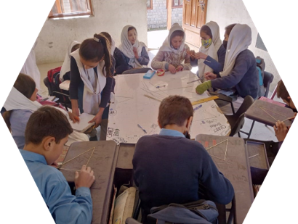
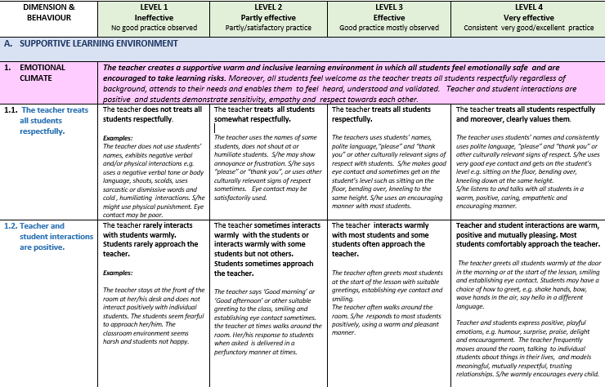
SUMMARY STEPS FOR VITAL AFTER CONTEXTUALISATION, TRAINING AND PILOTING.
STEP 1: CLASSROOM OBSERVATION
Purpose: To gather evidence on the emotional climate and the kind of teaching and learning practices that take place in the classroom.
How:
Observers are trained to observe classrooms becoming familiar with the Rubric describing four levels of practice from ‘ineffective’ to’ very effective practice’.
Notes:
VITAL STEPS AFTER CONTEXTUALISATION, TRAINING AND PILOTING. 15 min
1. Go through the steps of using VITAL. Please emphasise the importance of training and that more training will be needed to ensure that observers reach an 80%+ level of allocating the same levels to behaviours (inter-rater reliability).

Slide 87
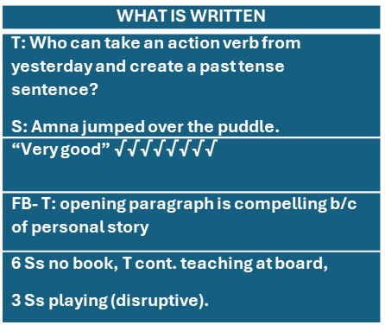
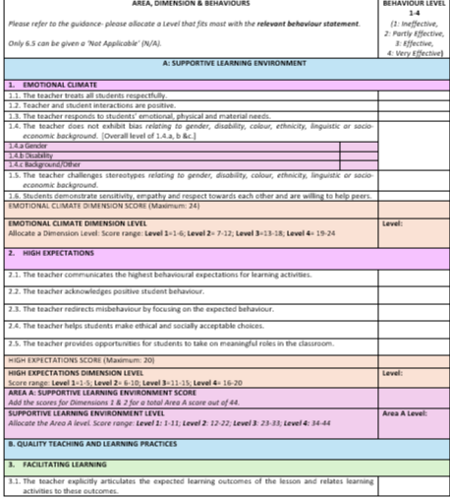
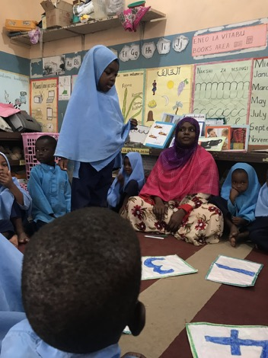
STEP 1: CLASSROOM OBSERVATION CONTD.
The observer observes the whole lesson and makes detailed notes, capturing interactions between teachers and learners and between learners and the teaching and learning practices that take place.
Immediately after the observation, the observer assigns a level (from 1-4) against each of the behaviours according to the Rubric level statements and notes this on the form as evidence.
When to Use:
The observation can be done 3 - 4 times a year:
  At the beginning of the year and at the end of the year to observe all the dimensions to see if there is any improvement.
  Twice during the year to help improve the specific dimensions/behaviours targeted by the teacher.
Notes:
Contd. Step1
2. Please stress the importance of observation notes as these form the evidence for the level allocation.

Slide 88
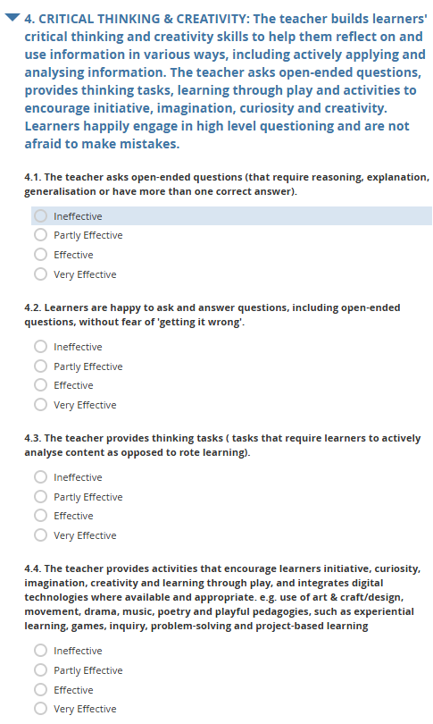
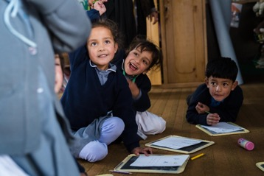
STEP 2: DATA ENTRY & ANALYSIS
Purpose: To enter the data in a way that provides evidence and enables easy analysis of the teaching and learning behaviours observed.
How:
The observation notes and form (photos) and Levels1-4 ratings are entered into an Excel sheet, through KOBO or the new Schools2030 Database.
The data is analysed and presented in various forms for teachers and the programme team.
Notes:
Contd. Step 2

Slide 89
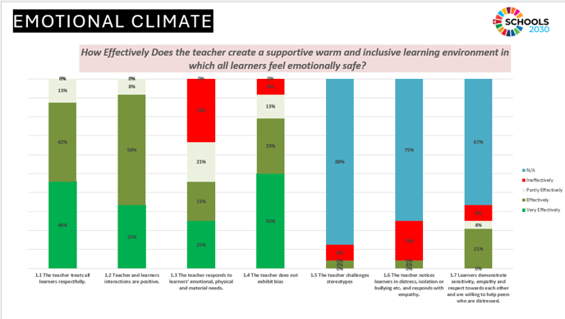
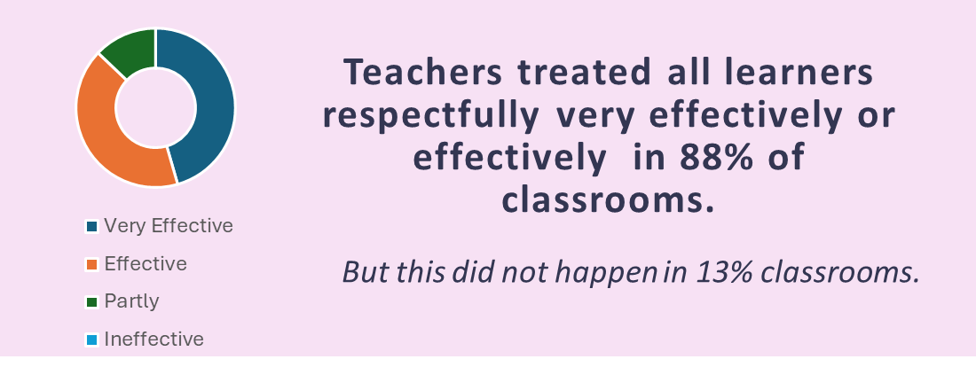
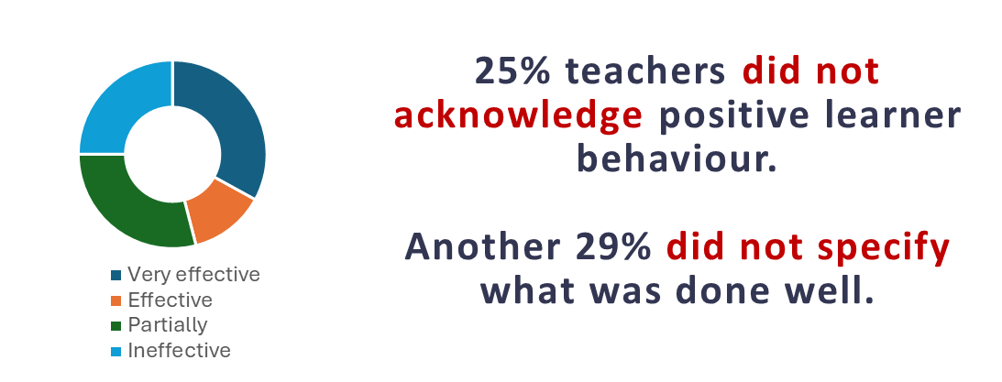


STEP 3: DATA PRESENTATION
Purpose: Present the data in a way that enables teachers (and programme teams) to reflect on their teaching and learning environments and practices.
How:
The data is analysed and presented in various forms for teachers and the programme needs, e.g. HCD training.
In 7 out of 10 classrooms, teachers
explained concepts and content very effectively.
Notes:
Contd. Step 3

Slide 90
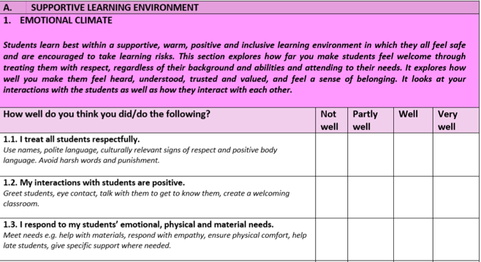
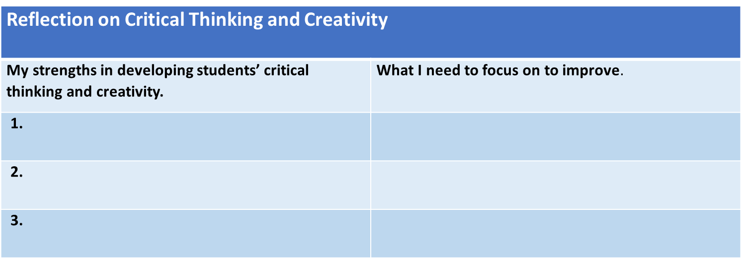
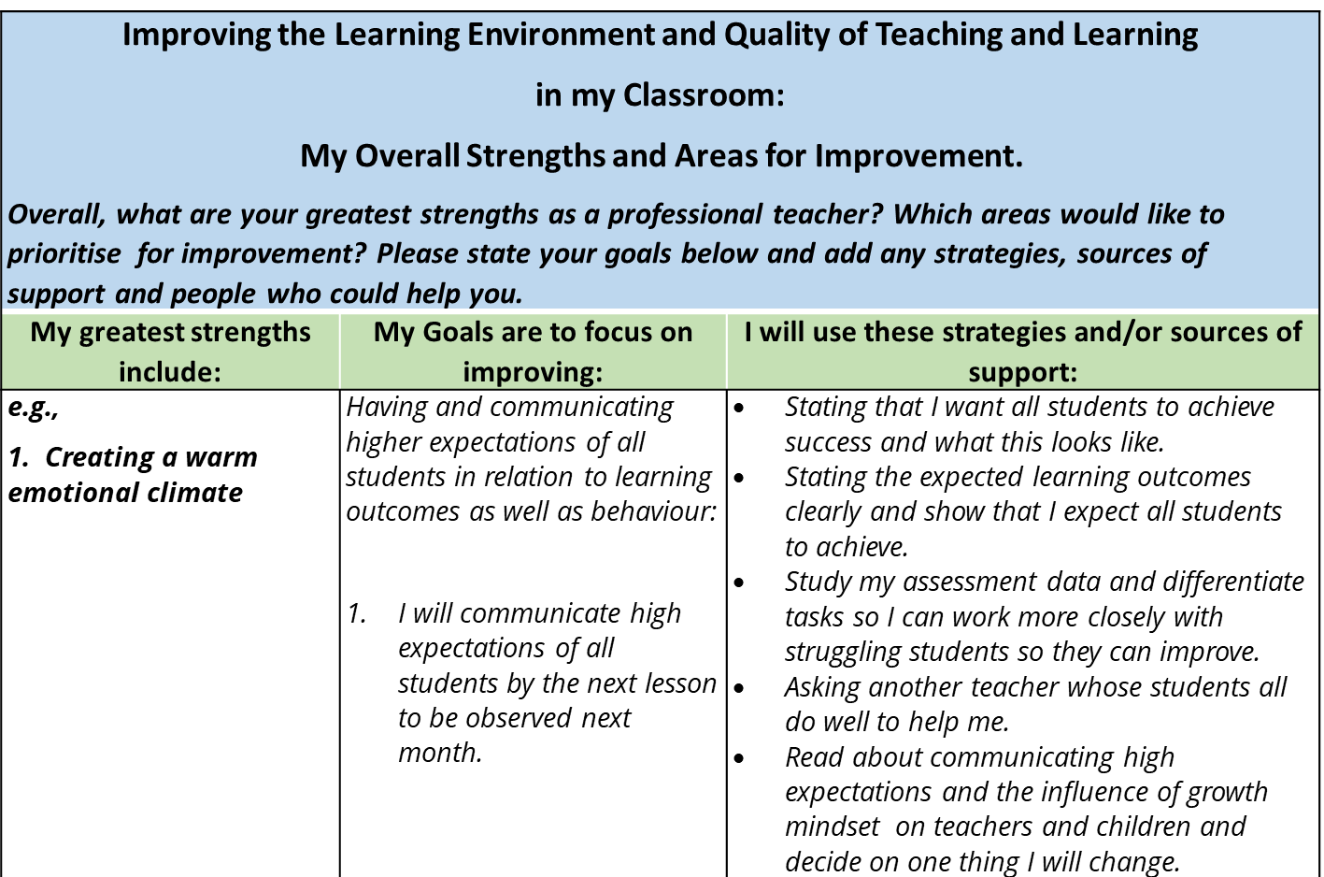
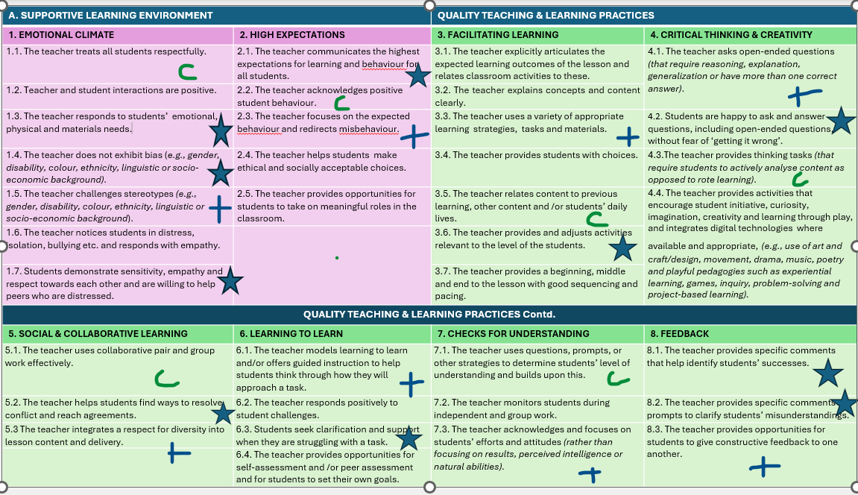
STEP 4: TEACHER FEEDBACK AND GOAL SETTING
Purpose: To give teachers individualized feedback and support them on areas for development.
How:
After the observation, teachers are provided feedback through a professional dialogue.
Teachers also reflect on their teaching practices and the lesson and bring this to the discussion.
Targets to improve dimensions and behaviours are set with the teacher and the teacher is mentored to help her/him improve their practice.
These targets include those set up during the HCD process.
Progress to achieving these targets are assessed twice or more during the year by observers/peers and support given.
Notes:
Contd. Step 4
Please inform participants that automated individual teacher feedback for VITAL observations is being prepared . This will be accessible through the BEQI (ECD Measure) platform in 2026.

Slide 91
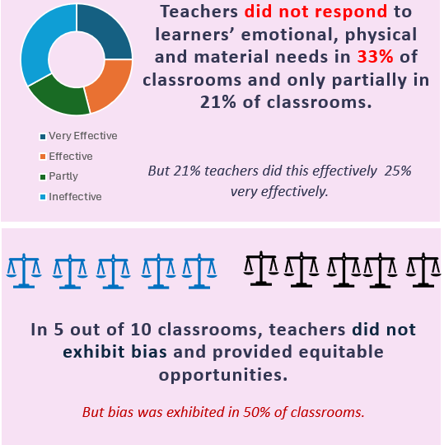
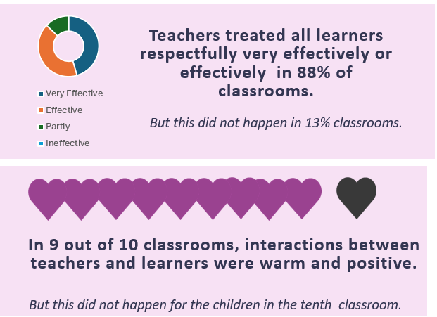
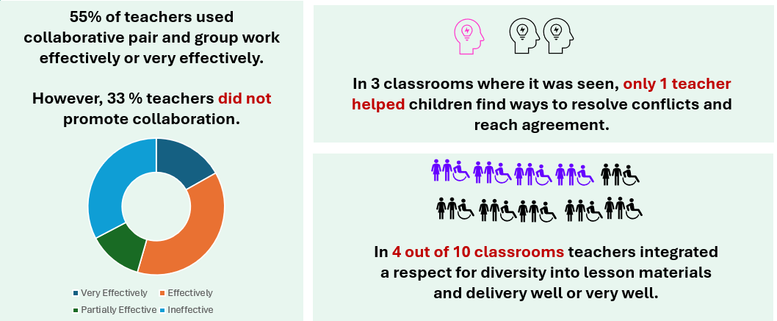
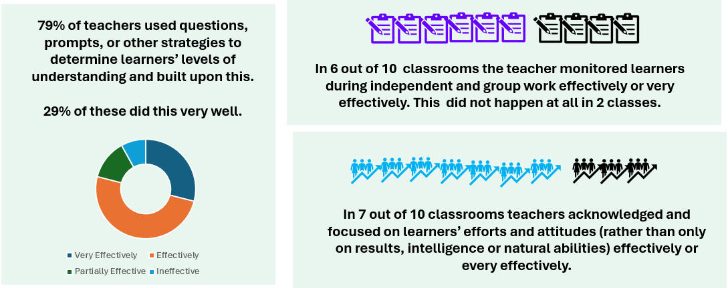

Examples of Data Presentation (Kenya 2024)
Notes:
Contd. Examples of Data Presentation (Kenya)
You may wish to present similar data visualisation for your country/contexts.

Slide 92

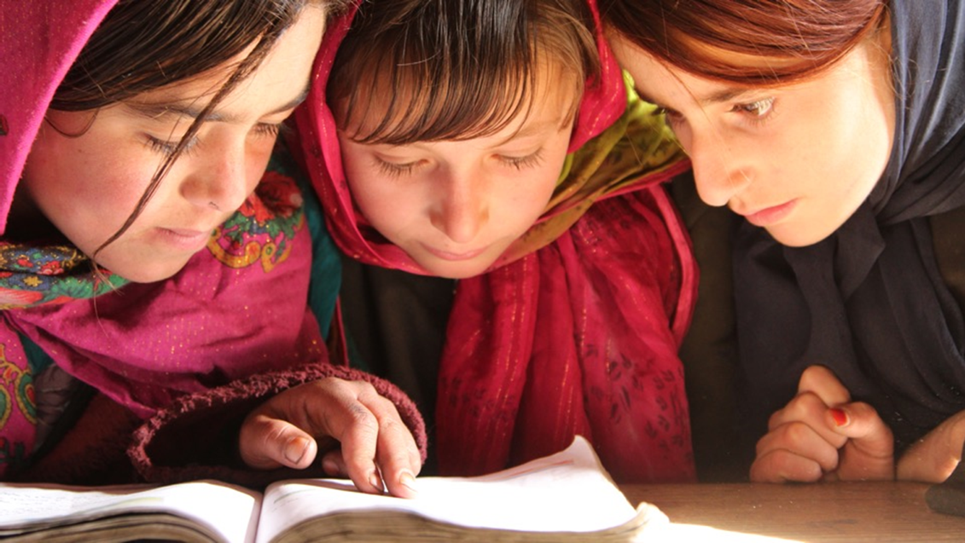
FINAL SESSION
CLOSING ROUND
How do you feel going forward?
Notes:
FINAL SESSION CLOSING ROUND 30 mins
You now need to close the session and training. Ask if there are any questions.
Ask participants to reflect on the three days and how they are feeling about the experience and the VITAL Toolkit – give them a minute or so to do so.
Ask them to share 1 sentence about how feeling they are feeling and one thing they will do going forward.
Thank the participants for their participation and let them know of next steps after the training.
Conduct a debrief on the training with your co-facilitator and identify what additional training that needs to take place, including on reaching reliable observer allocation of levels to behaviours.

Slide 93
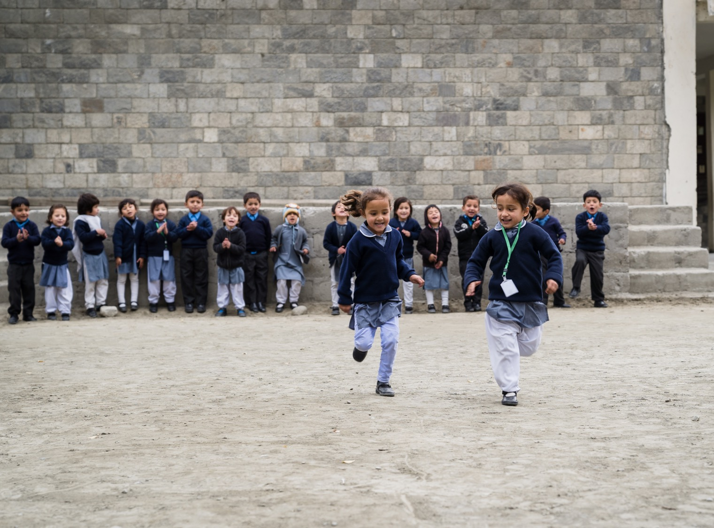
Questions?
Thank you!
Notes:
Contd.
6. Ask if there are any further questions.
7. Say goodbye. You may wish to take a group photo before leaving and post on social media if this is ok.

