Slide 1
Rapid Design Challenge

Slide 2
Redesign your partner’s morning routine

Slide 3
Redesign your partner’s morning routine
… in the time of COVID-19

Slide 4
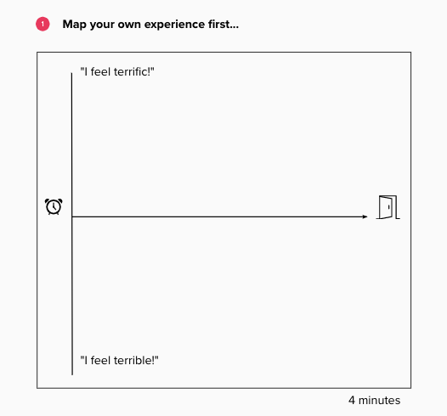

Slide 6
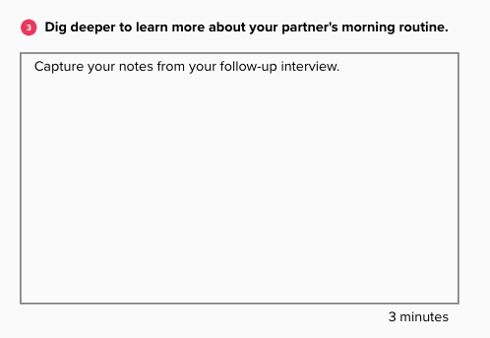

Slide 7
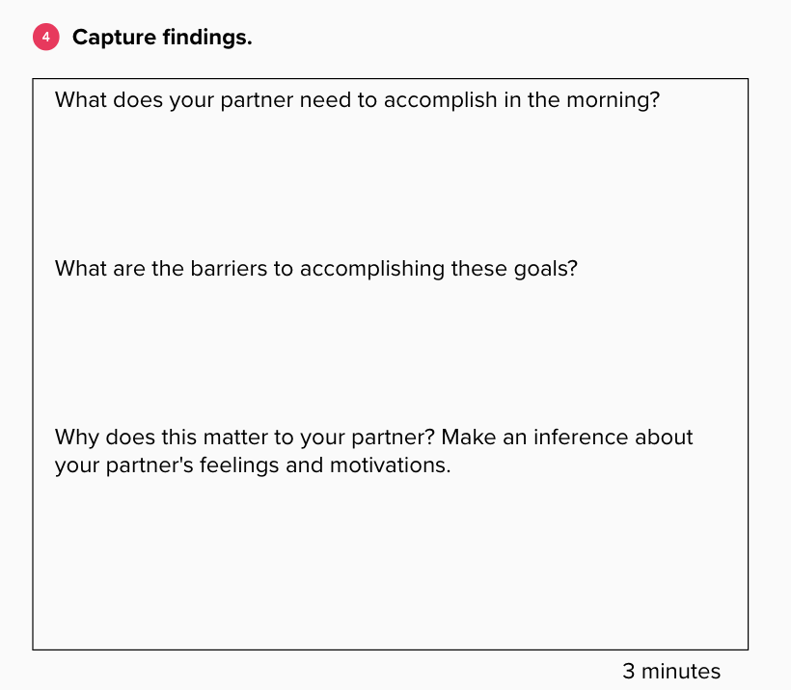

Slide 8
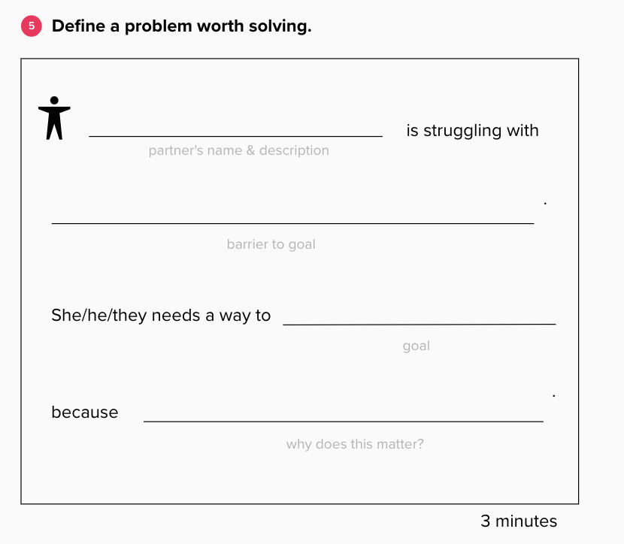

Slide 10
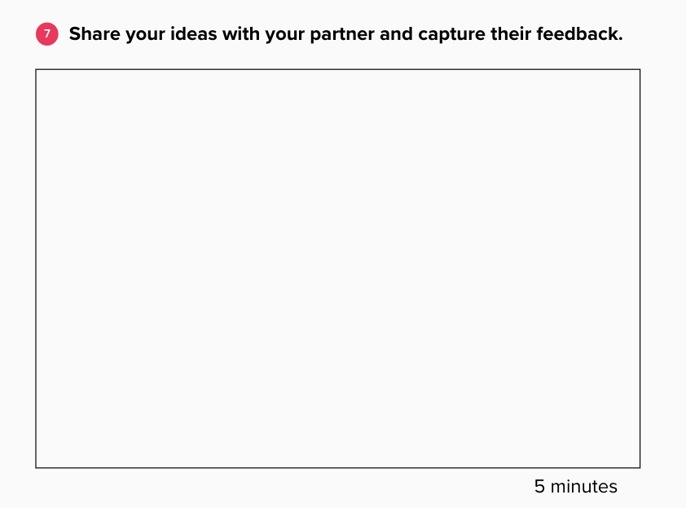

Slide 13
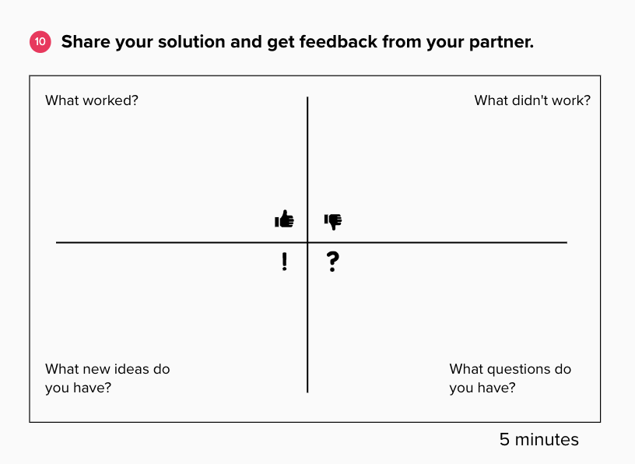

Slide 14
