Slide 1
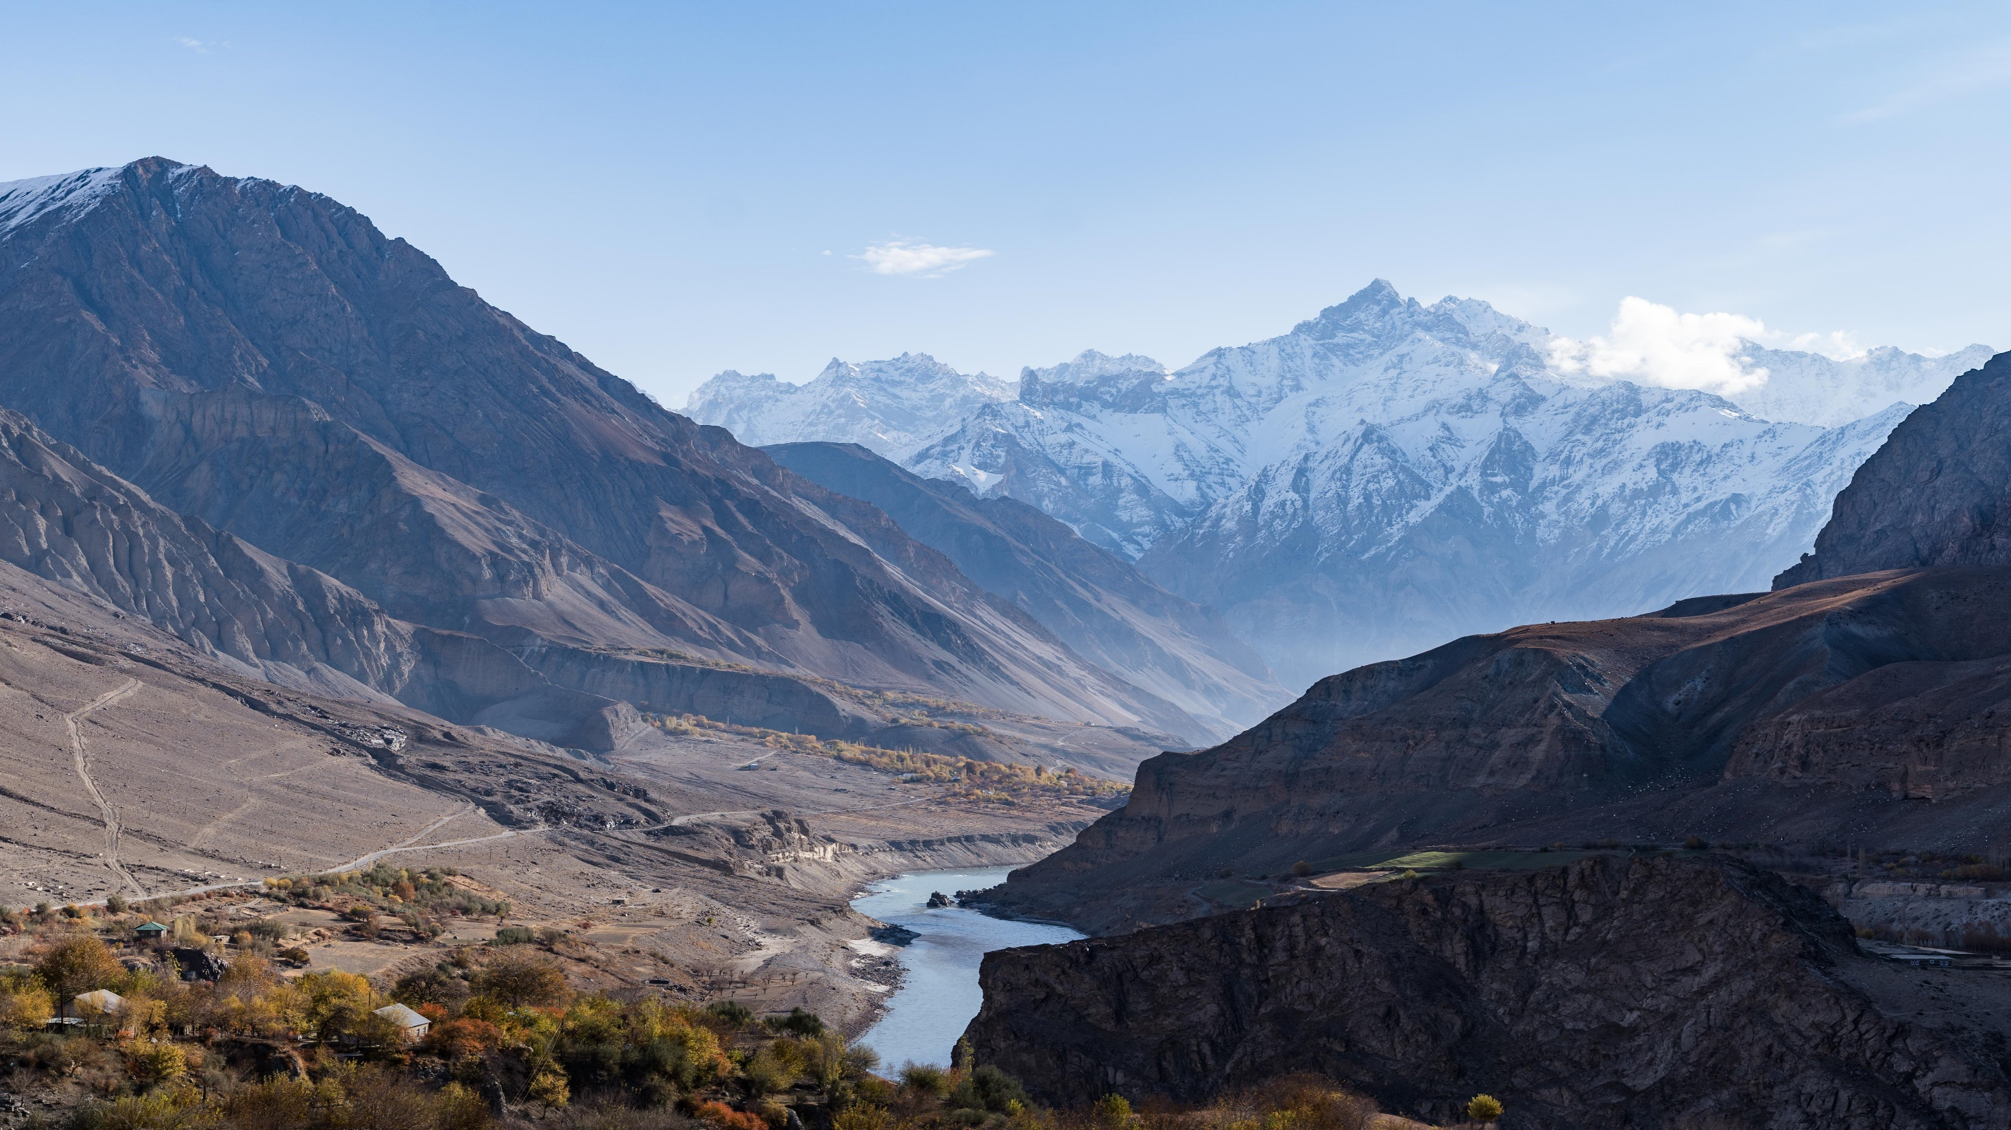
Tajikistan

Slide 2
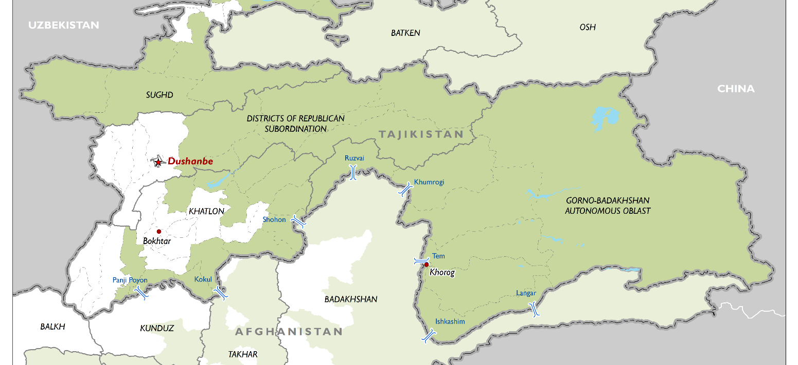

Slide 3
GRADE | AGE GROUP (IN YEARS) | CHILDREN OF SCHOOL AGE | STUDENTS IN SCHOOL | FEMALE STUDENTS
Pre-primary | 2-5 | 918,739 | 91,081 | 41,004
Primary (compulsory) | 7-10 | 799,736 | 771,040 | 372,268
Lower Secondary (compulsory) | 11-15 | 820,440 | 809,645 | 388,472
Upper Secondary | 16-17 | 336,212 | 254,184 | 98,046
Total: |  | 2,875,127 | 1,925,950 | 899,790

Slide 4
Key challenges of teaching and learning in school
Teacher centered model of teaching
Rote memorization method
Lack of teaching and learning resources

Slide 5
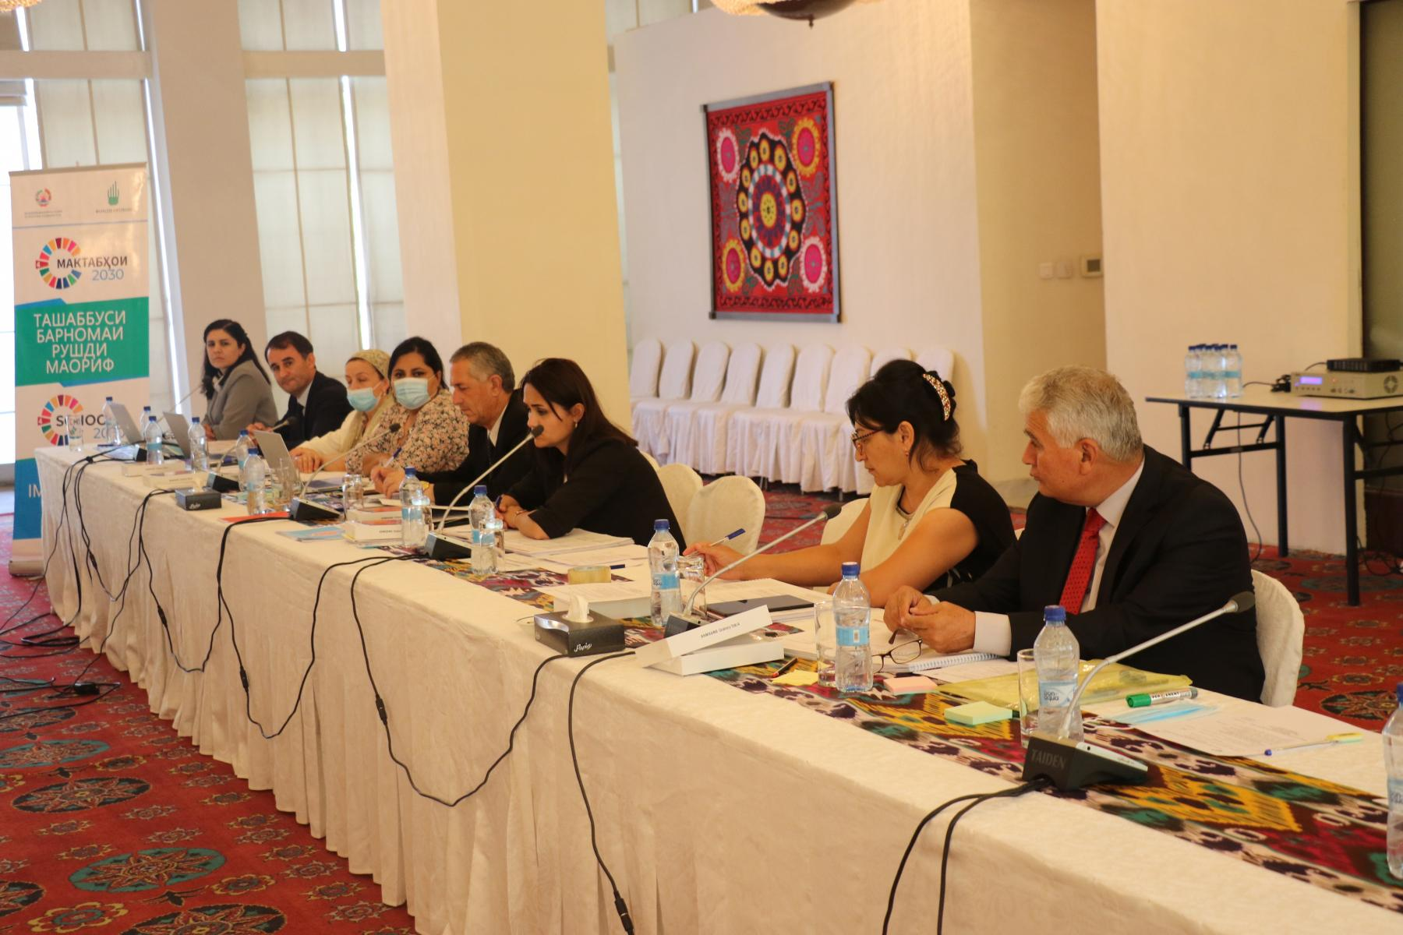

Slide 6
Supporting NSED and SDG4 in Tajikistan
Improving quality of education at all the levels (pre-school, primary and secondary)
Identifying best pedagogical practices.
Professional development of teachers on applying innovative approaches
Strengthening competency-based education.
Providing teaching and learning resources to improve learning environment of the classroom.
Improve learning of science subjects in public schools

Slide 7
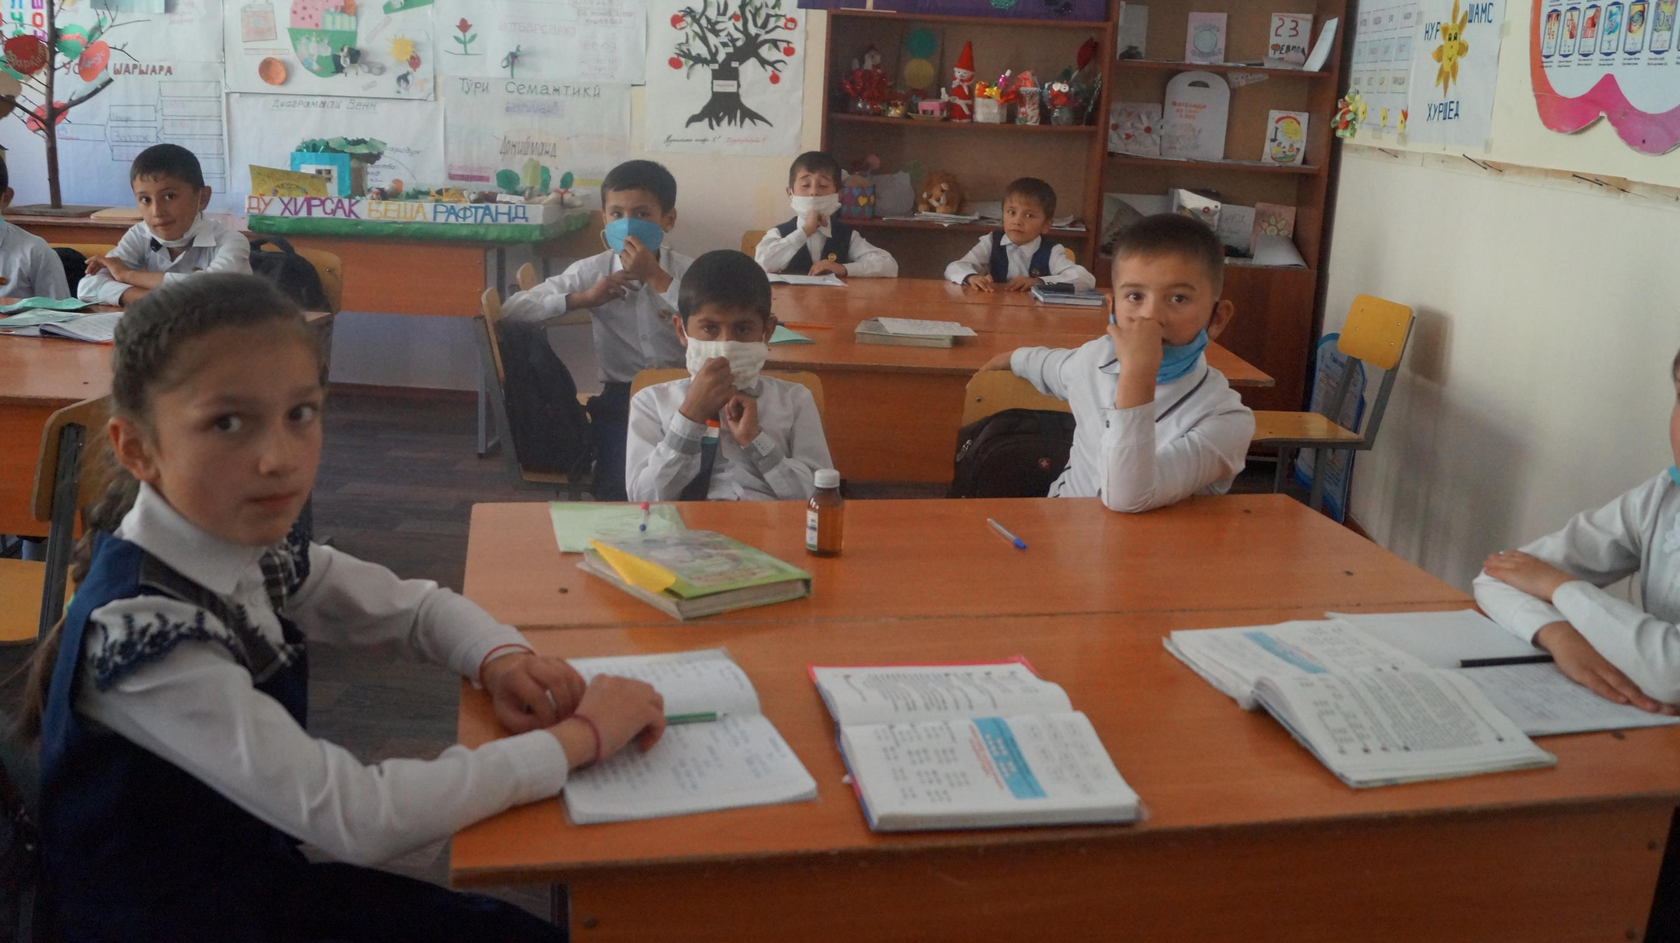
School #5 design challenge

Slide 8
Identified challenge
Students in grade 4 cannot comprehend math problems
60 % of students’ knowledge do not meet the national standards in math subject

Slide 9
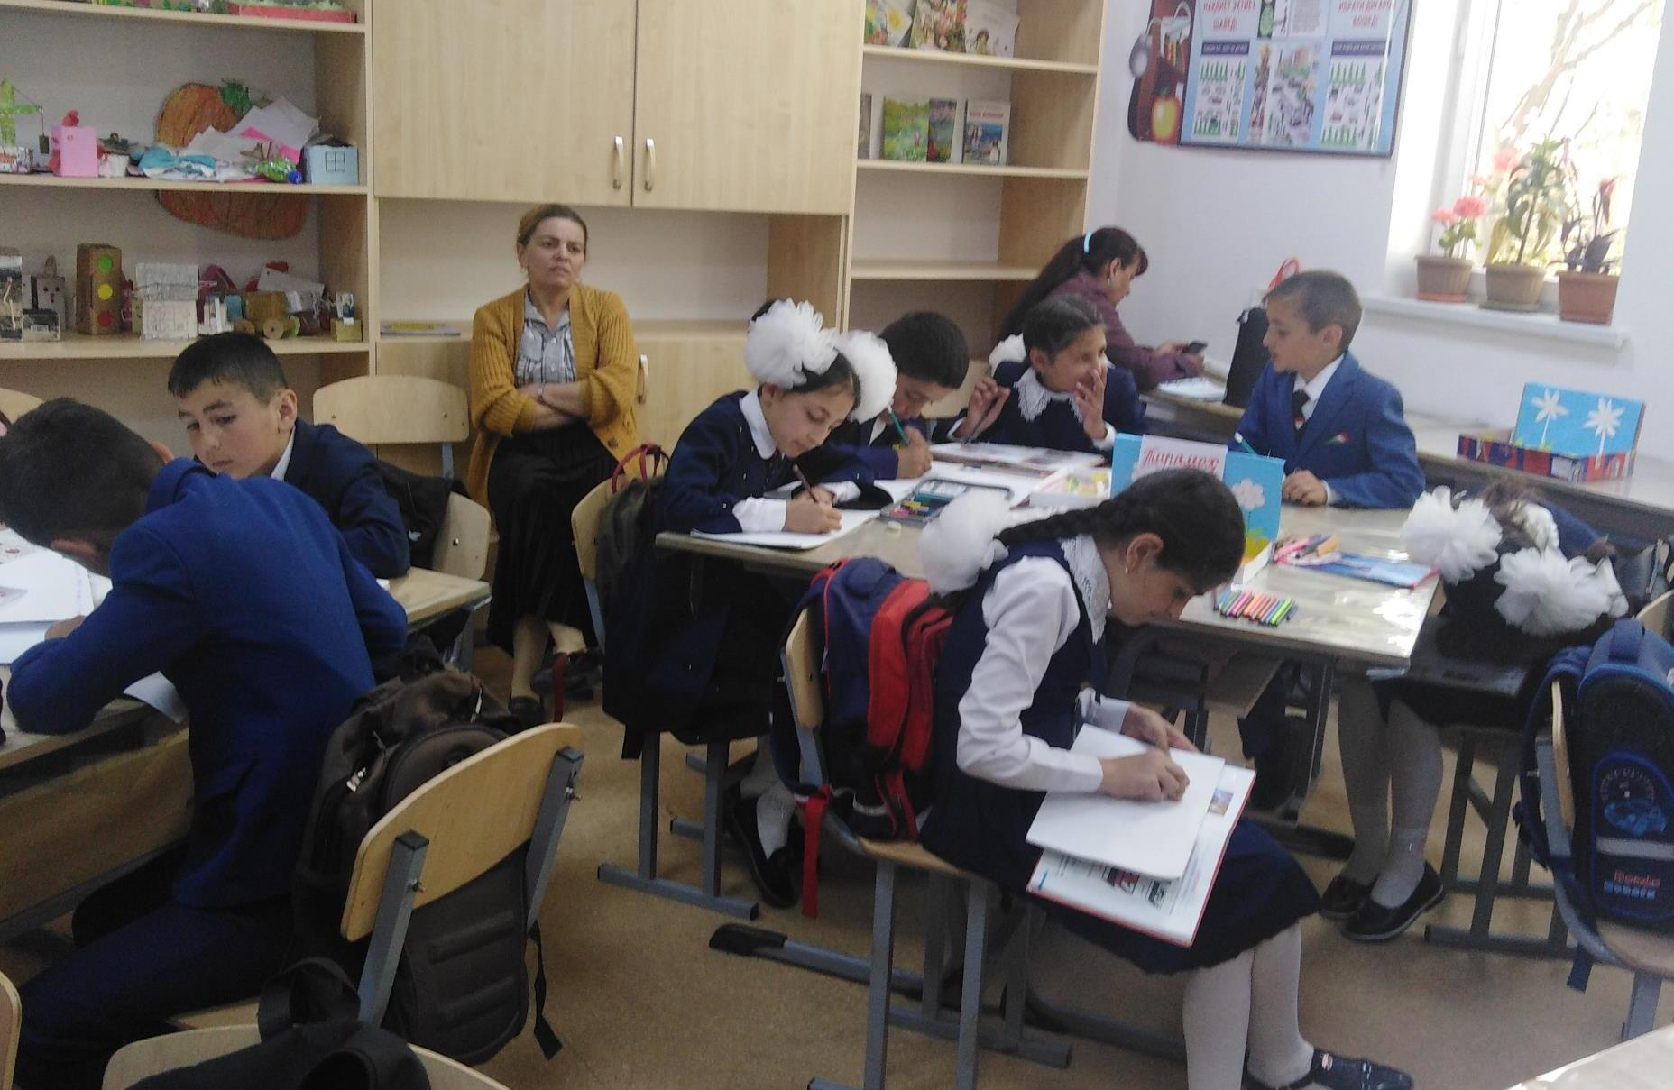
Evidences and the HCD Processes

Slide 10
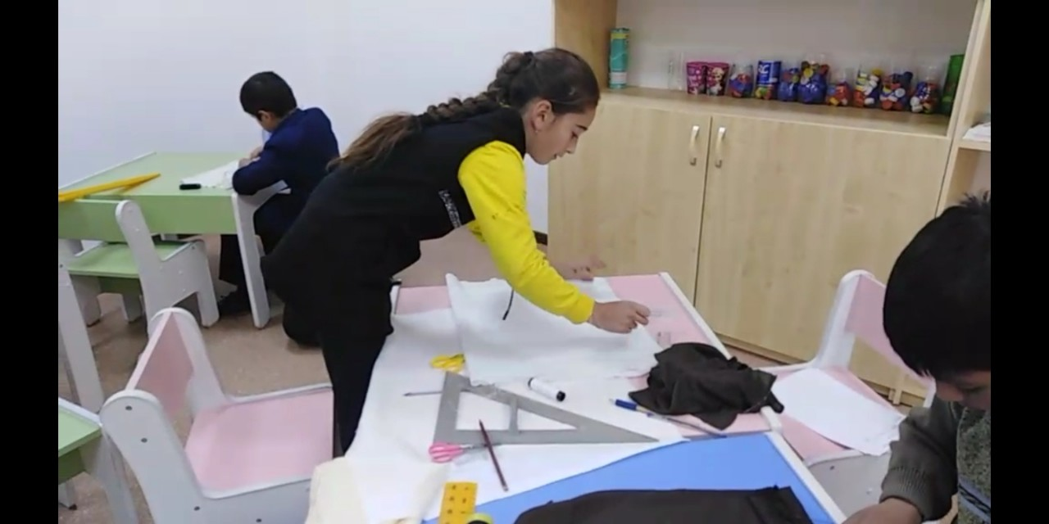
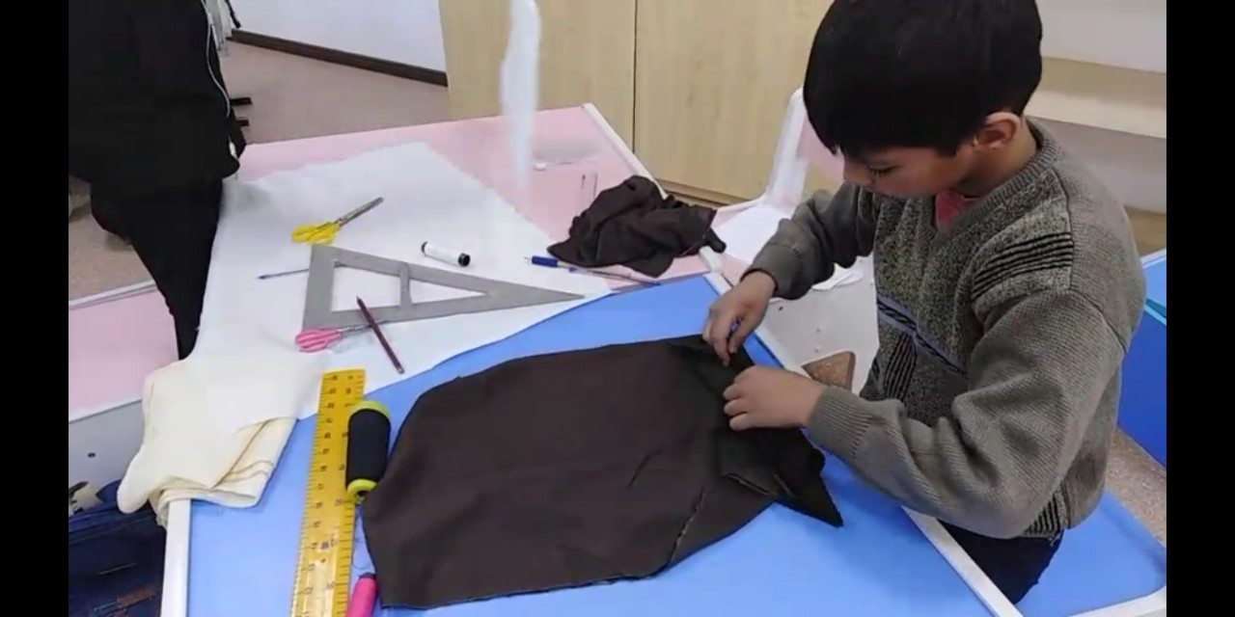
Prototype phase

Slide 11
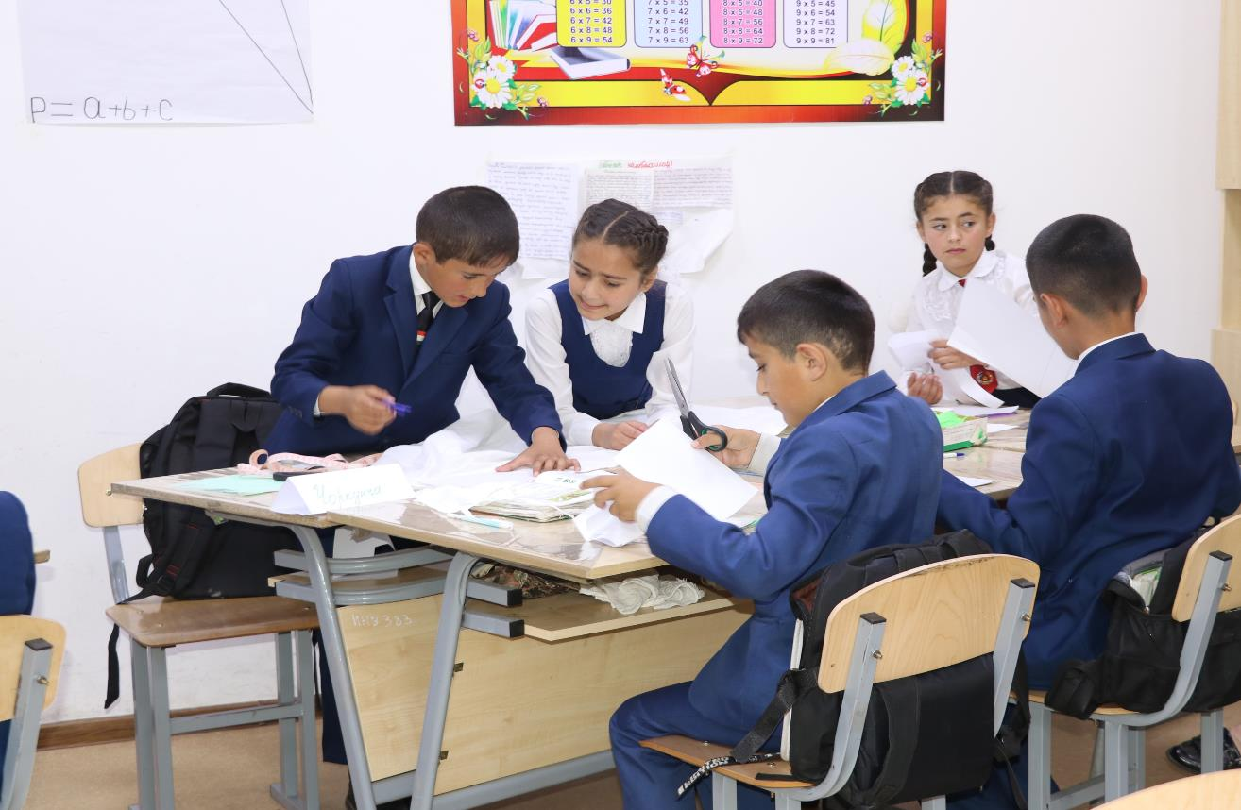
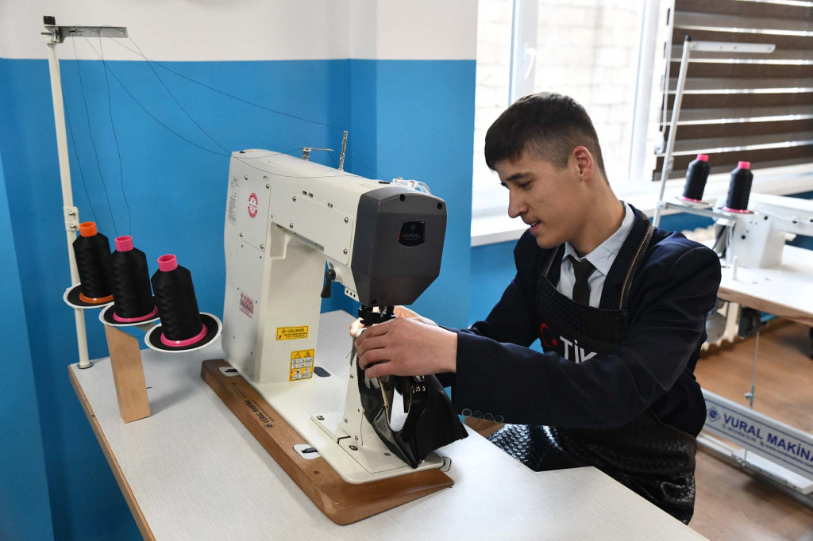
Our Story

Slide 12
If teachers are exposed and capacitated to be creative and innovative, learning environment will change and students will have significant opportunity for growth.

Slide 13
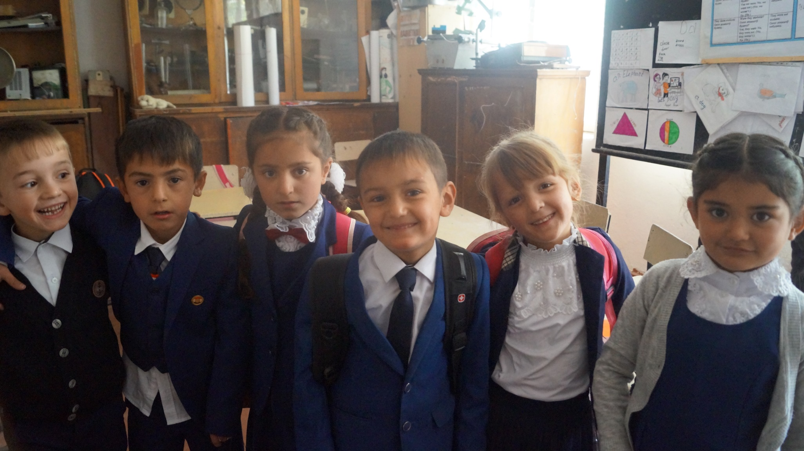
Thank YOU!

