Slide 1
THE WRITING TREASURE TROVE
By Teacher Jalia Nakyanzi

Slide 2
THE PROBLEM
In Uganda ,English proficiency is a preliquisite to accomplishing any official assignment. English is the language of business, social interaction but most importantly the very language of its own instruction in education.This therefore means English proficiency and Literacy share a synonymous relationship
However, the Human Centred Design Thinking I carried out courtesy of Schools 2030, was the spark I needed to discover that three quarters of my Senior two Class which could adequately listen, speak and read in English groped when it came to writing. This was attributed to the struggle with giving a detailed vivid descriptive account.
Specific to students;
The writing assessment tool administered showed for case study purposes that Resty,a knowledge-hungry 16year old Senior two girl from a humble background and irregular in attendance due to financial constraints, like three quarters of the rest got four and below out of ten
Her composition lacked depth in vivid description of her role model thus way below the 100word limit.
Resty’s written paragraphs had limited vocabulary re- echoing common words like good ,nice, beautiful hence predictable.
Evidently,it was shallow and not appealing to the senses of touch,sight,hearing, smell and taste.
She obviously lacked sense of direction in thought during writing thereby arranged composition haphazardly
Consequently, this gap was having its toll on Resty’s confidence to have her work shared about in class. This was threatening to injure her self esteem and assertiveness vital for her holistic development

Slide 3
THE SOLUTION
The solution to the above problem is The Writing Treasure Trove.
A treasure trove is a collection or store of valuable or delightful things. It has a historical connection in English Law to valuables of unknown ownership that are found hidden.
The name therefore suits the solution treasure trove which is an adventurous corner in everyone of the three senior two streams.
In this corner we embark on a hilarious journey which starts with Pseudonyms where we join an anonymous world for the purpose of doing away with victimisation in case we falter.
We then have a storyboard corner packed with Captivating sample written excerpts from novels,stories and own winning class work. This area enables the students to borrow a leaf from writers on for instance describing a person, object ,action and setting of course in phases. It was from this section for example that students learnt that every writer starts starts with a spark instant just like striking a match stick.
Close by are relevant magazine pull-Outs of pictures for personal practice. For example pictures of fascinating people and objects if our excerpt is on describing that. This runs for any period we agree upon.
Working on an aspect we have come up with a mind culture where we follow these steps : storyboard corner , sojourn the world in one moment, wave the magic wand , I can better it moment and at leisure the tree of compatibility on whose leaves learners keep writing synonyms of any word that we choose for an agreed length of time.
The beauty lies in it being learner driven . Even without a facilitator the corner remains functional catering for the disadvantaged Resty

Slide 4
THE IMPACT
Thanks to The treasure trove ,learners are fascinated about writing in that they daily anticipate some additional adventures.
There has been a boost in the life skills of confidence and assertiveness in a way that intense sharing leaves some learners unintentionally out of the Pseudonyms as they almost claim their work.
Liberal sharing has improved students’ speech ability. So, the sky is the limit.
What started as an Optional club is the dream of even the advanced learners.
The tree of compatibility has greatly improved their vocabulary.
Lastly the teacher can never want a better alternative of facilitation in this new lower secondary curriculum.
I see future authors in my class already.I envisage my dream in Resty Sincerely I can never thank Schools 2030 enough but promise to continue being the torch bearer for this cause.

Slide 5
THE FUTURE
To inculcate a culture in the students, the culture of writing, from a spark to a depth, vivid, enjoyable and worthy of international recognition
For The Writing Treasure Trove to be incorporated in learning institutions beyond Mackay Memorial College
For the students I teach to stand out in whatever their career pursuit, and shine while upholding the values and knowledge acquired from the Writing Treasure Trove.
For the trove to transcend the writing class and be used as a tool to demystify other abstract elements of school life.
Thank You Schools2030, thank you all !

Slide 6
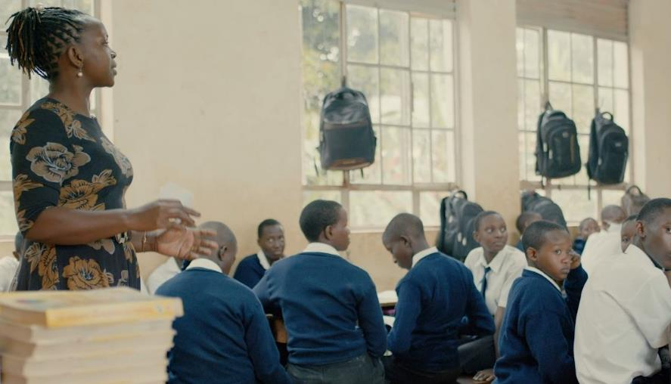
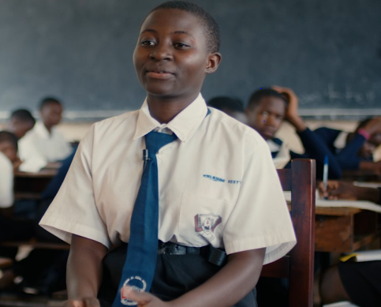
PICTORIAL

Slide 7
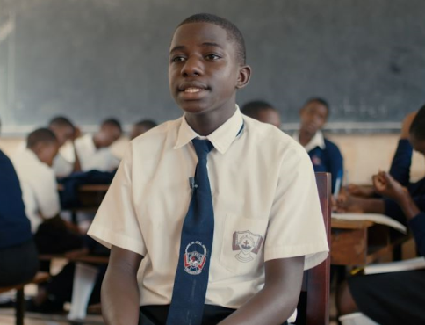
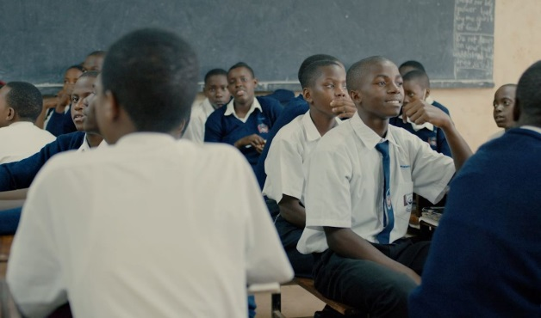
PICTORIAL

Slide 8
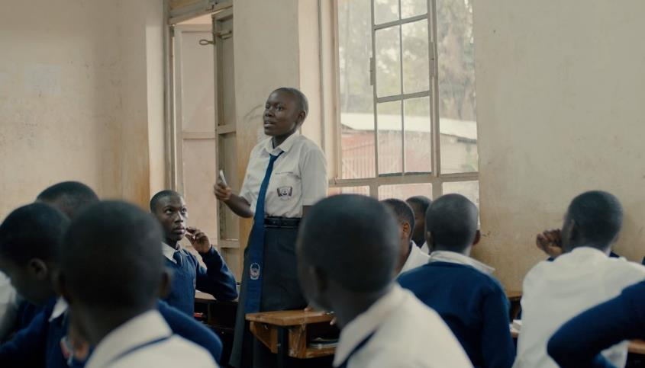
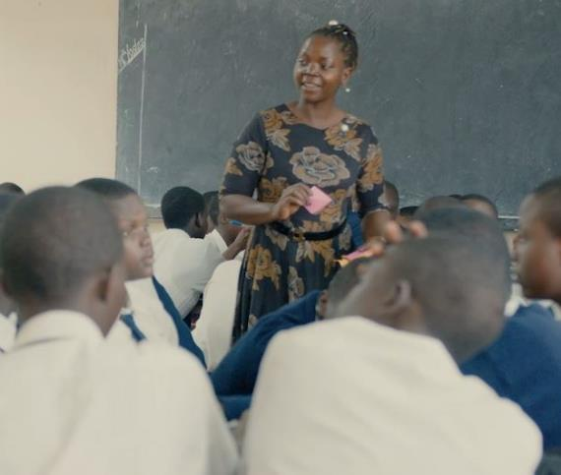
PICTORIAL

Slide 9
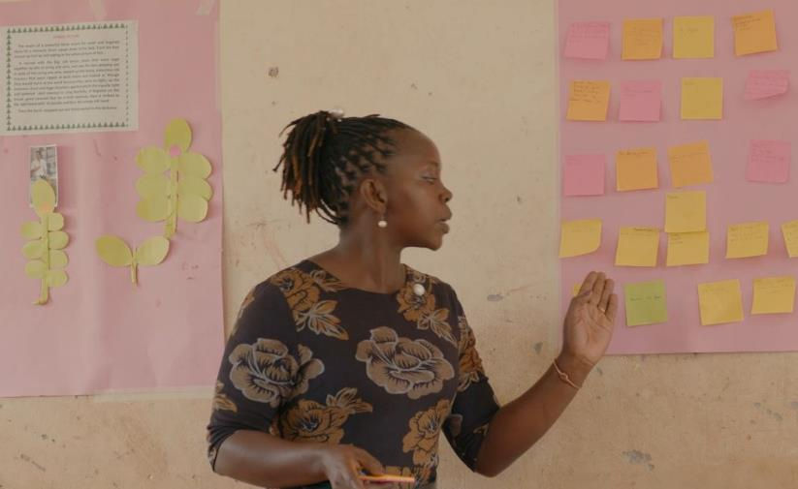
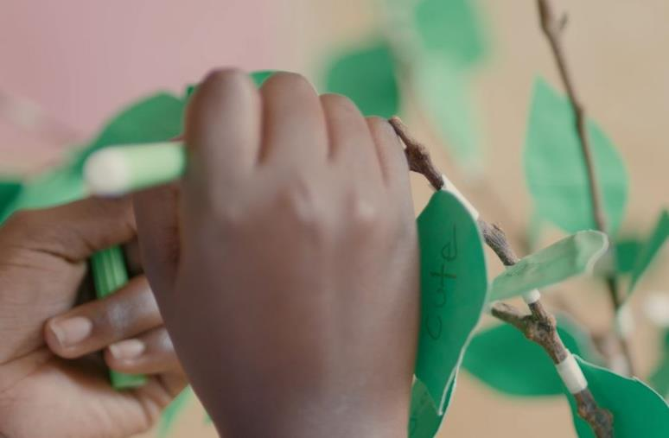
PICTORIAL

Slide 10
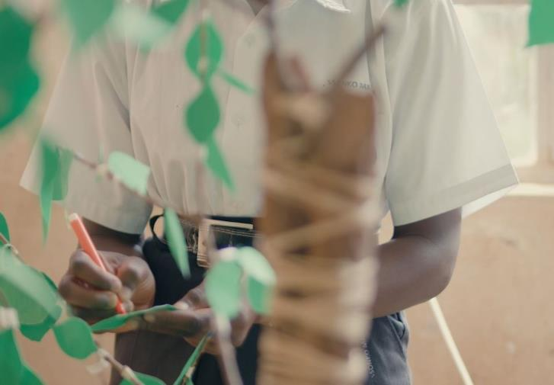
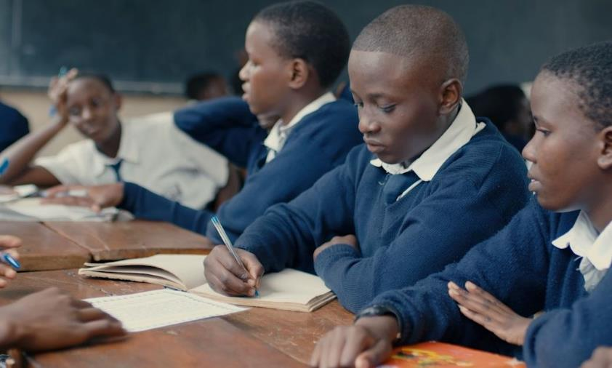
PICTORIAL

