Slide 1
India
Learning At Home Kit
Elementary School Nargada
Danapur Patna Bihar
India
June 2022

Slide 2
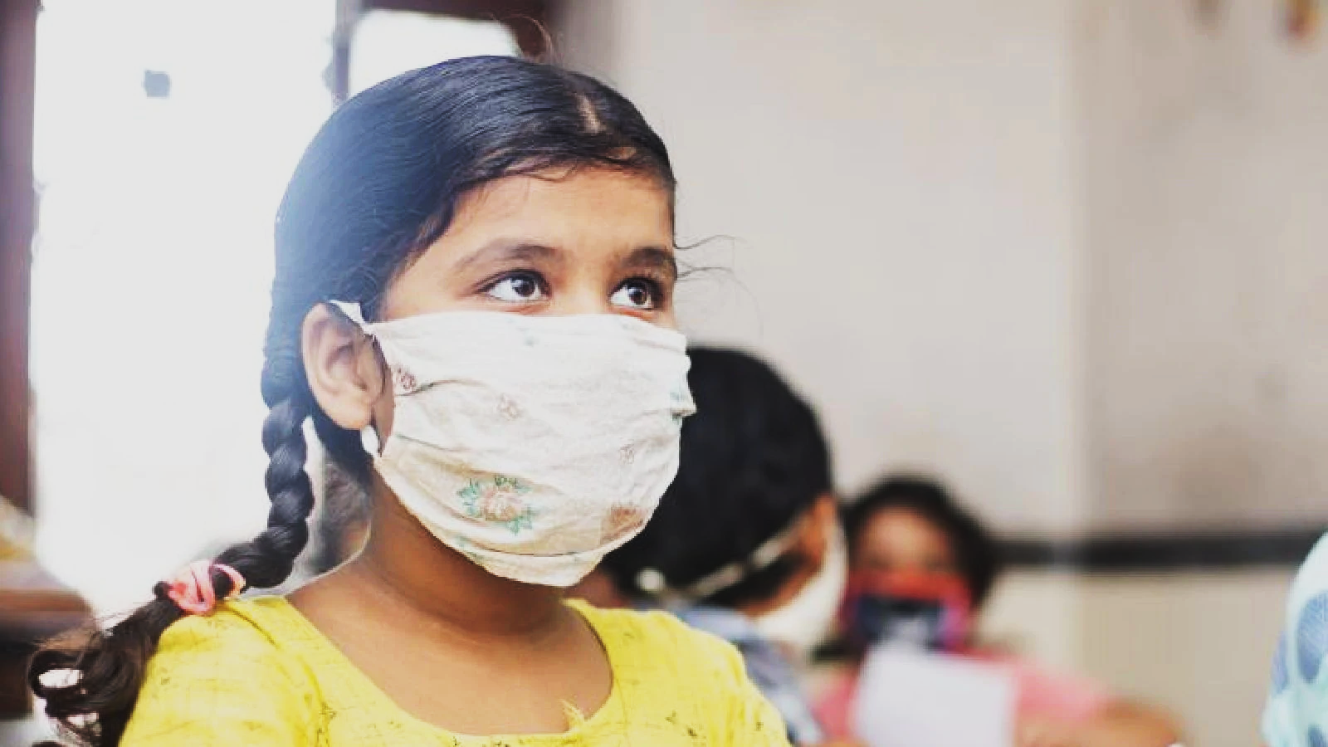

Slide 3
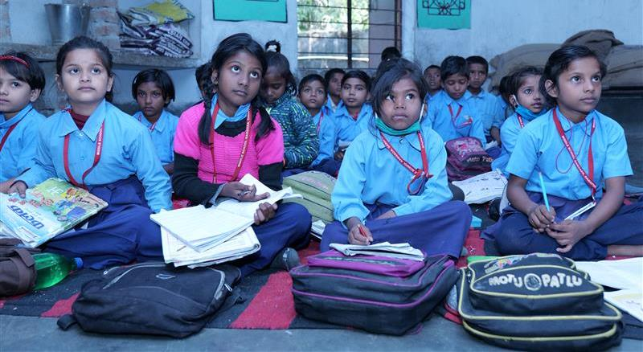
Situation Analysis
ASER DATA - 2018

Slide 4
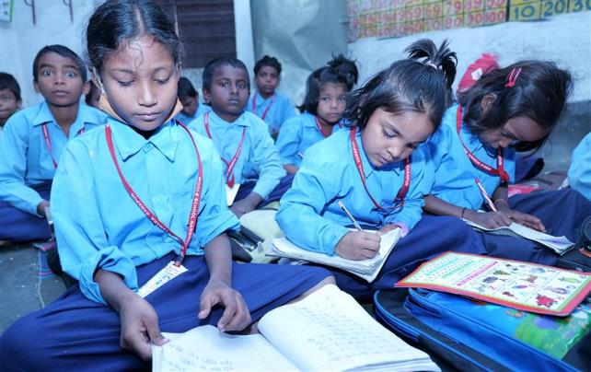
Situation Analysis
ASER DATA - 2018

Slide 5
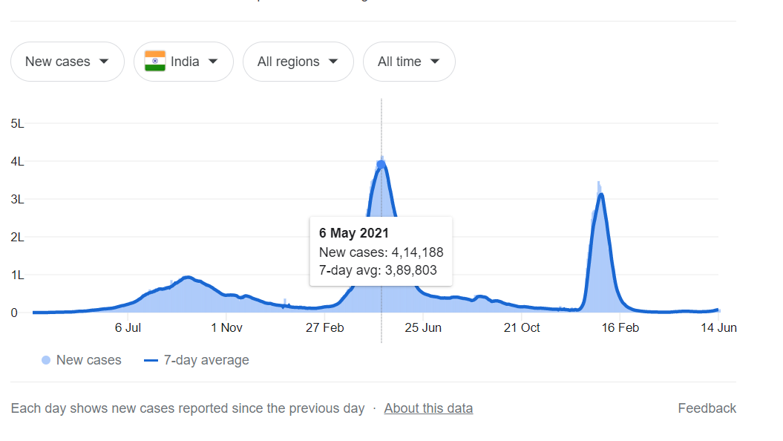
The problem
Impact of COVID-19 – India
India has faced three waves of COVID in last 32 months (from Nov 2019)
Highest daily new cases reported – 4,14,188 (6 May 2021)
School closures
Schools were closed for almost 24 Months
While there is gradual relaxation after each wave but reopening of schools on regular basis and parent sending children to schools started much later in early 2022 only with the senior grades.

Slide 6
The problem
Impact of COVID-19 – Bihar
Bihar has 32 million children of school-going age (6-17 years). Almost 700,000 students are not expected to return to school, & 7.5 million will experience learning loss (UNICEF Study 2021)
Most caregivers
Have low literacy levels
Do not have access to devices, data, internet
Have low resources – families below poverty line, loss of livelihoods
Are not confident of doing activities with their children
Most children
Had their routine disrupted
Less interaction with parents and don’t engage in activities
Have no access to learning/ play resources at home
92% of children have lost at least one specific language ability from the previous year across all classes 82% of children on an average have lost at least one specific mathematical ability from the previous year across all classes (Azim Premji Foundation study - 2020)

Slide 7
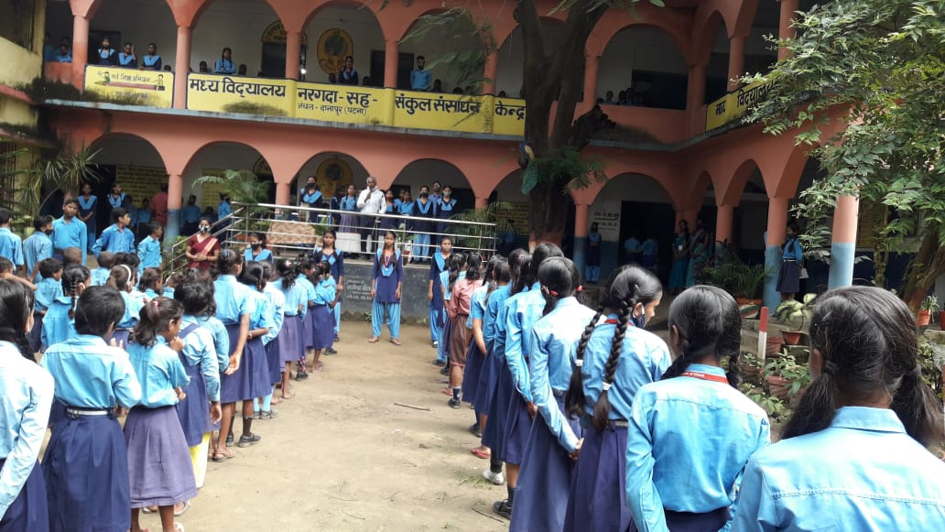
About School
Elementary School Nargada
Located in the peri-urban block of Patna district, Nargada elementary school was established in the year 1951. With Hindi as the medium of instruction, the school caters to a strength of 536 students and 11 teachers with 50% female coming from a wide catchment of learners from marginalized backgrounds.
Like other schools, Nargada Elementary school faced huge gap in the area of early
literacy and numeracy due to the pandemic.

Slide 8
What we learnt from parents?
“Observed a music class where teacher was singing on her own while children were listening on mute …”
“… Don’t have ideas of how to engage… need guidance…”
“Muting children voices" is a troubling sight…”
“Conventional schools + online mode= Recipe for disaster…”
“I try to help a little for the homework, as much as I can…”

Slide 9
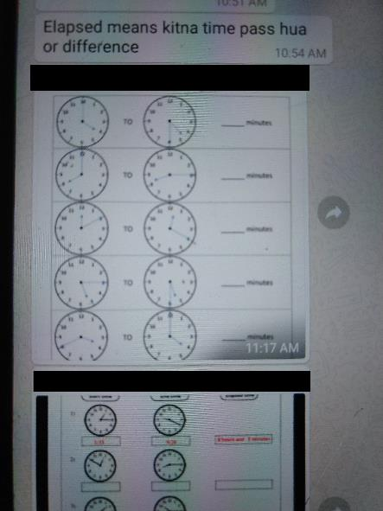
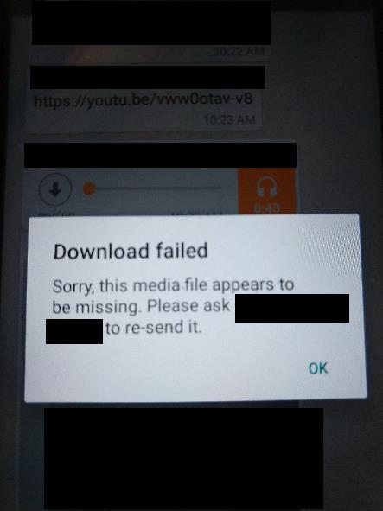
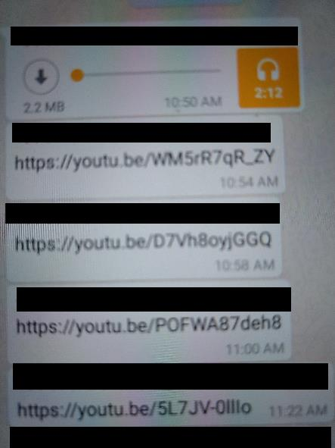
What we learnt from parents?
Worksheets – scanned from textbooks, but not engaging for the child
YouTube links not working
Parents not able to download
Parents not able to respond on WhatsApp groups (moderators disabled responses making it a one-way information channel)

Slide 10
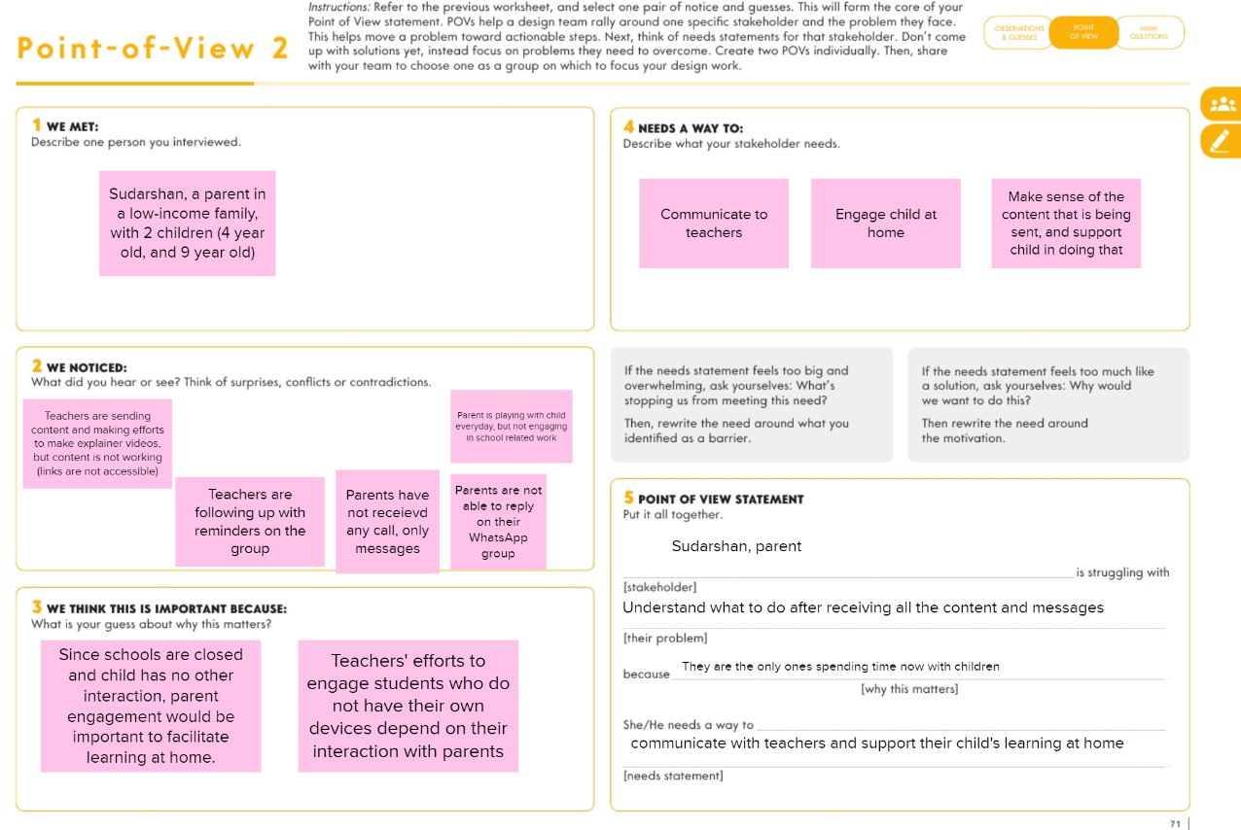
POV and HMW

Slide 11
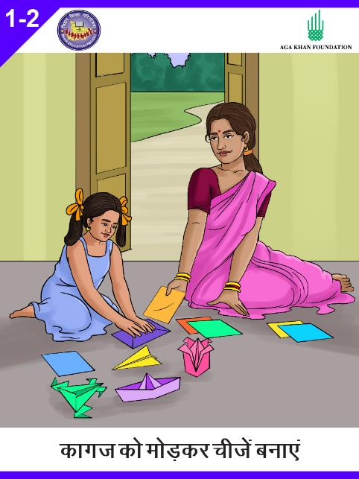
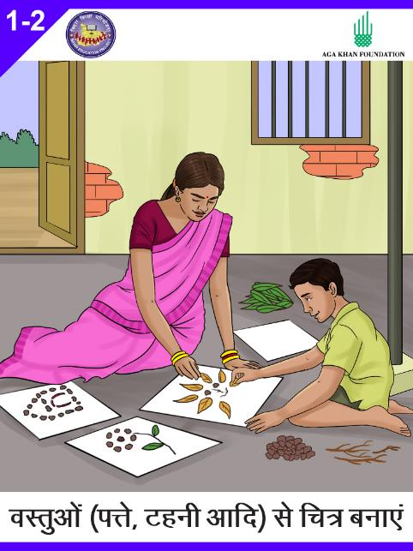
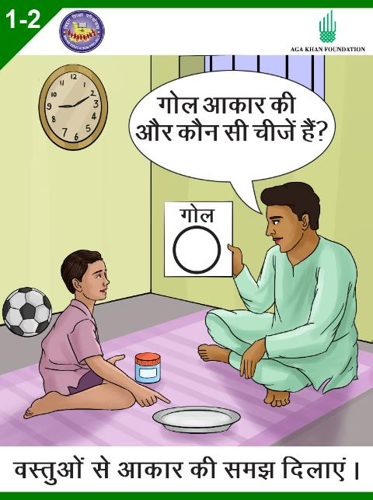
What we learnt from parents?
A slightly better option
Share visuals of activities with parents and encourage them to share back images and videos of their children doing those activities.

Slide 12
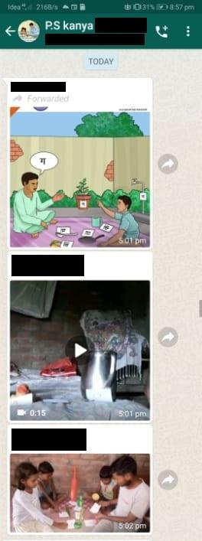
What we learnt from parents?
BUT
This could reach only 20-30% of children in the communities we work with. What about the parents who do not have access to smartphones, internet, WhatsApp?

Slide 13
HMW
HMW enable parents without internet to engage with children better, and continue learning at home?

Slide 14
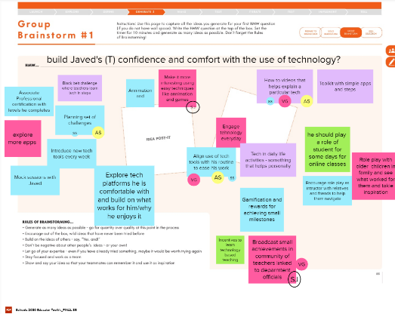
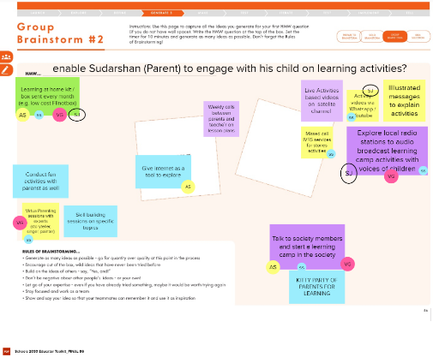
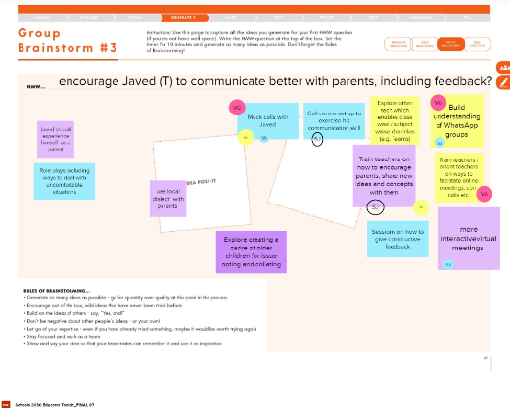
Brainstorming
Rounds of rapid brainstorming
Multiple ideas

Slide 15
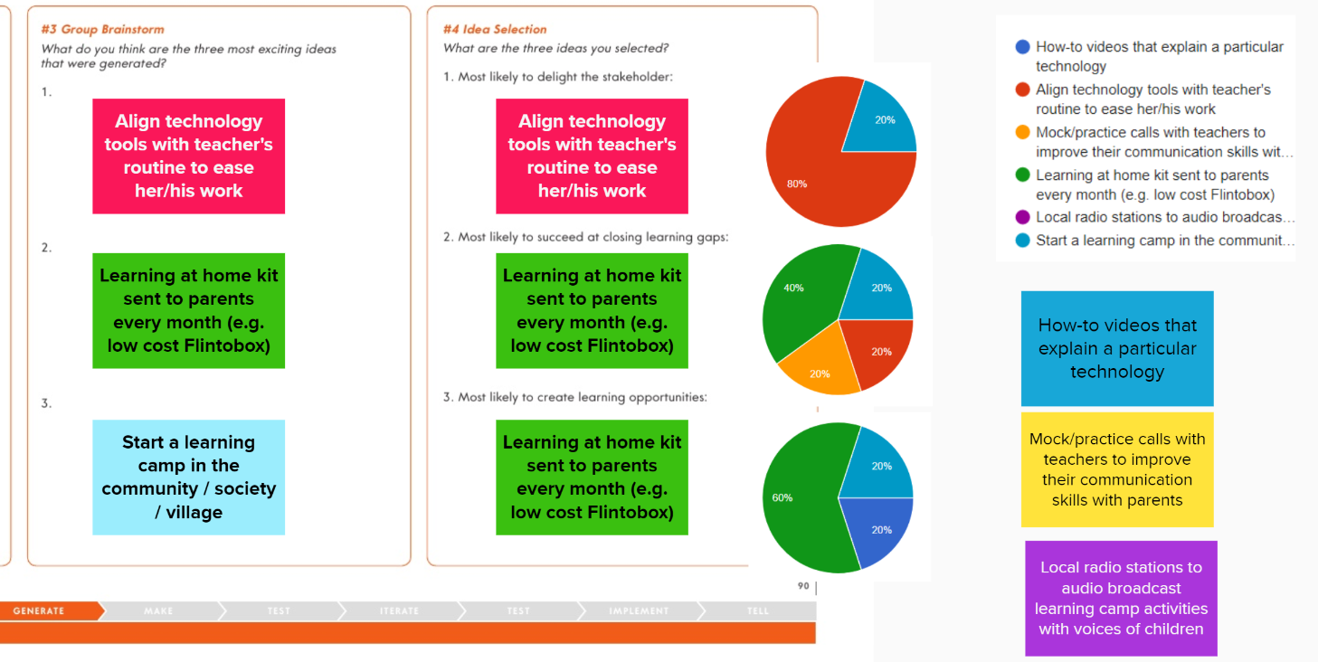
How did we select the idea to work on?

Slide 16
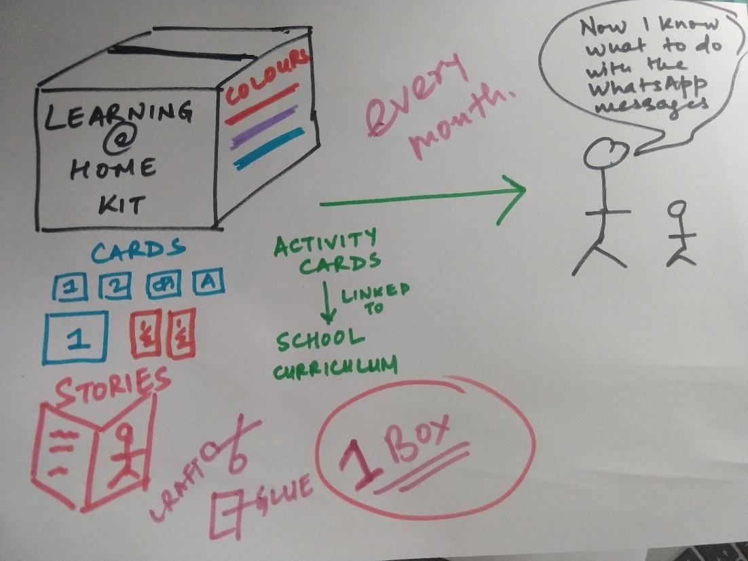
First sketch of the idea

Slide 17
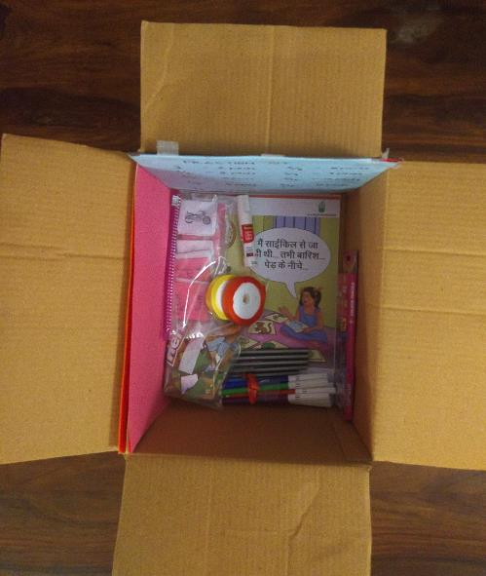
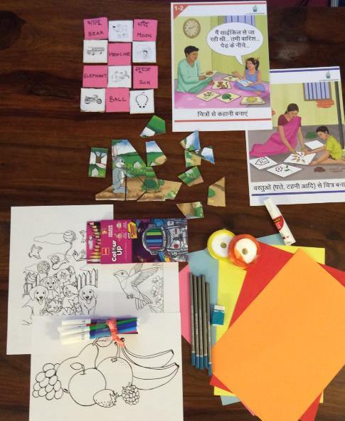
Our prototype
Learning at Home Kit
A low-cost kit with learning materials (puzzles, word cards, illustrated activity ideas etc.)
that enables under-resourced families without internet access
to improve engagement with children and continue learning at home.
New items and activities every month, aims to supplement available resources, and
inspire parents to think of other learning activities they can do at home.

Slide 18
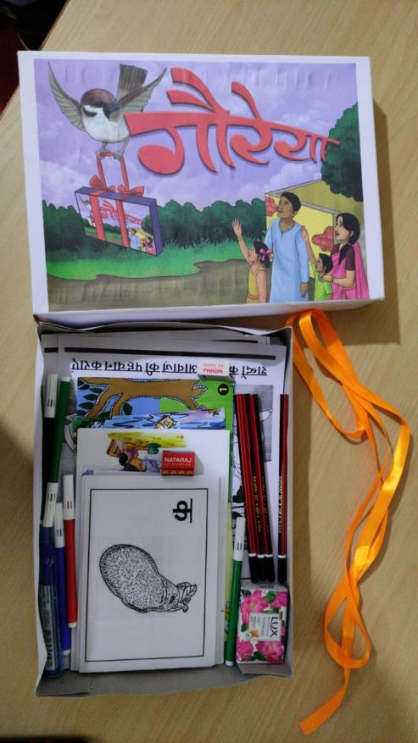
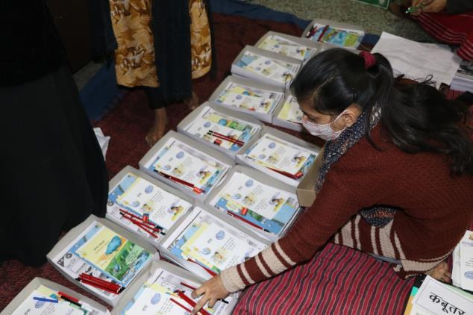
Our prototype
Learning at Home Kit

Slide 19
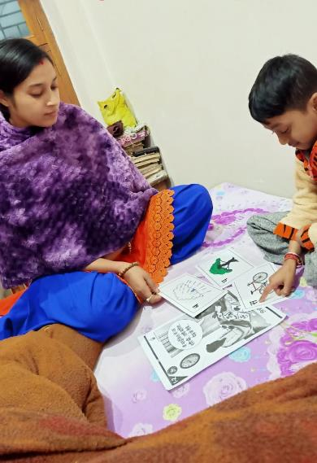
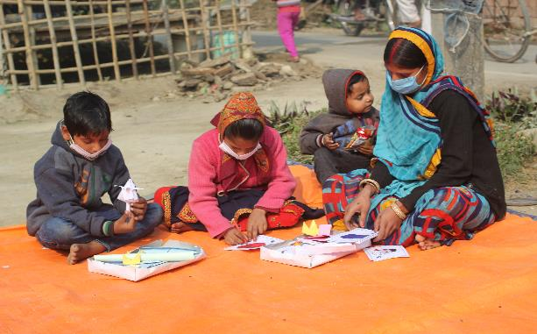
Feedback
What Parents did

Slide 20
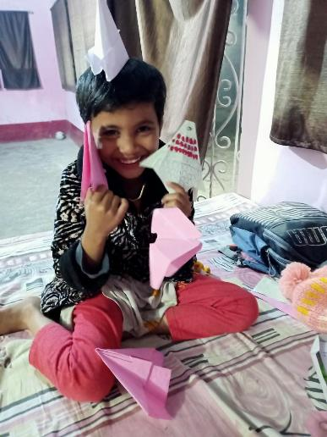
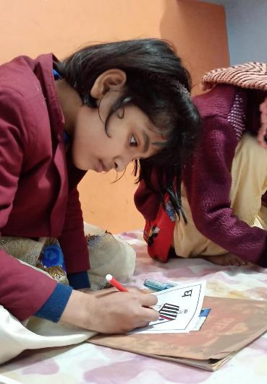
Feedback
What children did

Slide 21
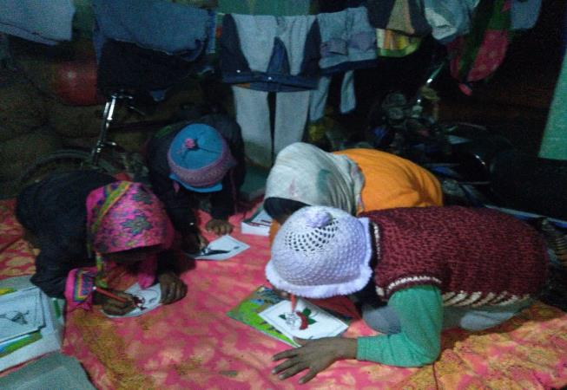
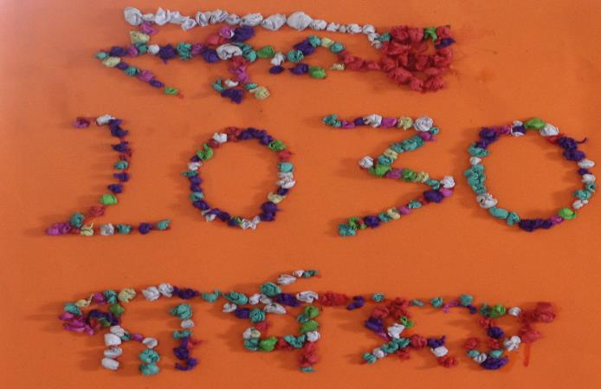
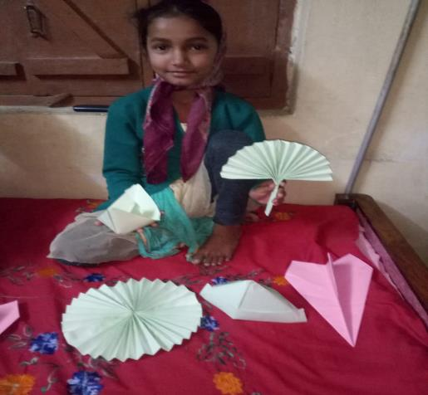
Feedback
What children did

Slide 22
Feedback
What parents and children said
“This is easy”
“Children can do themselves”
“Maybe easier for the school, if we get all at once”
“I will get idea(s) from this”
“No scissors”
“Should not be too expensive… school (private) has sent stuff… costs 1,500 Rupees!”
“We will also learn with them”
“Need to correct name”
What we observed?
Seemed happy with carboard cut-outs; did not seem to care that it was not laminated
Liked colouring materials, coloured paper
Looked confused with items like word cards, picture cards, but were able to related to the illustrated activity poster.
Seemed more at ease when video is shown,

Slide 23
Components of the solution
Multiple-use materials
Illustrated activity posters
Low cost (less than Rs. 99)
Sent every month to parents
School teachers, who follow up with parents and children
Community volunteers facilitating activities in small groups
Community level resources (books)
Messages / stories sent through automated calls

Slide 24
Other development ideas
Kits that can be made / assembled by local women / Self-Help Groups
Thematic kits linked to school curriculum, that focus on certain skills (creativity, critical thinking)
Kits for higher grades (4-8)
Learning kits for out-of-school adolescents
How do we make the box itself a puzzle / game?
Low cost + bonus materials variant

Slide 25
Resources
Designers for design and development of kits (grades 1-3)
Government teachers, Community volunteers
Experts for content of grades 1-3, 4-5, 6-8
Logistics, including ensuring safety during distribution

Slide 26
Timeline
Sep. – Dec 2020
Co-Create the idea, Design kits
Jan.–Mar. 2021
Set up school and community level mechanisms
Mar. - Jun 2021
Send a kit once in two months to children (grades 1-3); Design kits for grades 4-8
Phase 1: September 2020 - June 2021
Phase 2: Jul – Dec 2021
Jul – Sept 2021
Oct 2021
Nov - Dec 2021
Send a kit in every quarter to children (Grades 4-5)
Evaluation
Refining the products/ Developing variants

Slide 27
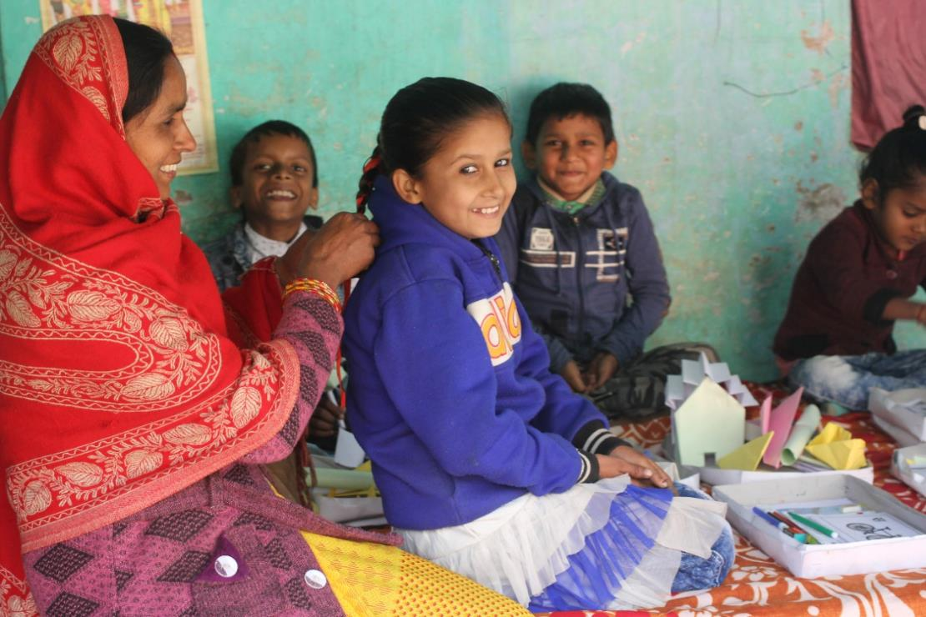
Impact
67% caregivers gave a score of 8+ to LaHK Box 1 on a scale of 10, in terms of effectiveness / usefulness. 92% of respondents (caregivers and children) shared an increase in engagement in learning activities after receiving the kit (Source- Learning Partner)

Slide 28
Impact
Short term
Increase in parent's engagement
Engagement of other stakeholders (teachers, volunteers, community)
Increase in activity-based learning
Decrease in screen time
Medium - long term
Improvement in learning outcomes of children
Caregivers are confident in facilitating learning activities
How will we measure?
2-3 groups of families - #1 supported by teachers (phone calls), #2 supported by community volunteers (learning camps with small groups of children), #3 comparison group
Feedback from caregivers and children
Photo summaries, videos of interactions at home
Sample assessment of learning outcomes

Slide 29
Thank you !!!

