Slide 1
Inspiring Change through Our Stories Presentation Script Template
Katie Krummeck | Munir Ahmad

Slide 2
How to Use this Template
Write the words you are going to say using this script.
1
Review the storytelling frameworks you completed to gather the components of your presentation.
2
Use the prompts to write the words you will say during your presentation. Once you have completed the visuals for your presentation (see other template), add the notes from this template into your visual slide deck.
Notes:
Sources

Slide 3
Welcome Message
Introduce yourself, what you teach (grade level & subject, where you teach, and how long you have taught.
Suggested time: 1 minute | The slide you present to your audience for The Welcome Message should include pictures of your school and community.

Slide 4
The Challenge
What is the problem that you want to solve?
Use the Describe the Context Framework to answer the following questions. Then, write your script in the presenter notes section below.
1
Please describe your community and your school as well as any context specific information that helps understand the issue.
Why is the problem worth solving? How is it relevant to your students? Why do we need to solve it urgently?
2
Suggested time: 1 minute | The slide you present to your audience for The Challenge should include pictures of your school and community.
Notes:
Sources

Slide 5
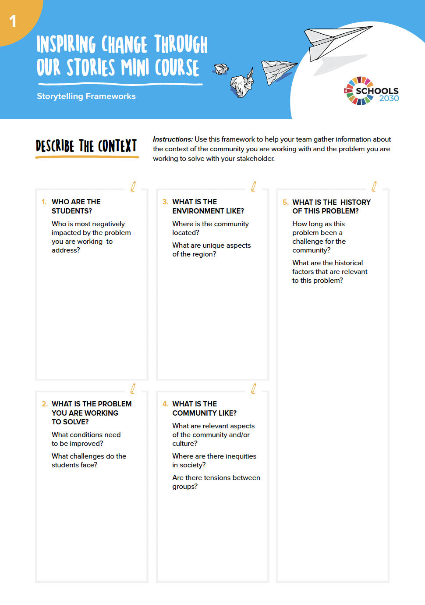
REFERENCE: Describe the Context Framework

Slide 6
The Idea
How will you solve the problem?
Use the Why is your Idea Worth Supporting Framework to answer
the following questions. Then, write your script in the presenter notes section below.
1
2
3
What is the idea?
How will it solve the problem you are facing?
How will it benefit your students?
Suggested time: 1 minute | The slide you present to your audience for The Idea should include pictures of your students and your micro-innovation.
Notes:
Sources

Slide 7
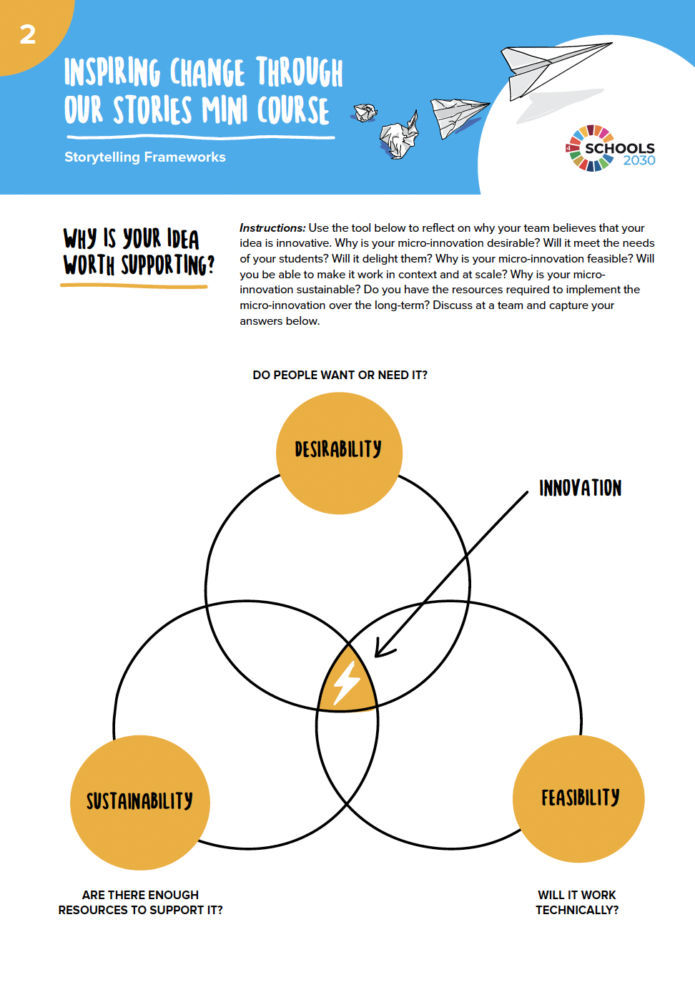
REFERENCE: Why is Your Idea Worth Supporting?

Slide 8
Design Process | Empathy
What did you learn from those you interviewed?
Use the Demonstrating Desirability through Storytelling Framework to answer the following questions. Then, write your script in the presenter notes section below.
1
2
3
We met…
Share more about the stakeholder you focused on in your design work, so that the audience can get a better visualization of the context and stakeholder’s life.
We noticed/ saw/heard…
What were your key observation? Was there something surprising/ contradictory you discovered while interviewing your stakeholder?
Our insight…
Based on your understanding of the context, stakeholder and your observations, what is the key insight that you had?
Suggested time: 1 minute | The slide you present to your audience for The Design Process – Empathy should include pictures of the specific stakeholder you are focusing on.
Notes:
Sources

Slide 9
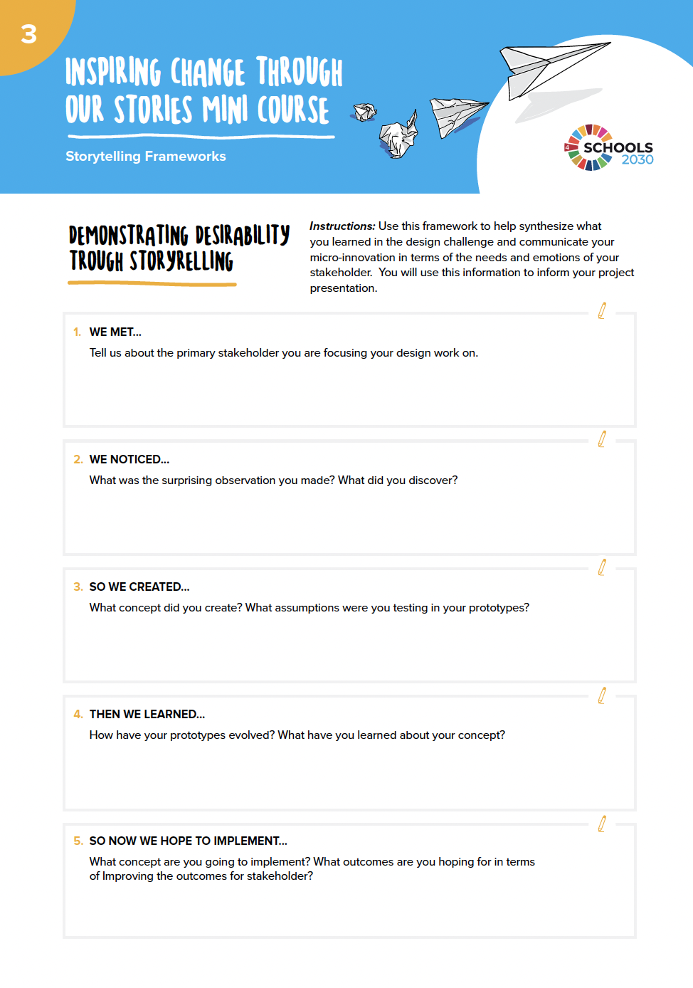
REFERENCE: Demonstrating Desirability through Storytelling Framework

Slide 10
1
Prototyping and Testing
What prototype did you create?
So we created… and we learned…
Design Process
2
What assumptions were you testing in your prototypes?
Use the Demonstrating Desirability through Storytelling Framework to answer the following questions.
Then, write your script in the presenter notes section below.
3
What did you learn from testing your prototype?
How has your idea evolved?
Suggested time: 1-2 minutes | The slide you present to your audience for The Design Process – Prototyping and Testing should include pictures of testing your prototypes.
Notes:
Sources

Slide 11
REFERENCE: Demonstrating Desirability through Storytelling Framework

Slide 12
About Your Innovation
How will you implement your innovation?
Use the Demonstrating Feasibility through Strategy Framework to answer the following questions. Then, write your script in the presenter notes section below.
1
2
3
What are the key activities of the solution you plan to implement?
What resources do you need?
Financial, physical and human?
What is the timeline for your project?
Show key steps in a diagram/as a Gantt chart.
Suggested time: 1-2 minutes | The slide you present to your audience for About Your Innovation should include pictures of testing your prototypes.
Notes:
Sources

Slide 13
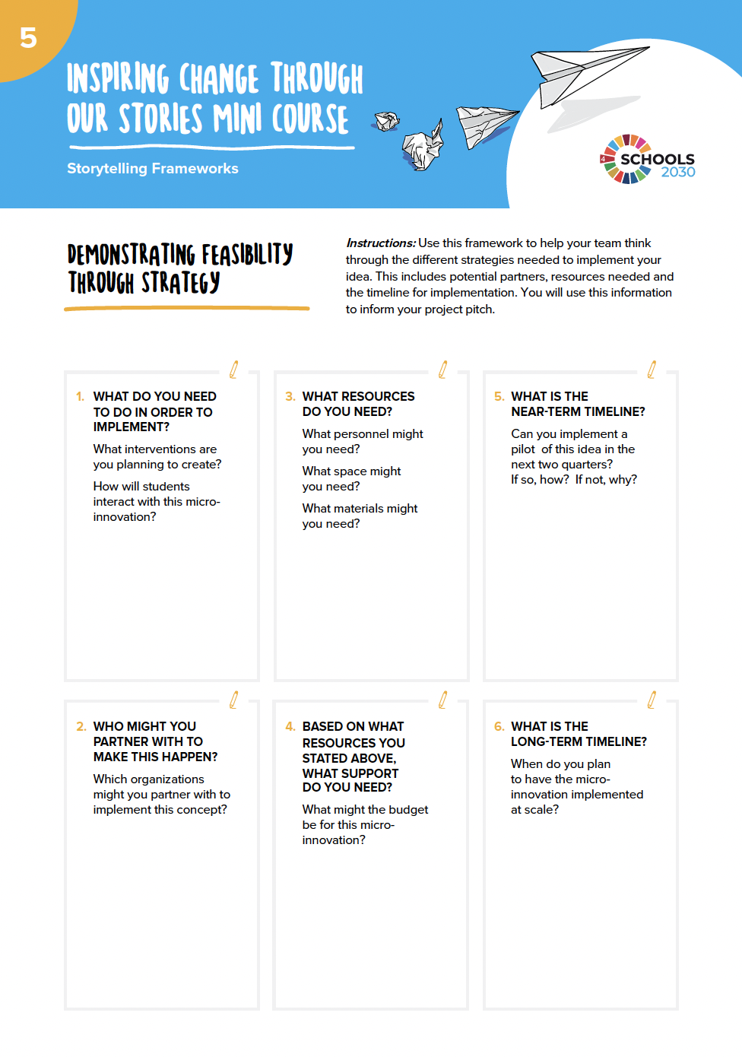
REFERENCE: Demonstrating Feasibility through Strategy Framework

Slide 14
Creating Positive Change
How will you know if your idea is successful?
Use the Demonstrating Sustainability through a Theory of Change Framework to answer the following questions. Then, write your script in the presenter notes section below.
1
2
What is the potential impact in the short-term?
In the long-term?
How will you know if your solution is successful?
How will you measure its impact in the short term?
How will you learn and iterate?
Suggested time: 1 minute | The slide you present to your audience for Creating Positive Change should include pictures of your students.
Notes:
Sources

Slide 15
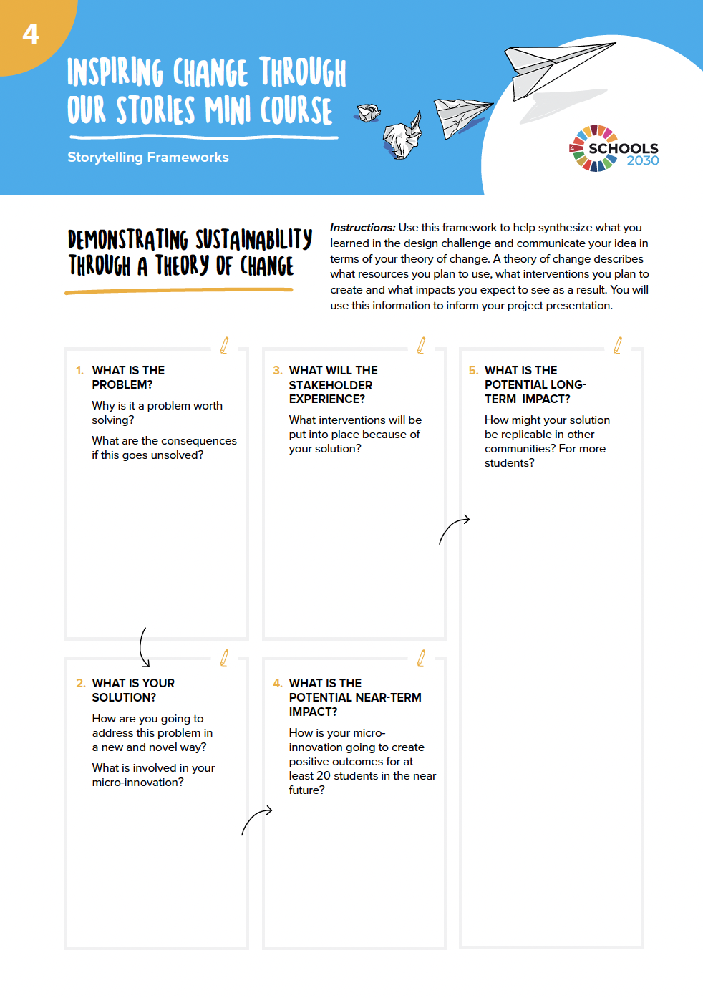
REFERENCE: Demonstrating Sustainability through a Theory of Change Framework

Slide 16
Call to Action
What support do you need?
Reflect on what support you need and how the audience can help.
Then, write your script in the presenter notes section below.
1
2
3
Call to Action #1 Title
Share more about who the audience can support your innovation.
Call to Action #2 Title
Share more about who the audience can support your innovation.
Call to Action #3 Title
Share more about who the audience can support your innovation.
Suggested time: 1 minute | The slide you present to your audience for the Call to Action should include pictures of your students.
Notes:
Sources

Slide 17
The Closing
Share your visionary statement about the possibilities you see for your students if you innovation is successful.
What is possible for your school if your innovation succeeds?
What is possible for your students if your innovation succeeds?
Suggested time: 1 minute | The slide you present to your audience for the Closing should include pictures of your school and community.
Notes:
Sources

